Slide 1
Adversarial Search in Context
Game: Mini-Max Search
Neeraj Khatri Ujjawal Tiwari Raj Jagtap

Slide 2
Outline
Introduction
Implementation of Mini-Max algorithm
Properties of Mini-Max algorithm
Surprise

Slide 3
Mini-Max
Introduction

Slide 4
Adversarial Search
Old classic
defination
“ In which we examine the problems that arise
when we try to plan ahead in a world where
other agents are planning against us.”

Slide 5
Optimal Decisions in Games
Game Problem Formulation
* Initial state: Initial board position and identifies the player move
* Successor function: legal move a player can make
* Goal: determines when the game is over
* Utility function: gives a numeric value for the terminal states (win, loss, draw)

Slide 6
Mini-Max Algorithm
The Mini-Max algorithm was proven by John von
Neumann in 1928.
This is a backtracking algorithm to find the optimal move for a player.
Two players involved:
maximizer
minimizer
If the optimal value is positive then player who take the first step wins the game, and vice versa.
Application of Mini-Max algorithm can be seen in
i) Tic-Tac-Toe ii) Zero sum iii) Chess
Mini-Max algorithm performs DFS for the game-tree.

Slide 7
About Mini-Max Algorithm
The Mini-Max algorithm was proven by John von
Neumann in 1928.
This is a Backtracking algorithm to find the optimal move for a player.
Two players involved:
Maximizer
Minimizer
If the optimal value is positive then player who take the first step wins the game, and vice versa.
Application of Mini-Max algorithm can be seen in
i) Tic-Tac-Toe ii) Zero sum iii) Chess
Mini-Max algorithm performs DFS for the game-tree.

Slide 8
2X2 Tic Tac toe
Max
X
Min
X | O
X
 | O
X
O
The first player to get 2 same signs horizontally is the winner.
Max
X | O
X
X | O
 | X
X
X | O
X
O | X
Min
X | O
X | O
X | O
O | X
X | O
X | O
X | X
 | O
X | O
O | X
X | X
O
0
0
0
+1
0
+1

Slide 9
Running Example
Max
X
Min
X | O
X
 | O
X
O
Max
X | O
X
X | O
 | X
X
X | O
X
O | X
Min
0
X | O
X | O
X | O
O | X
X | O
X | O
X | X
 | O
X | O
O | X
X | X
O
0
0
0
+1
0
+1

Slide 10
Running Example
Max
X
Min
X | O
X
 | O
X
O
Max
0
X | O
X
X | O
 | X
X
X | O
X
O | X
Min
0
X | O
X | O
X | O
O | X
X | O
X | O
X | X
 | O
X | O
O | X
X | X
O
0
0
0
+1
0
+1

Slide 11
Running Example
Max
X
Min
X | O
X
 | O
X
O
Max
0
X | O
X
X | O
 | X
X
X | O
X
O | X
Min
0
0
X | O
X | O
X | O
O | X
X | O
X | O
X | X
 | O
X | O
O | X
X | X
O
0
0
0
+1
0
+1

Slide 12
Running Example
Max
X
Min
X | O
X
 | O
X
O
Max
0
0
X | O
X
X | O
 | X
X
X | O
X
O | X
Min
0
0
X | O
X | O
X | O
O | X
X | O
X | O
X | X
 | O
X | O
O | X
X | X
O
0
0
0
+1
0
+1

Slide 13
Running Example
Max
X
Min
0
X | O
X
 | O
X
O
Max
0
0
X | O
X
X | O
 | X
X
X | O
X
O | X
Min
0
0
X | O
X | O
X | O
O | X
X | O
X | O
X | X
 | O
X | O
O | X
X | X
O
0
0
0
+1
0
+1

Slide 14
Running Example
Max
X
Min
0
X | O
X
 | O
X
O
Max
0
0
X | O
X
X | O
 | X
X
X | O
X
O | X
Min
0
0
0
X | O
X | O
X | O
O | X
X | O
X | O
X | X
 | O
X | O
O | X
X | X
O
0
0
0
+1
0
+1

Slide 15
Running Example
Max
X
Min
0
X | O
X
 | O
X
O
Max
0
0
0
X | O
X
X | O
 | X
X
X | O
X
O | X
Min
0
0
0
X | O
X | O
X | O
O | X
X | O
X | O
X | X
 | O
X | O
O | X
X | X
O
0
0
0
+1
0
+1

Slide 16
Running Example
Max
X
Min
0
X | O
X
 | O
X
O
Max
0
0
0
X | O
X
X | O
 | X
X
X | O
+1
X
O | X
Min
0
0
0
X | O
X | O
X | O
O | X
X | O
X | O
X | X
 | O
X | O
O | X
X | X
O
0
0
0
+1
0
+1

Slide 17
Running Example
Max
X
Min
0
0
X | O
X
 | O
X
O
Max
0
0
0
X | O
X
X | O
 | X
X
X | O
+1
X
O | X
Min
0
0
0
X | O
X | O
X | O
O | X
X | O
X | O
X | X
 | O
X | O
O | X
X | X
O
0
0
0
+1
0
+1

Slide 18
Running Example
Max
X
Min
0
0
X | O
X
 | O
X
O
Max
0
0
0
X | O
X
X | O
 | X
X
X | O
+1
X
O | X
Min
0
0
0
0
X | O
X | O
X | O
O | X
X | O
X | O
X | X
 | O
X | O
O | X
X | X
O
0
0
0
+1
0
+1

Slide 19
Running Example
Max
X
Min
0
0
X | O
X
 | O
X
O
Max
0
0
0
0
X | O
X
X | O
 | X
X
X | O
+1
X
O | X
Min
0
0
0
0
X | O
X | O
X | O
O | X
X | O
X | O
X | X
 | O
X | O
O | X
X | X
O
0
0
0
+1
0
+1

Slide 20
Running Example
Max
X
Min
0
0
X | O
X
 | O
X
O
Max
0
0
0
0
X | O
X
X | O
 | X
X
X | O
+1
X
O | X
+1
Min
0
0
0
0
X | O
X | O
X | O
O | X
X | O
X | O
X | X
 | O
X | O
O | X
X | X
O
0
0
0
+1
0
+1

Slide 21
Running Example
Max
X
Min
0
0
0
X | O
X
 | O
X
O
Max
0
0
0
0
X | O
X
X | O
 | X
X
X | O
+1
X
O | X
+1
Min
0
0
0
0
X | O
X | O
X | O
O | X
X | O
X | O
X | X
 | O
X | O
O | X
X | X
O
0
0
0
+1
0
+1

Slide 22
Running Example
Max
0
X
Min
0
0
0
X | O
X
 | O
X
O
Max
0
0
0
0
X | O
X
X | O
 | X
X
X | O
+1
X
O | X
+1
Min
0
0
0
0
X | O
X | O
X | O
O | X
X | O
X | O
X | X
 | O
X | O
O | X
X | X
O
0
0
0
+1
0
+1

Slide 23
Mini-Max
Implementation

Slide 24
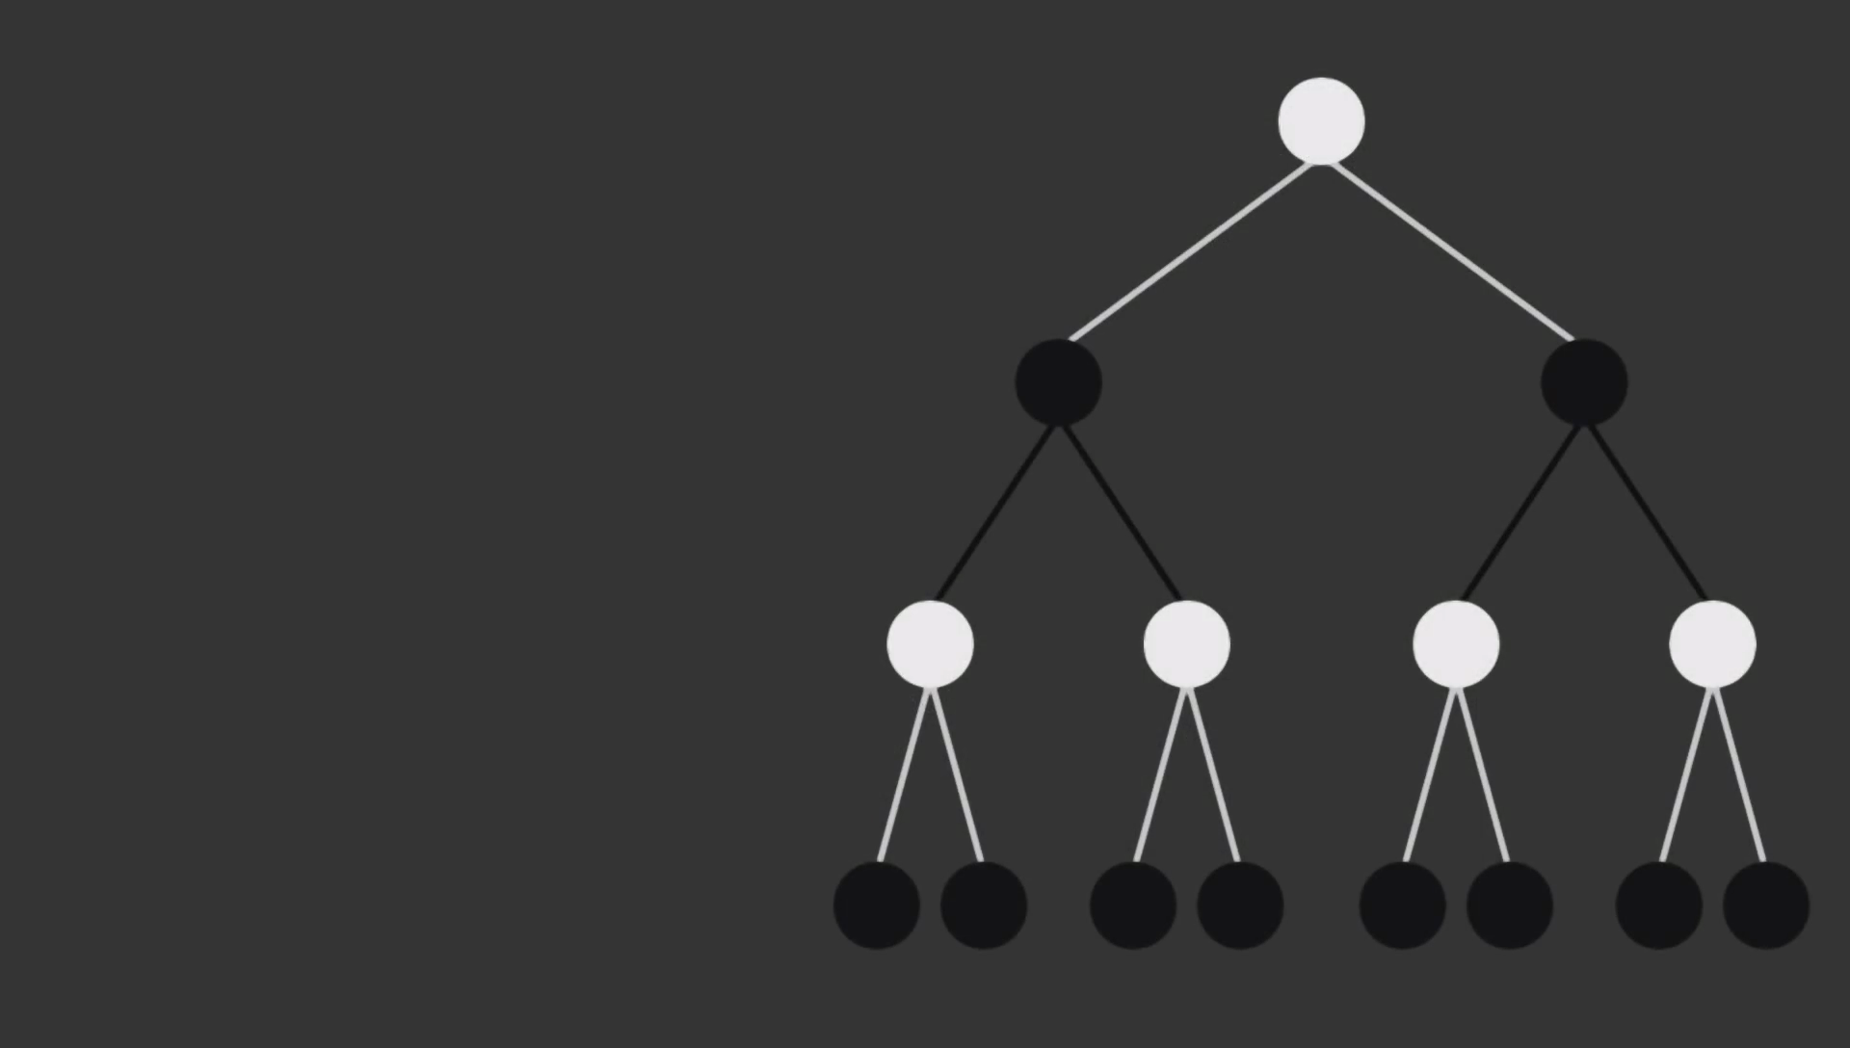
TREE
Nodes: Game States
Edges : Moves by Players

Slide 25
TREE
Nodes: Game States
Edges : Moves by Players
Two Players : Maximizer Minimizer
Assuming Maximizer has first move.

Slide 26
Maximizer
TREE
Nodes: Game States
MInimizer
Edges : Moves by Players
Maximizer
Assuming Max has first move.
Terminal Nodes

Slide 27
Simplified Minimax Algorithm
Expand the entire tree below the root.
Evaluate the terminal nodes as results for the minimizer or maximizer (i.e. utility).
Select an unlabeled node, n, all of whose children have been assigned values. If
there is no such node, we're done --- return the value assigned to the root.
If n is a minimizer move, assign it a value that is the minimum of the values of its
children. If n is a maximizer move, assign it a value that is the maximum of the
values of its children. Return to Step 3.

Slide 28
Mini-Max Function
position = node position
depth = at which depth function is called
maximizingPlayer = Bool Variable (True if current move is of Maximizer
False if current move is of Minimizer)

Slide 29
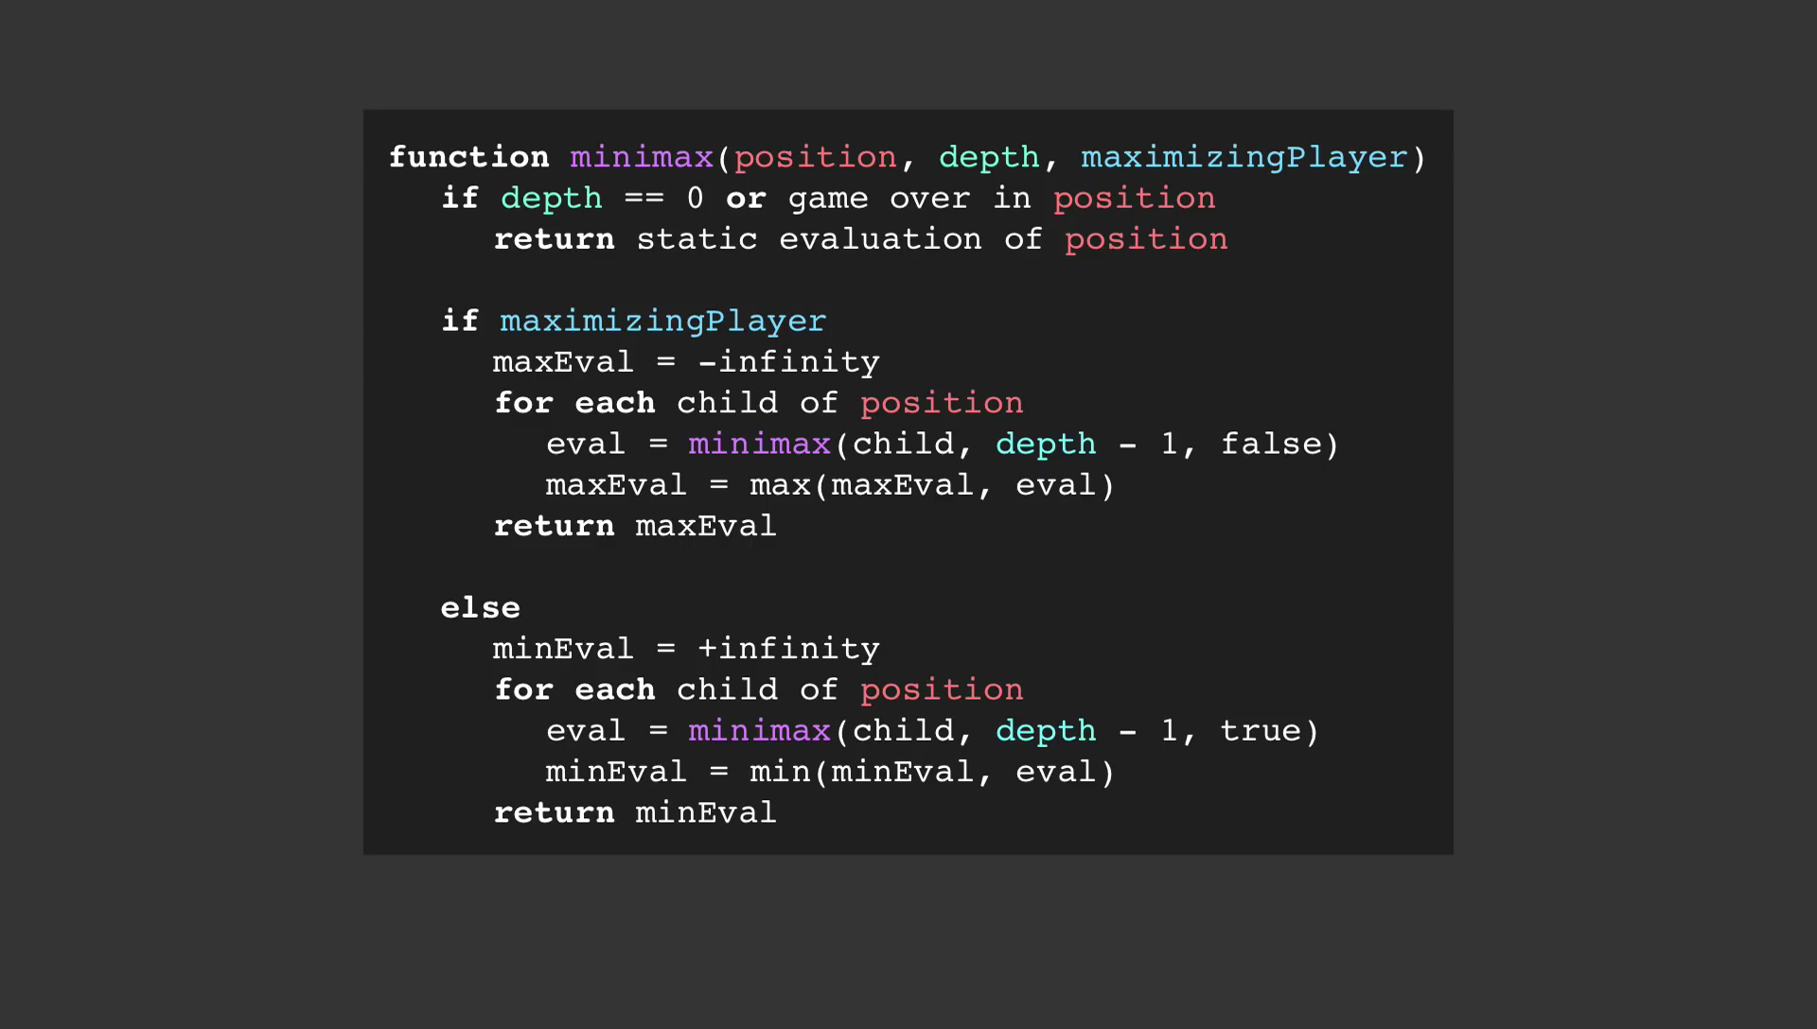
Mini-Max Function

Slide 30
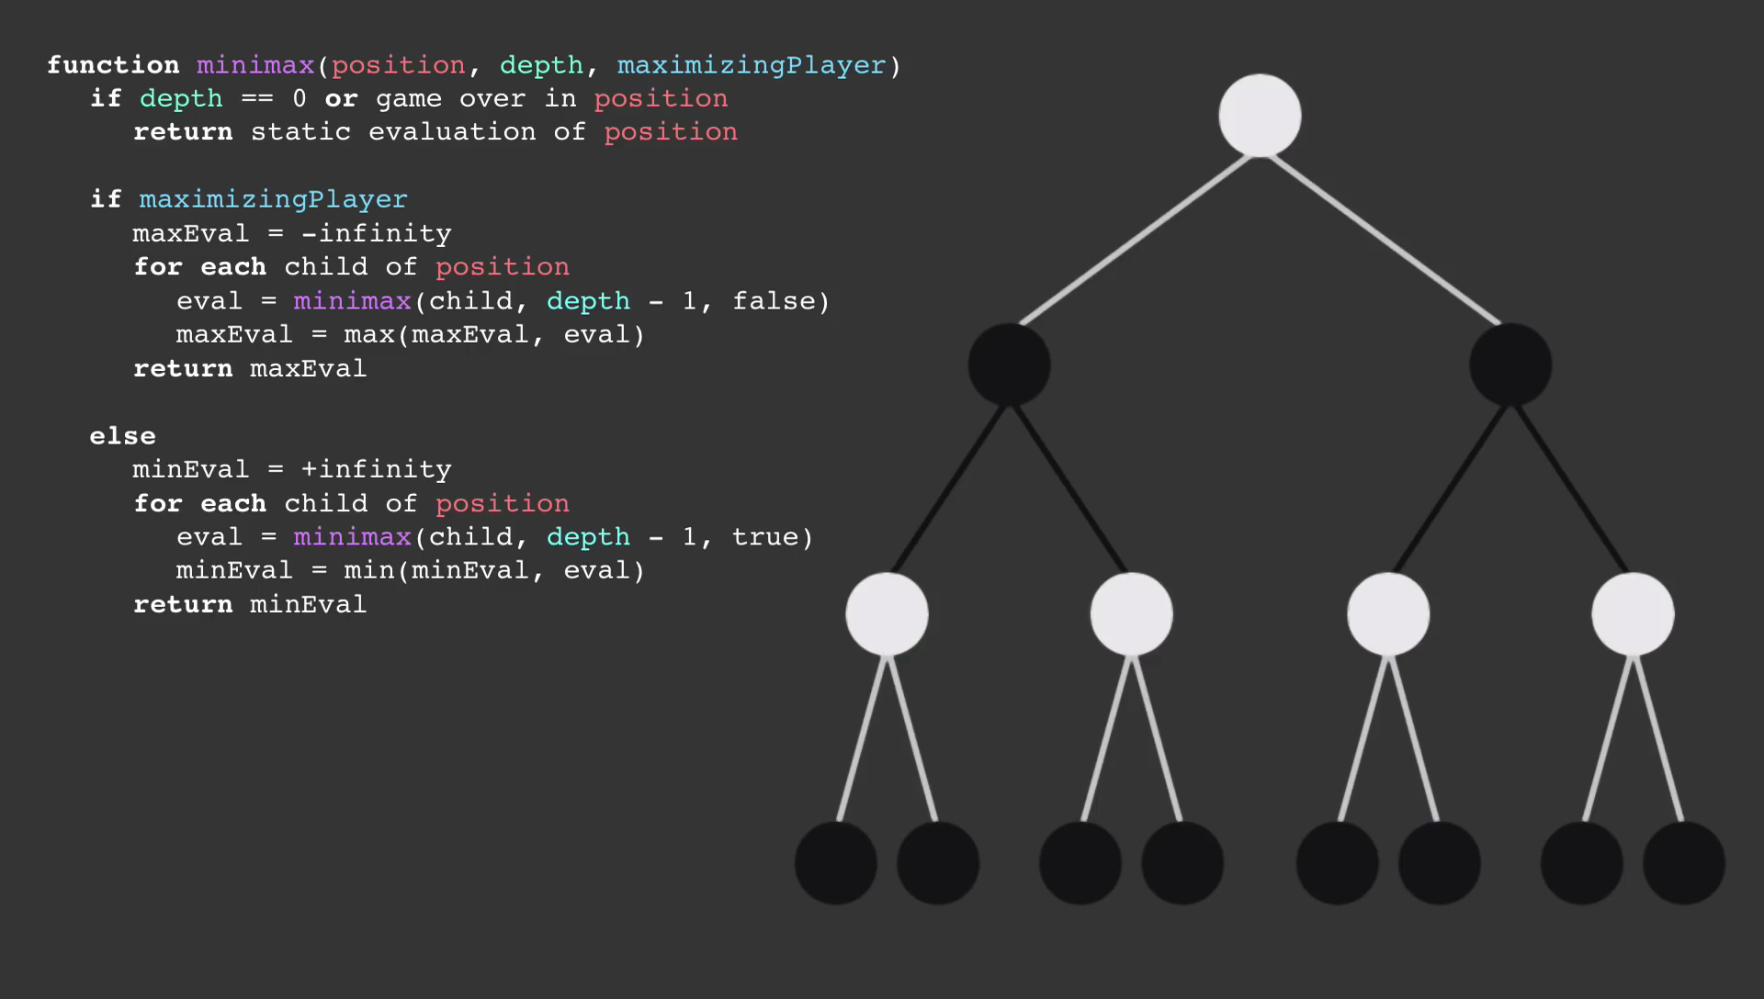

Slide 31
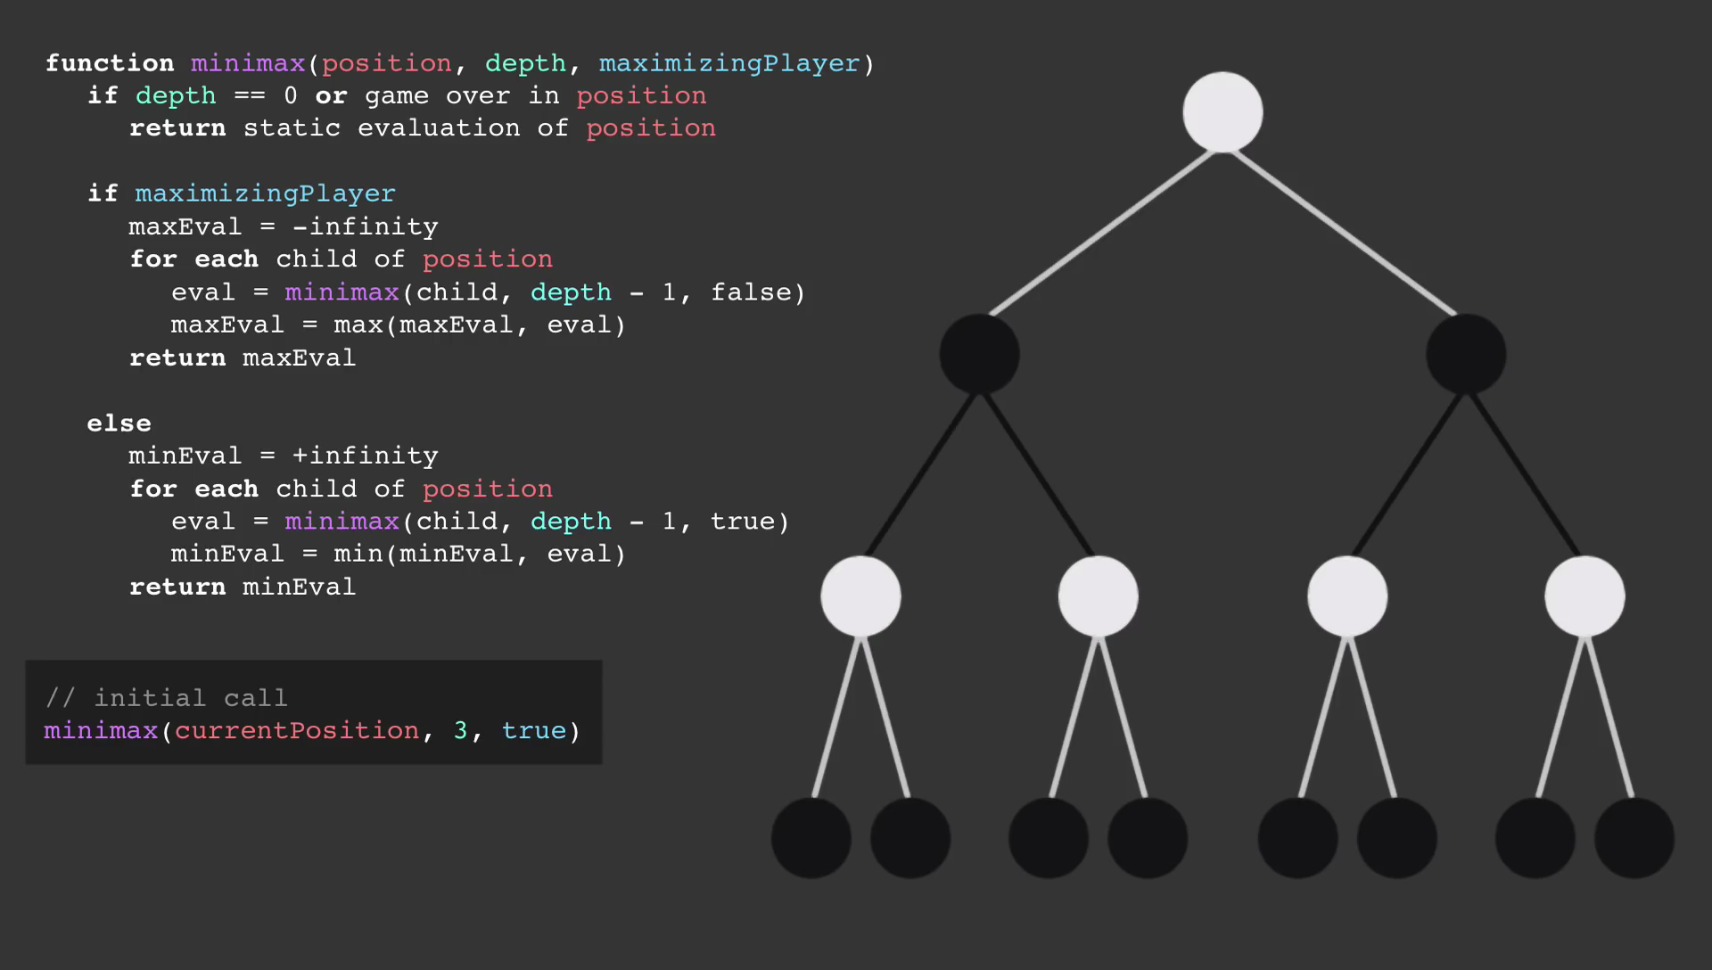

Slide 32
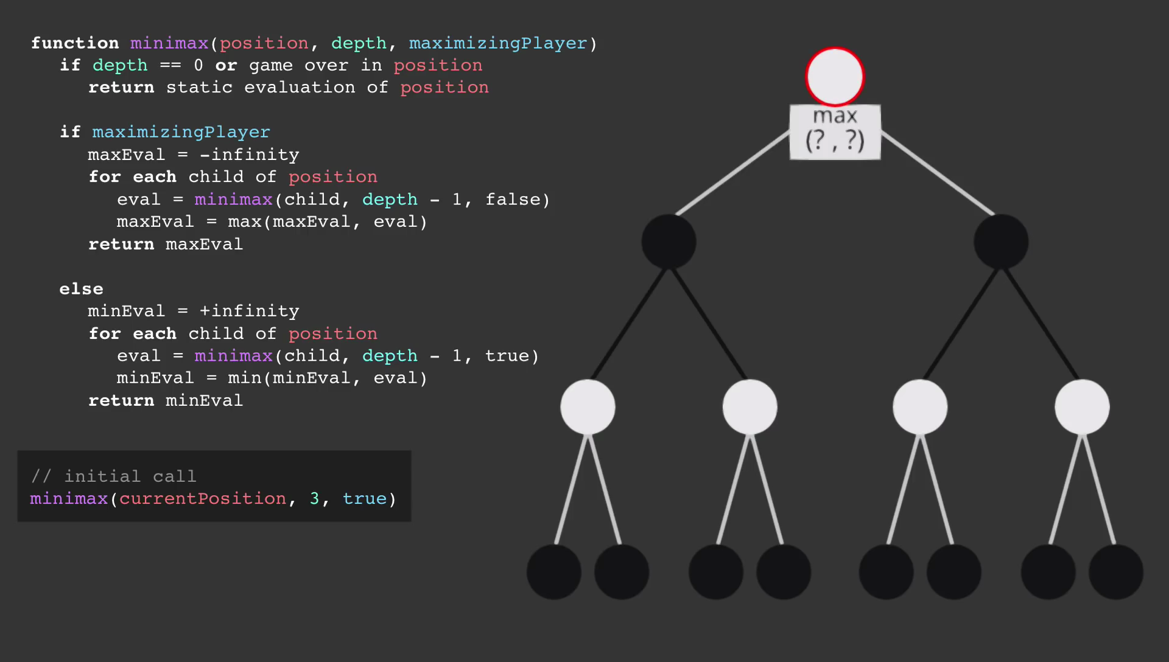
Depth = 3

Slide 33
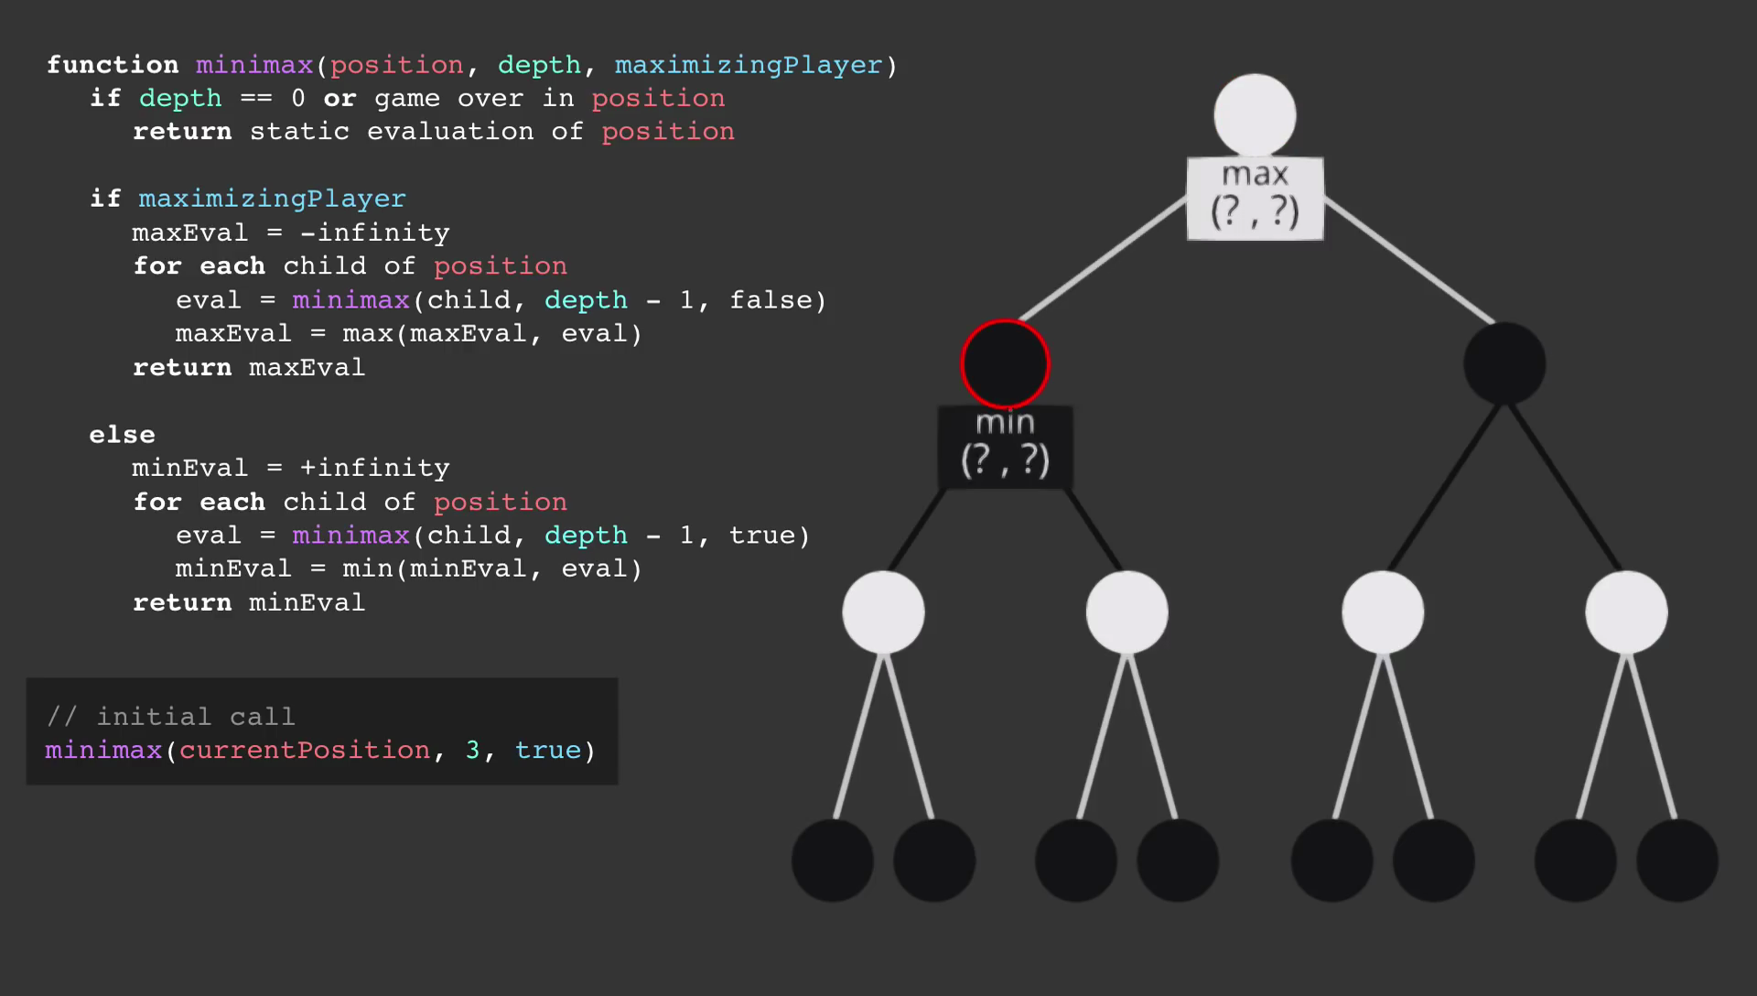
Depth = 2

Slide 34
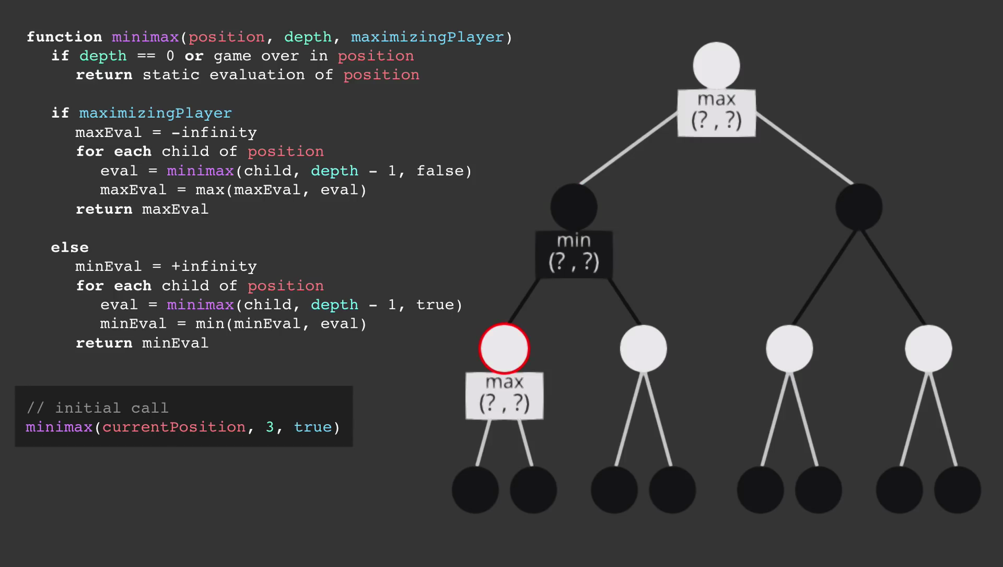
Depth = 1

Slide 35
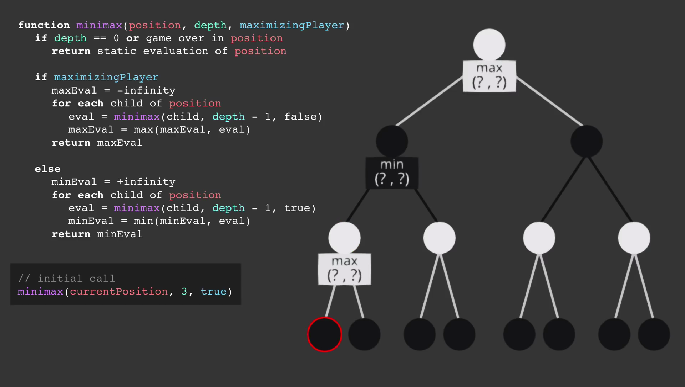
Depth = 0

Slide 36
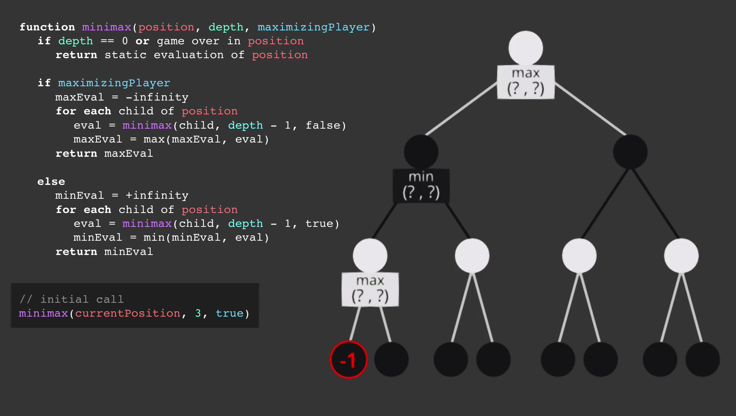

Slide 37
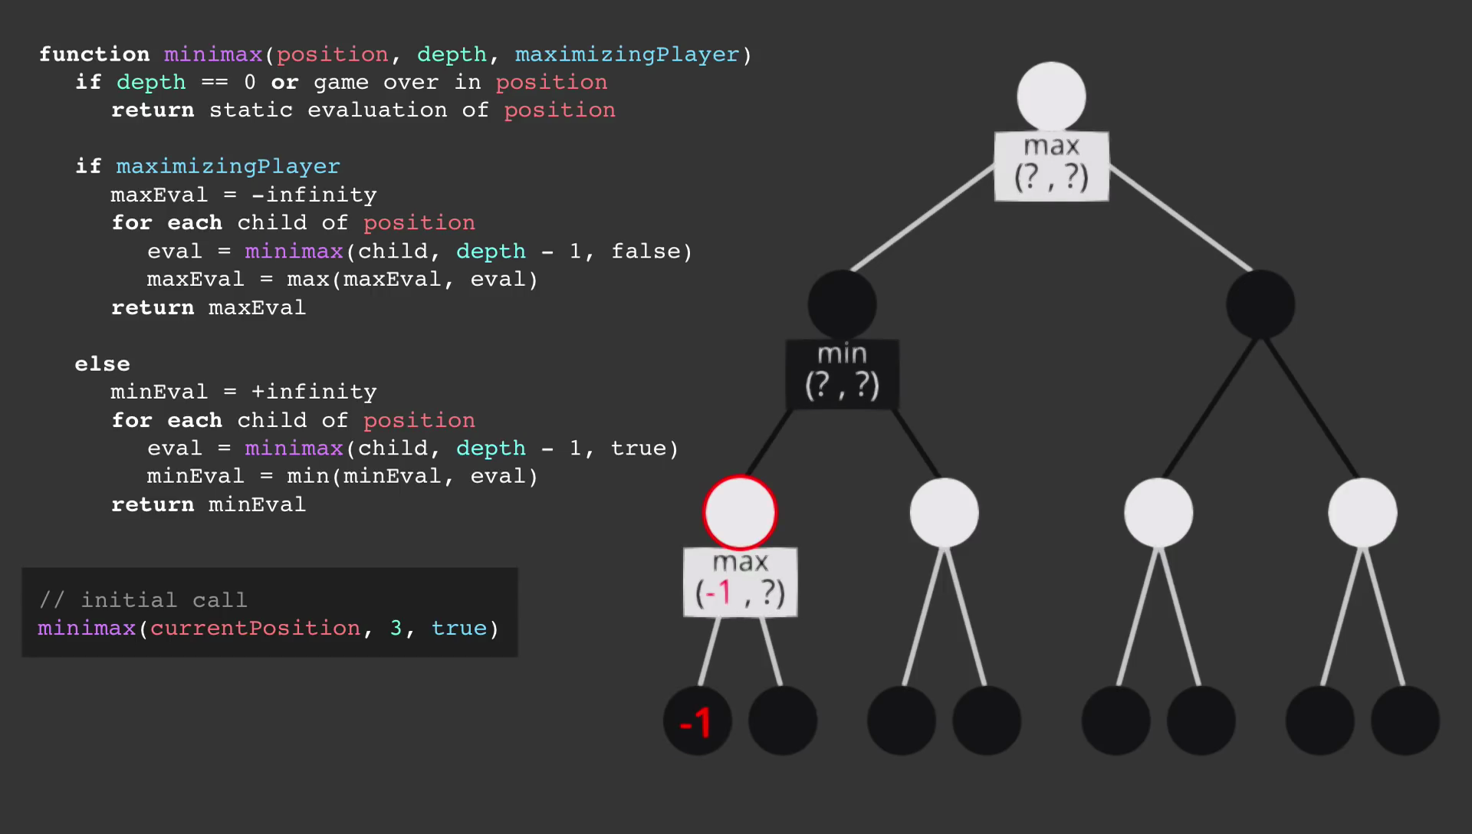

Slide 38
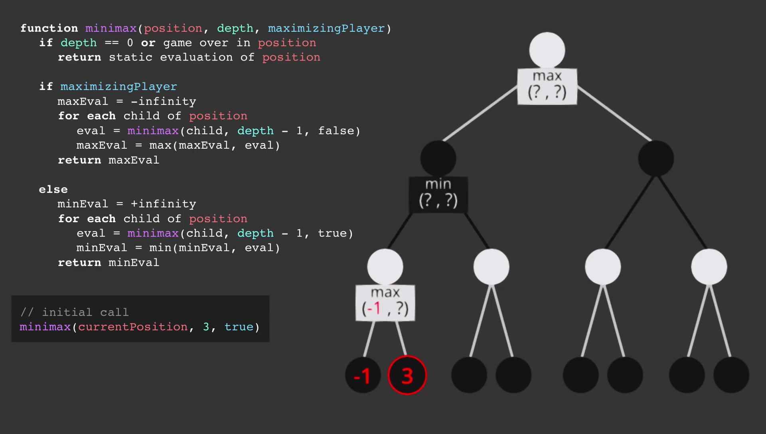

Slide 40
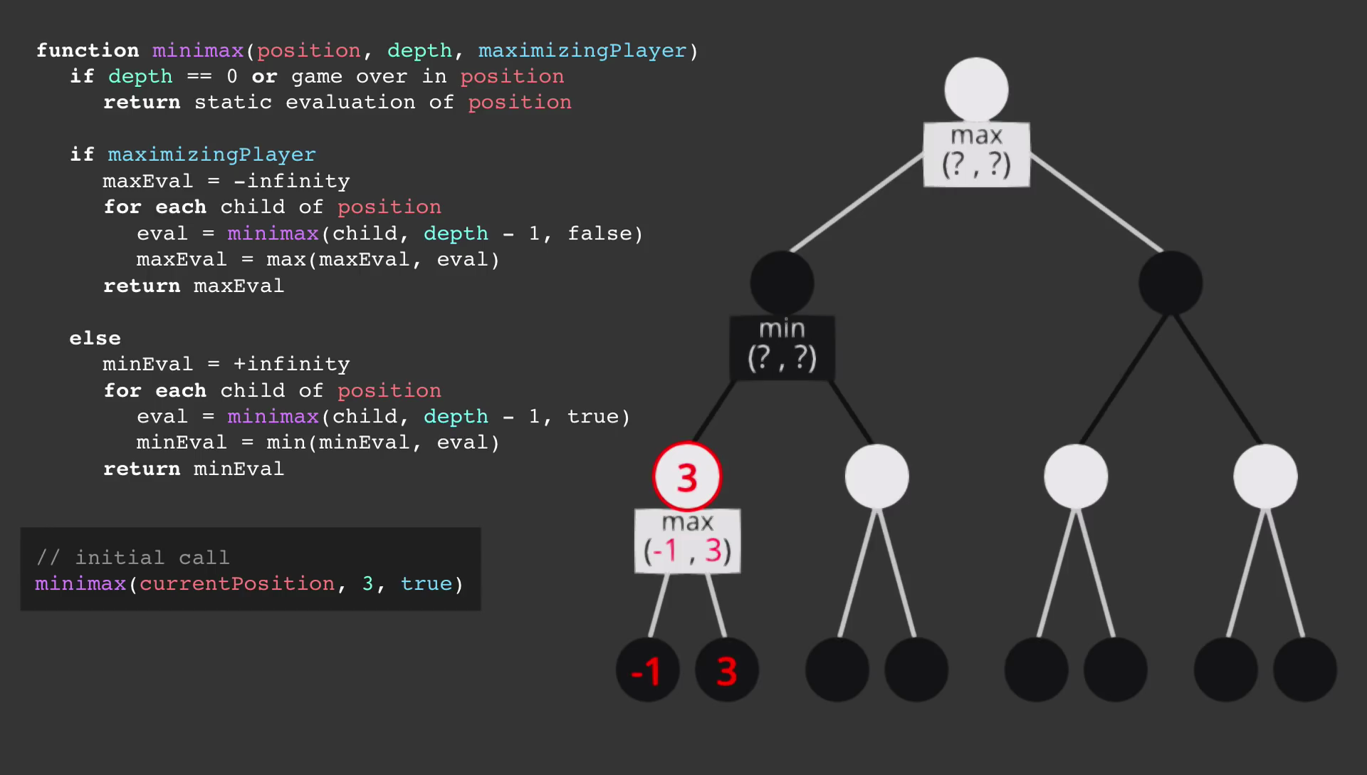

Slide 41
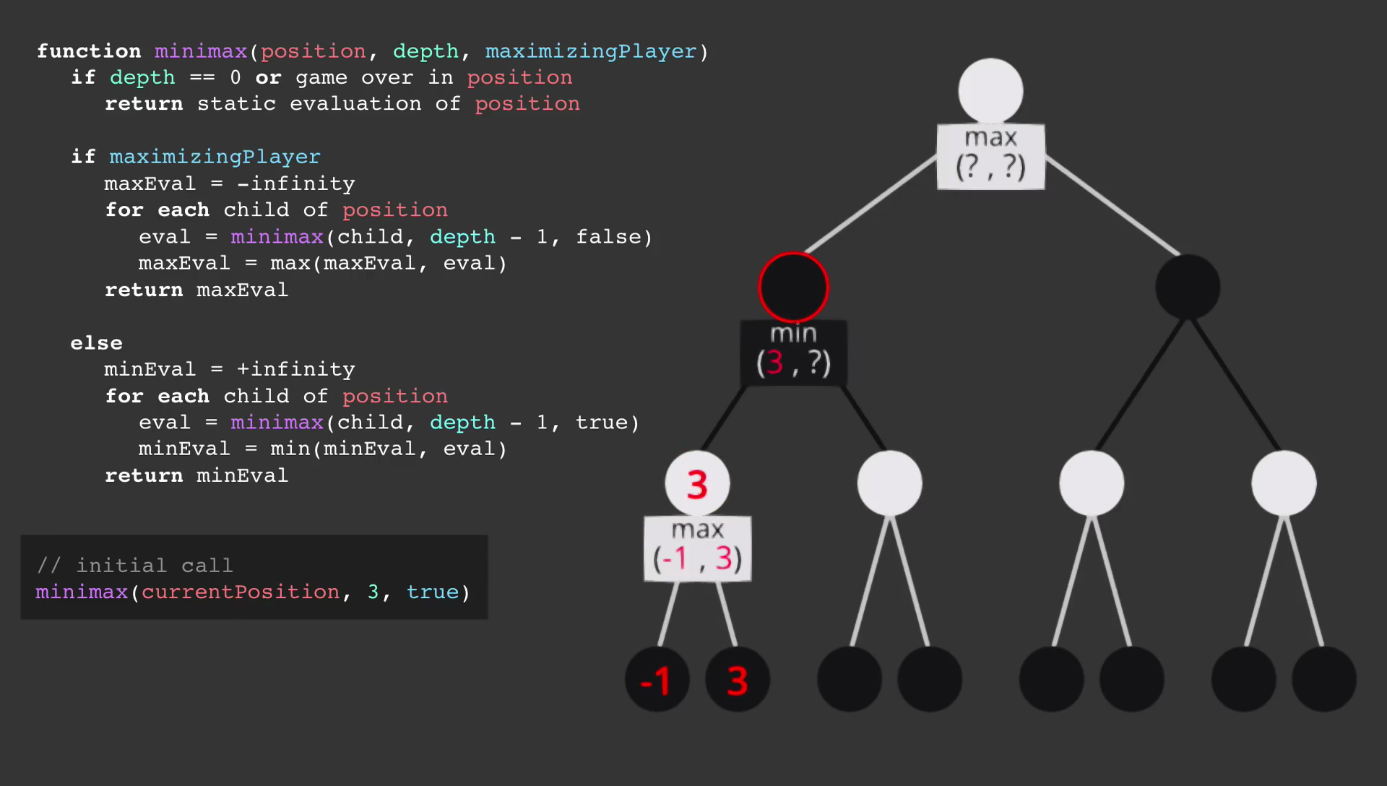

Slide 42
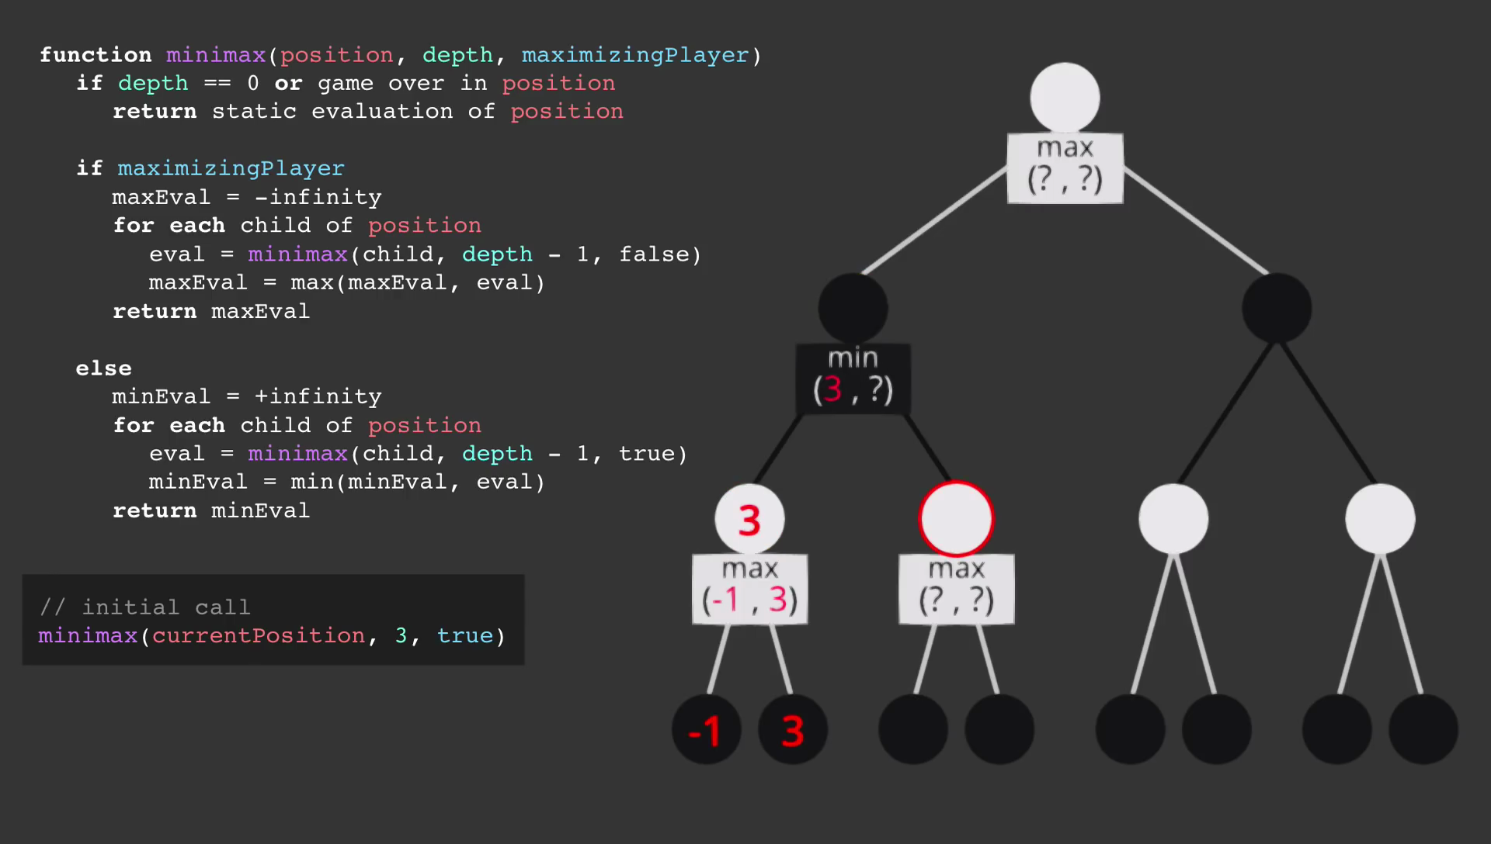

Slide 43
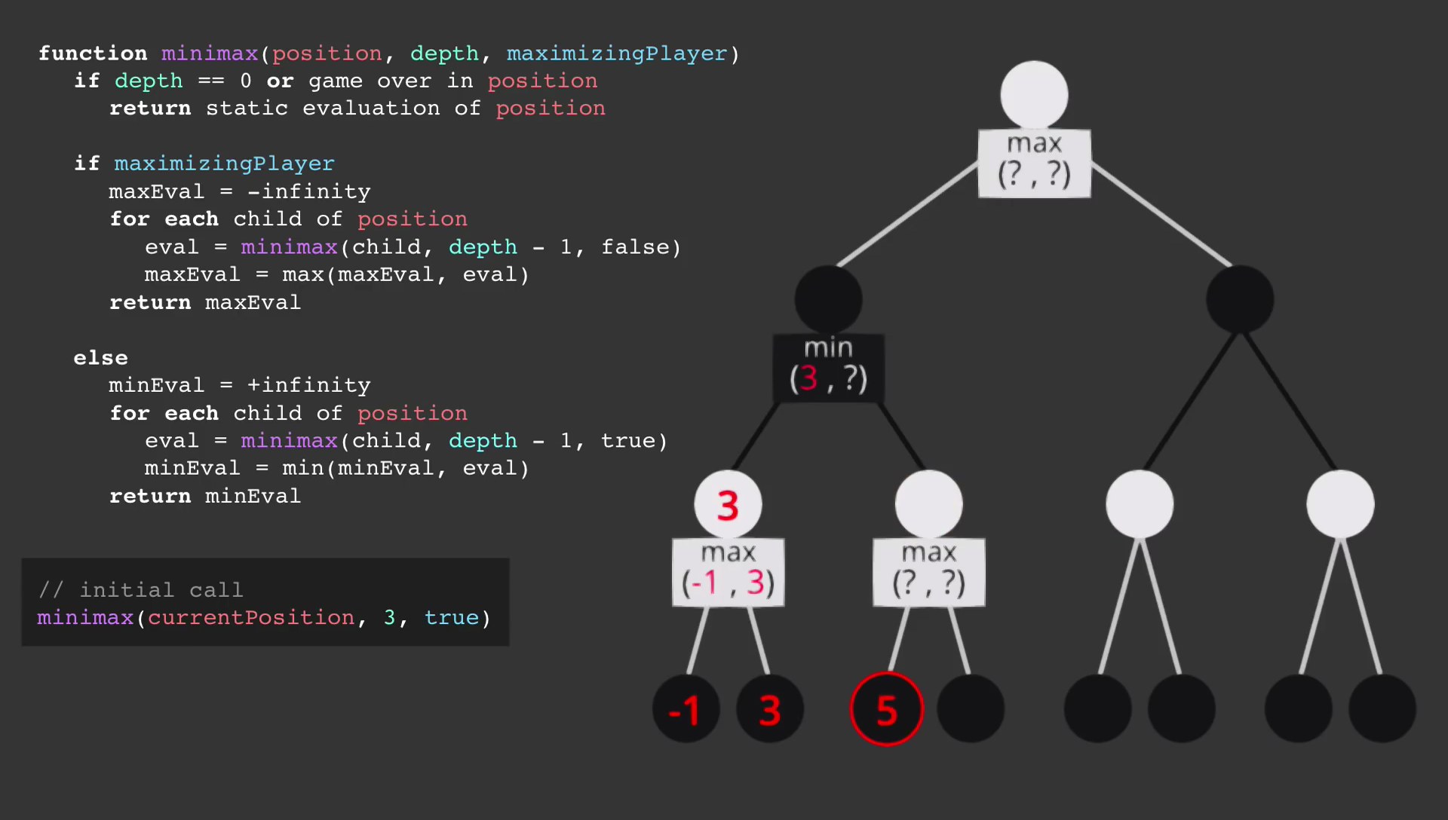

Slide 44
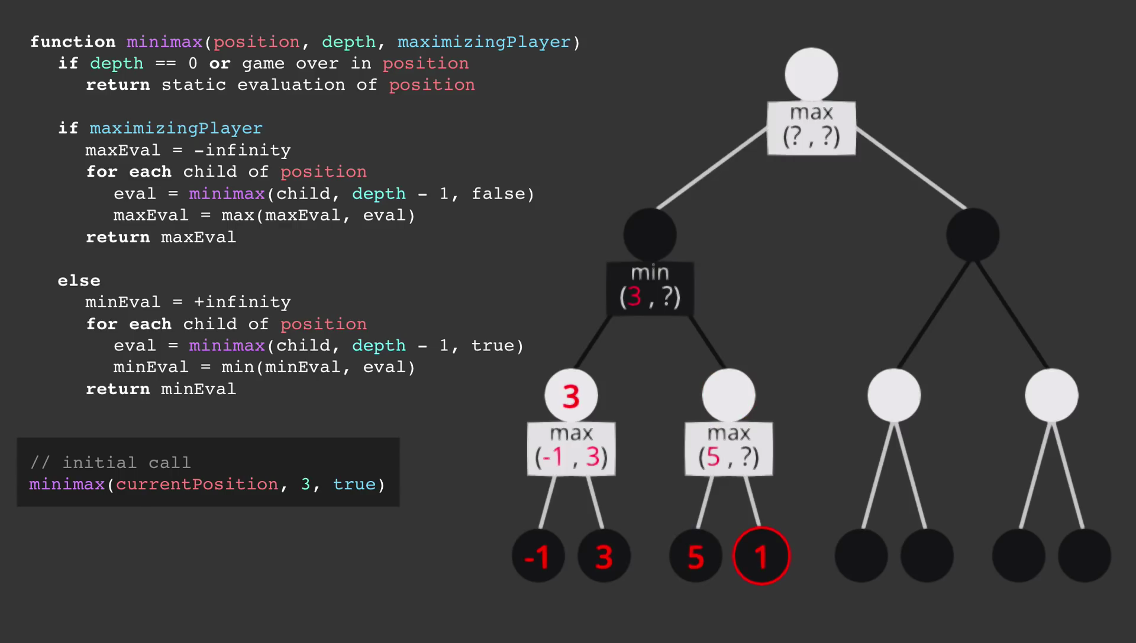

Slide 45
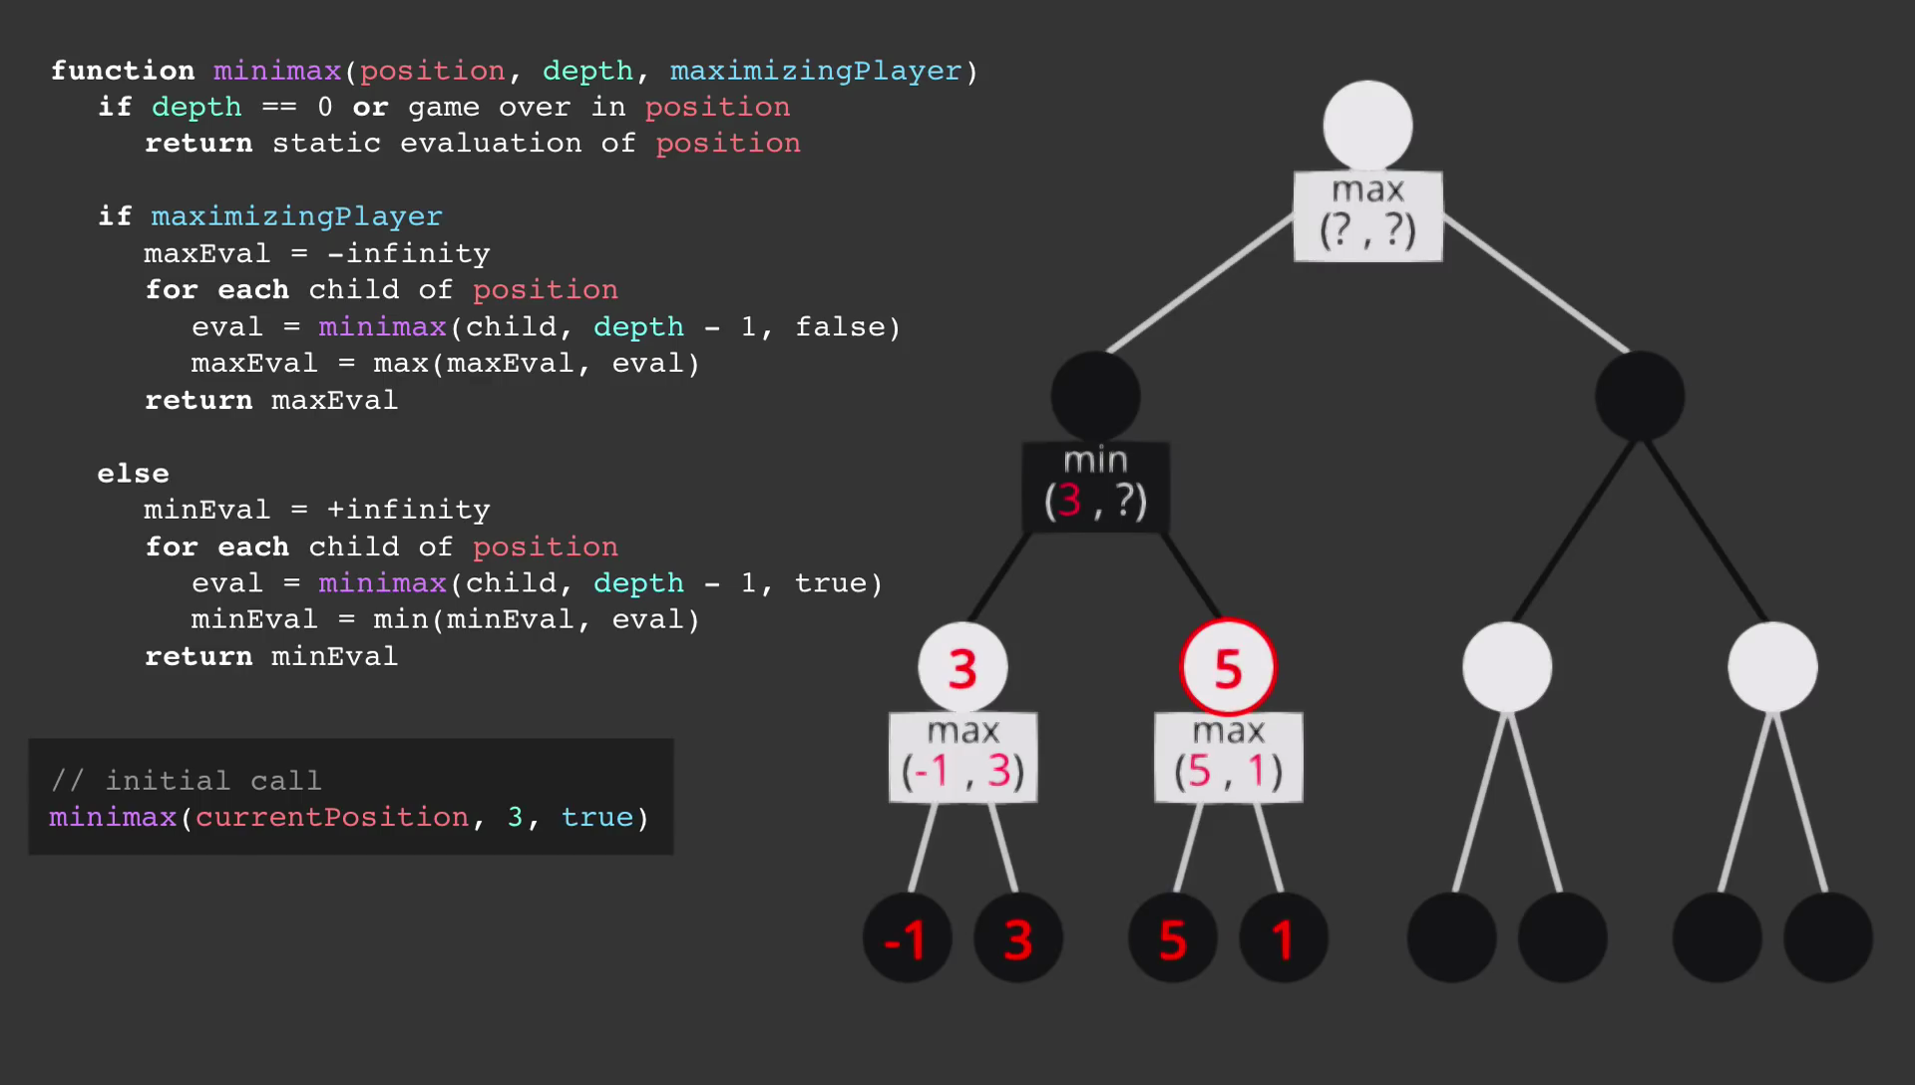

Slide 46
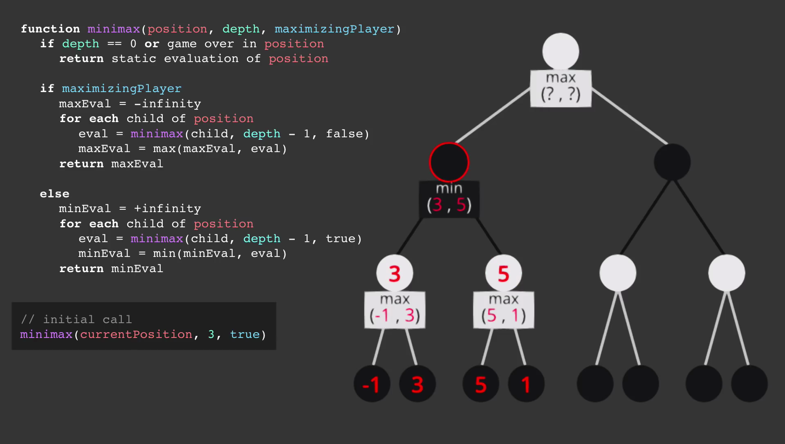

Slide 47
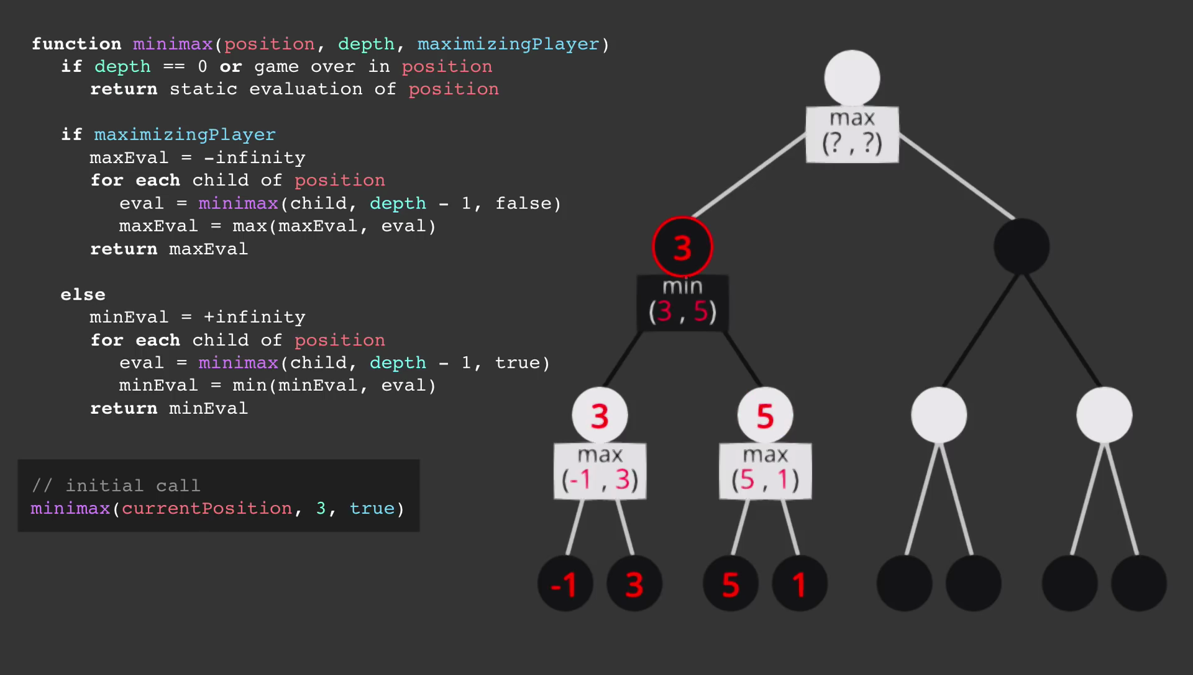

Slide 48
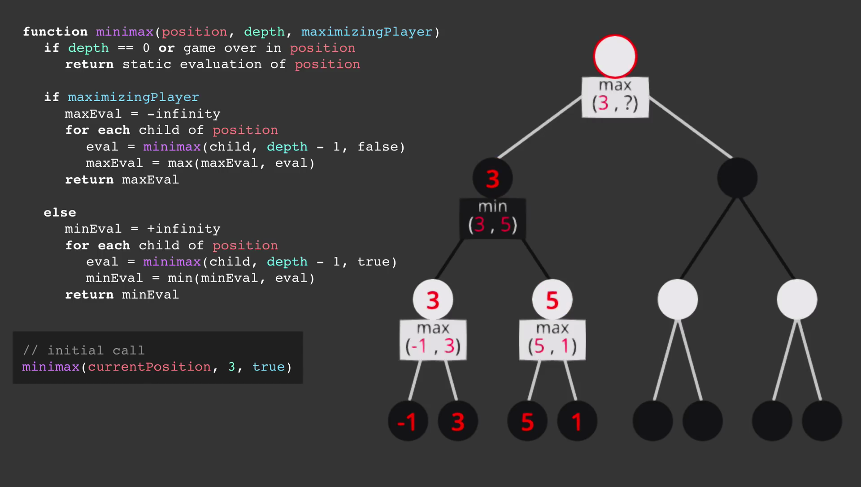

Slide 49
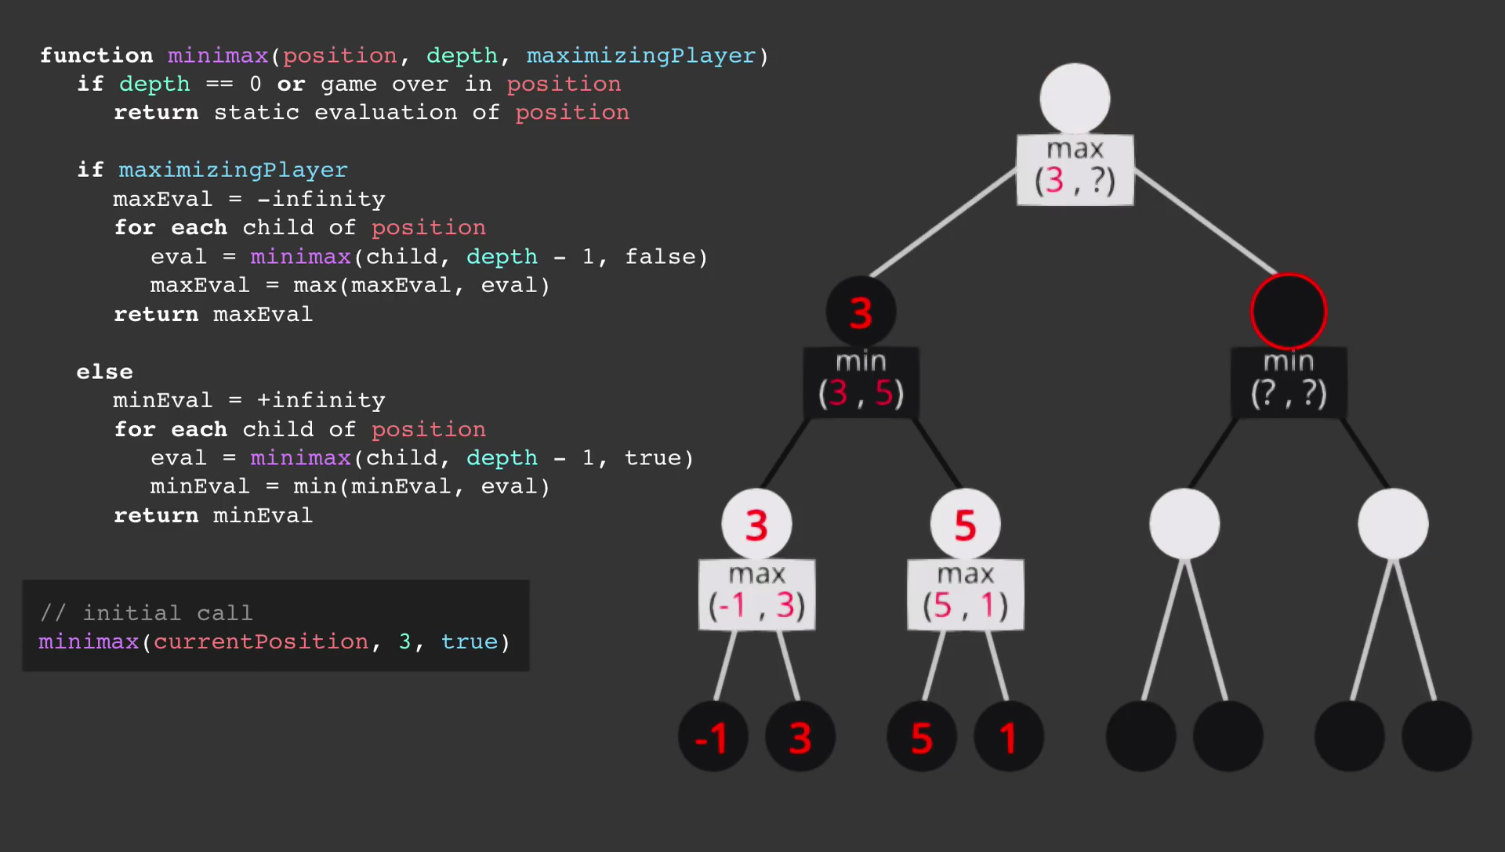

Slide 50
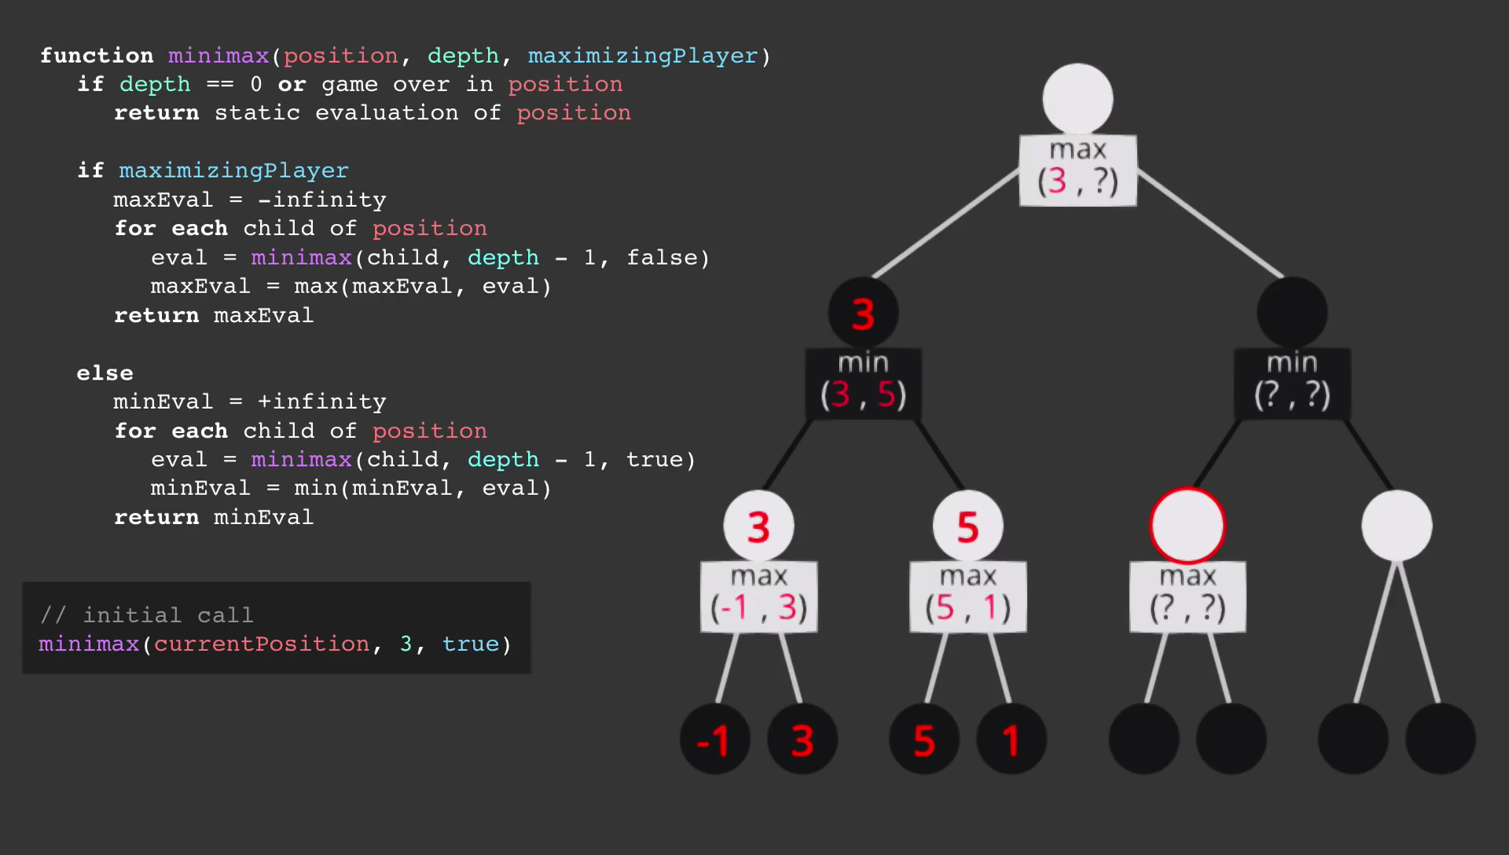

Slide 51
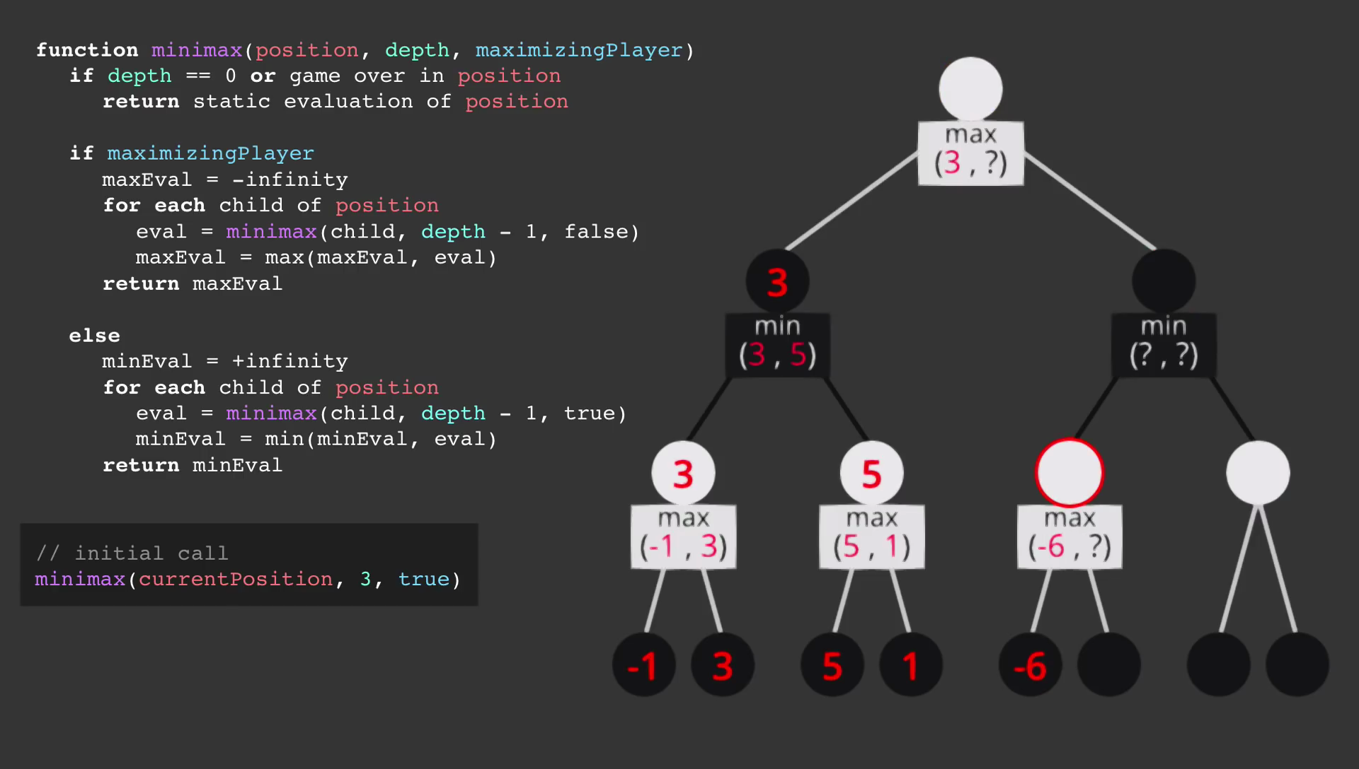

Slide 52
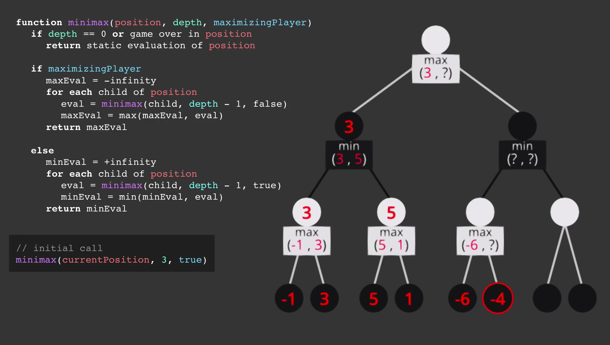

Slide 53
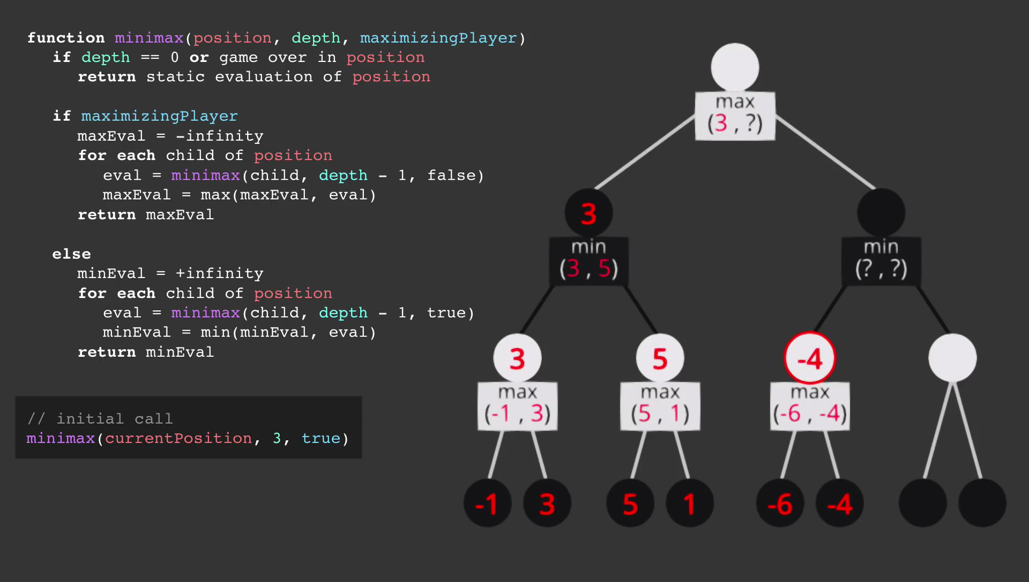

Slide 54
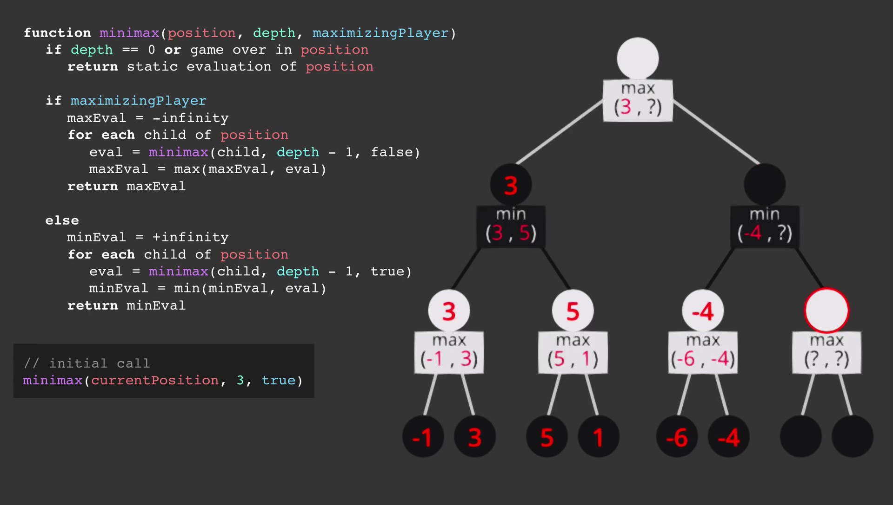

Slide 55
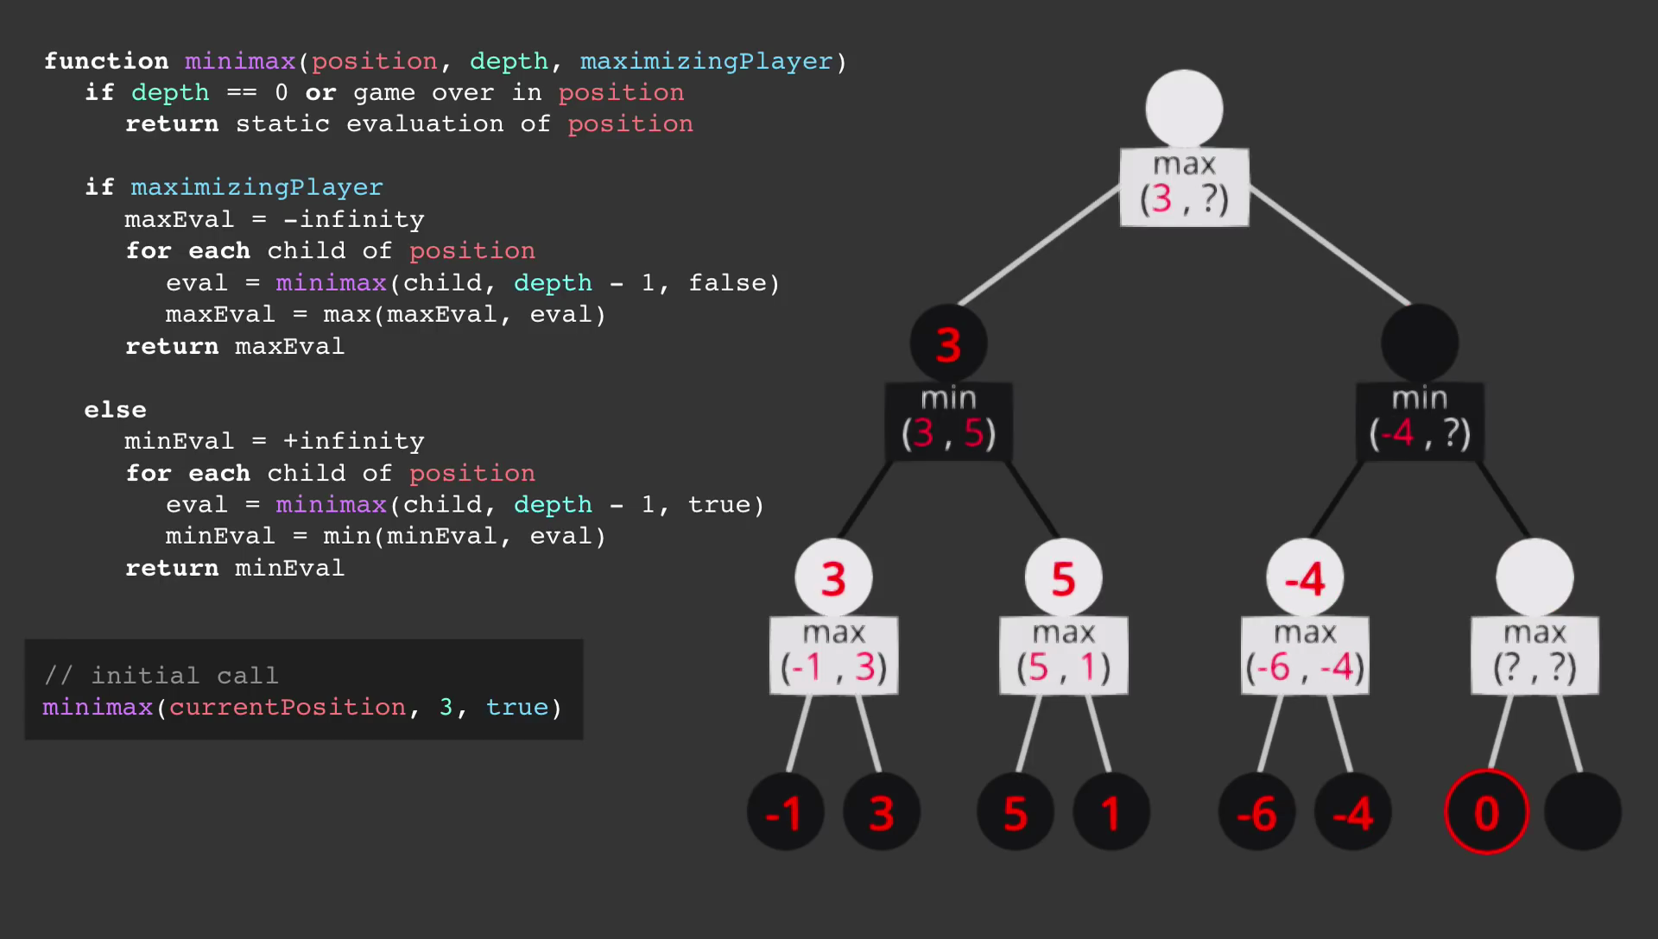

Slide 56
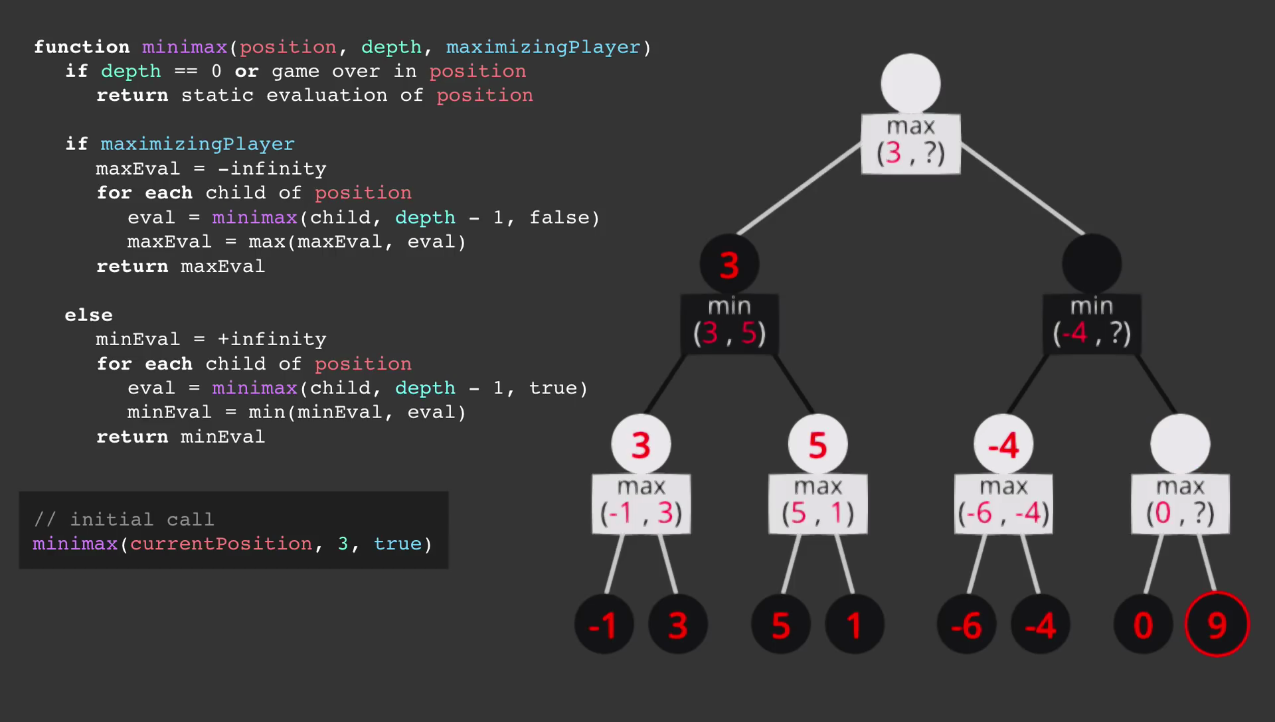

Slide 57
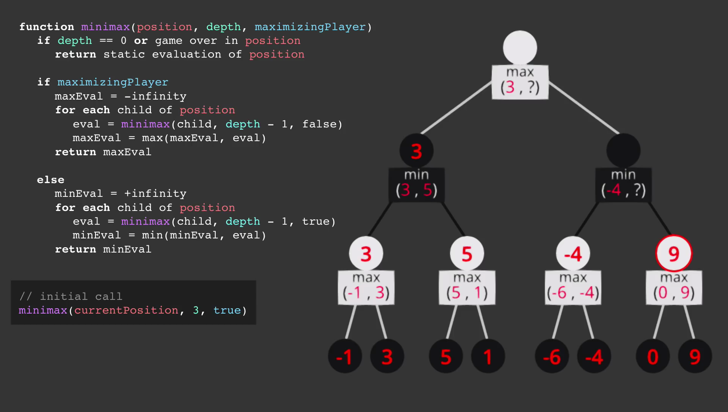

Slide 58
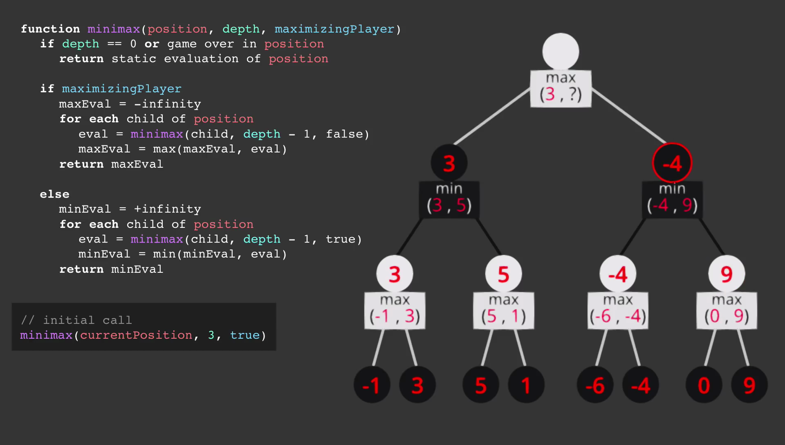

Slide 59
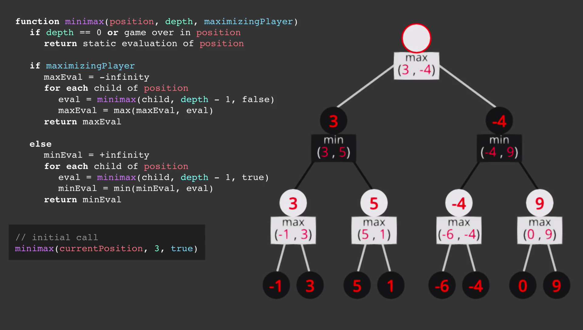

Slide 60
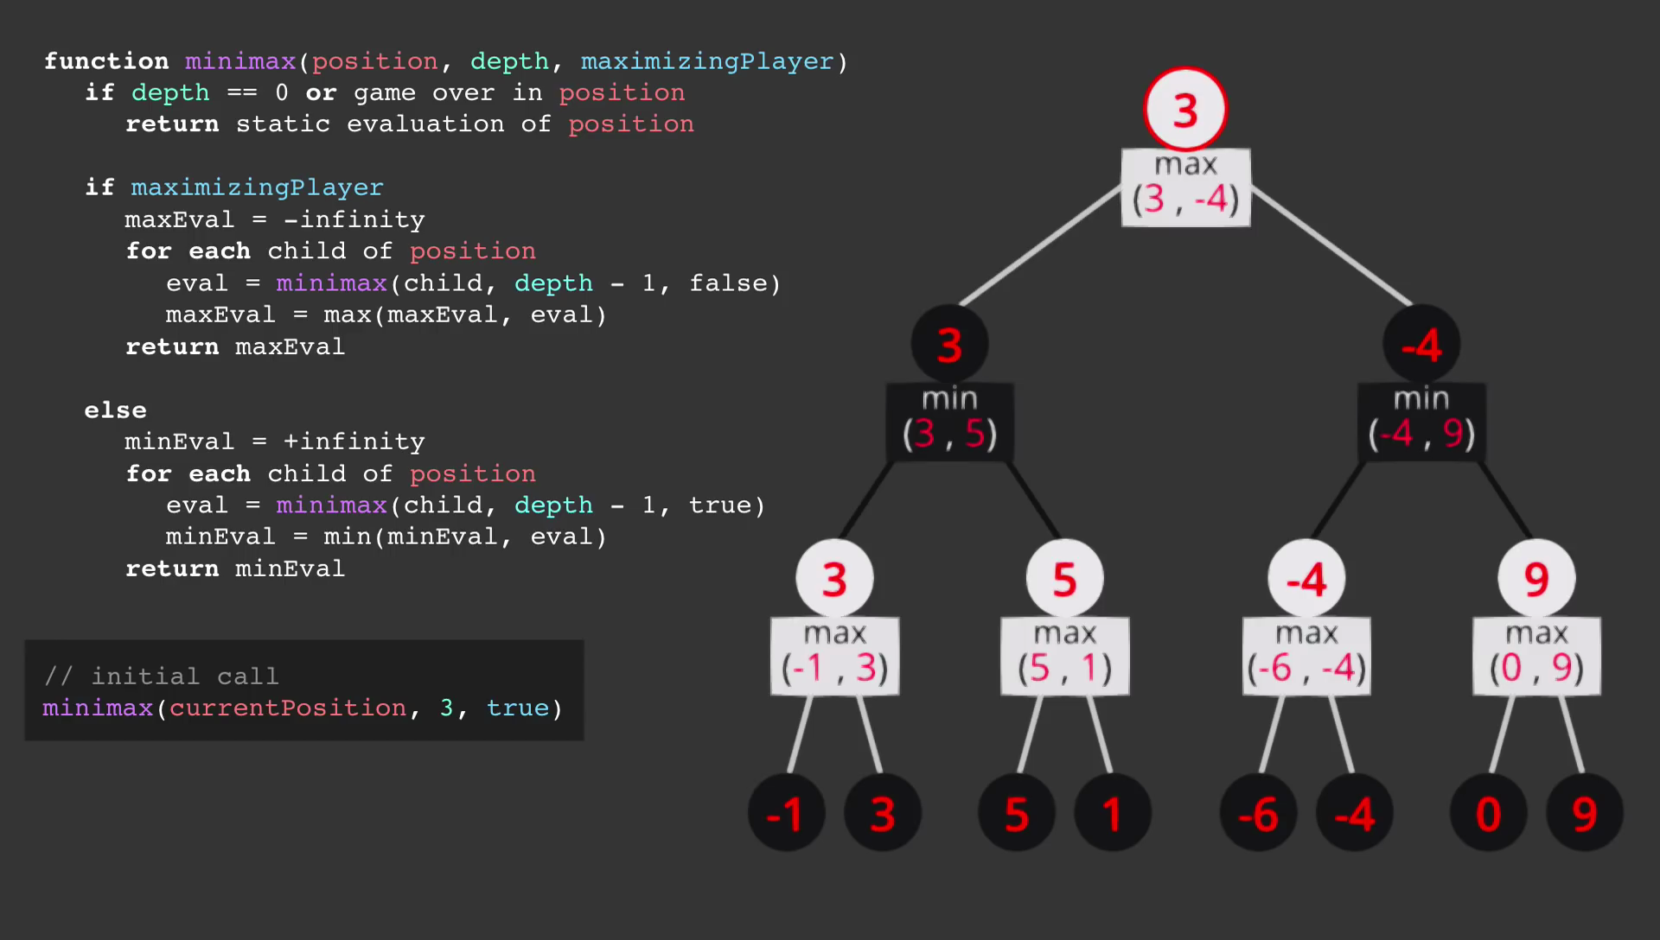

Slide 61
Mini-Max
Example

Slide 62
CHESS
Chess is a two player game with 32 pieces(16 for each player) of 6 types.
The Goal of the game is to Checkmate.
Games do not necessarily end with checkmate - players often resign if they believe they will lose.
In addition , there are several ways game can end iin a draw.
How Mini-Max
Player Max starts with white and makes the move.
Player Min moves with black and makes the move.
The Max keeps up the move assuming the Min next move.
i.e Maxmakes the best move assuming the opponent Min move.
The Min also tries to defeat Max by making good moves.

Slide 63
Mini-Max
Properties

Slide 64
Properties of Mini-Max algorithm
Completeness :
If tree is finite then the algorithm finds a solution.
Optimal :
Yes (If the opponent is also optimal)
Time Complexity :
O(b^{m})
Space Compelxity :
O(b*m) (depth-first search, generate all actions at once)
where b is branching factor,
m is depth of the game tree.

Slide 65
Completeness :
Min-Max algorithm is Complete.
It will definitely Halt, if the search tree is finite.
Optimality :
Min-Max algorithm is Optimal if both opponents are playing optimally.
Time Complexity:
Chess–
b ≈ 35 (approximate average branching factor)
d ≈ 100 (depth of game tree for “typical” game)
b^{d} ≈ 35¹⁰⁰≈ 10¹⁵⁴ nodes!!
If we consider time for exploring 1 node to be 1us.
Mini-Max will take 10¹⁵⁴*10⁻⁶/(3600*24*365) years = 10¹⁴⁰ years

Slide 66
Tic Tac Toe (3x3) :–
b ≈ 5 legal actions per state on average, total of 9 actions in game.
5⁹= 1,953,125
9! = 362,880 game states to check (Computer goes first)
8! = 40,320 game states to check (Computer goes second)
Imagine a 4x4 Tic Tac Toe !!!

Slide 67
Optimizations
Alpha - Beta Pruning :
Delete some nodes because we are getting better results anyways...
Using previously visited game states :
X
 |  | X
Now we can see we can visit same state from two different sequence of moves.
So, how about we store visited states ?
X
 | O
 | O
 |  | X
Number of possible states are :
arranging 2 possible symbols per cell.
i.e. 3⁹ = 19,683 states only !!
X
 | O
 |  | X
X
 | O
 |  | X

Slide 68
Optimizations
Using previously visited game states :
Number of possible states are :
arranging 2 possible symbols per cell.
i.e. 3⁹ = 19,683 states only !!
Can we reduce this number of stored data ?
Is there any way of predicting the outputs before before reaching end game states ?

Slide 69
Frozen states
The notion of 'Frozen States' is derived from Chemistry.
In chain compounds, if a chain can form only from the ends.
A chain can stop increasing in length if a it starts folding inside.
Can we predict if a chain is going to get 'Frozen' and stop increasing its length.

Slide 70
Frozen states
In Tic Tac Toe :
We can detect how a game is going to end without even playing it.
X |  | O
O | O | X
X |  | X
O |  | X
 | X
O |  | O
If both the players always play best move we can detect result of game much earlier.
X |  | O
O | X | X
 |  | O
X |  | O
 | X
 |  | O

Slide 71
Mini-Max
Questions

Slide 72
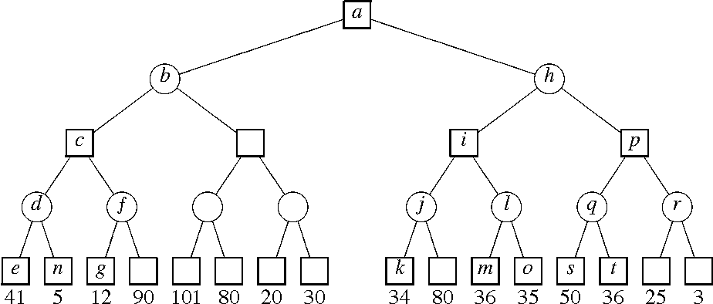
Questions
Question: Given a game search tree apply mini-max algorithm and find out the values of a,b,c,.......,t.
Question: What happens if min plays not optimal?Can we implement minimax algorithm in this case?
Quesion: Can Mini-Max algorithm perform BFS for the game search tree?

Slide 73
Bibliography
Thanks to Sebastian Lague for providing amazing youtube channel.
We also like to thank John Von Neumann for his legendary work in the field of Applied Mathematics and Physics.
We would like to thank Clint sir for giving us this opportunity.
You can find the link of Mini-Max implementation of Tic-Tac-Toe here

Slide 74
Thank You

