Slide 1
Google PageRank Algorithm and it’s Modification
Presenters-Raj Hansini Khoiwal,Chetan Rajput and Pulaksh Garg
Guide: Dr. Clint P George

Slide 2
Topics covered in the presentation:
Raj Hansini Khoiwal
Chetan Rajput
Pulaksh Garg
What’s and Why’s.
Algorithm.
Math behind the algorithm.
Examples
Convergence
Modifications
Applications
Let’s get straight to the point and dive deep.

Slide 3
Larry Page and Sergey Brin developed PageRank at Stanford University in 1996 as part of a research project about a new kind of search engine. Sergey Brin had the idea that information on the web could be ordered in a hierarchy by "link popularity": a page ranks higher as there are more links to it.

Slide 4
What is Page Rank Algorithm:
PageRank (PR) is an algorithm used by Google Search to rank web pages in their search engine results.
PageRank is a link analysis and iterative algorithm.
It assigns a numerical weighting to each element of a hyperlink of documents, such as the World Wide Web.
Stay Tuned for more info...

Slide 5
THE WHY….
Why is Pagerank important ?
If you're looking to raise your rankings in Google,then you'd better take in consideration Google's Page Rank.
The number may have an effect on where your site displays in the rankings and may tell you how important Google thinks your website is.
Page Rank is given to a website with a number between 0 to 10; the higher the number the better for your website.
If you're a zero and your website has been around for a while, that 's something to be concerned about.

Slide 6
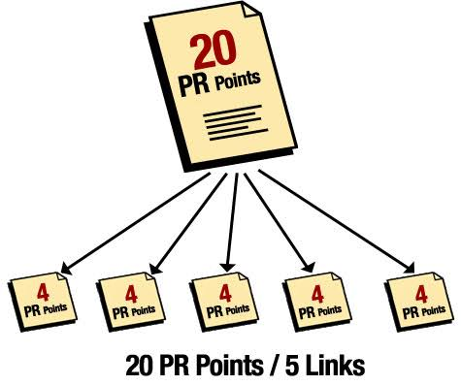
Terms to know beforehand :
PR(E): Numerical weight that the algorithm assigns to any given web page E is the PageRank of E.
d denotes the damping factor.
L(v): The outgoing links from web page v.
The above terms are used in the algorithm.

Slide 7
Algorithm ahead….

Slide 8
Assume a small universe of four web pages: A, B, C and D.

Slide 9
Natural question
What is the damping factor and why is it set to 0.85?

Slide 10
Natural question
What is the damping factor and why is it set to 0.85?
The PageRank theory holds that an imaginary surfer who is randomly clicking on links will eventually stop clicking.

Slide 11
Natural question
What is the damping factor and why is it set to 0.85?
The PageRank theory holds that an imaginary surfer who is randomly clicking on links will eventually stop clicking.
The probability, at any step, that the person will continue is a damping factor d.

Slide 12
Natural question
What is the damping factor and why is it set to 0.85?
The PageRank theory holds that an imaginary surfer who is randomly clicking on links will eventually stop clicking.
The probability, at any step, that the person will continue is a damping factor d.
Various studies have tested different damping factors, but to stop the other pages having too much influence, this total vote is “damped down” by multiplying it by 0.85 (the factor “d”)

Slide 13
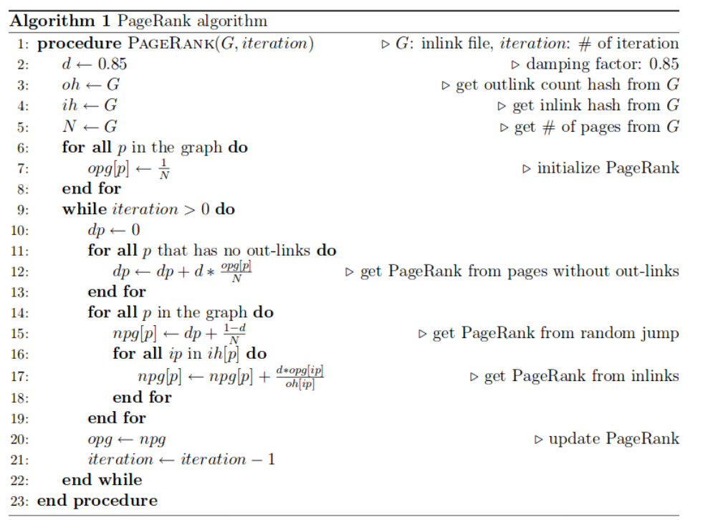

Slide 14
Computation:
Iterative method
Algebraic method

Slide 15
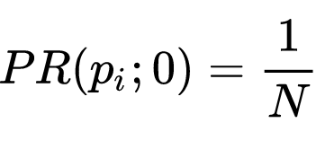
Iterative Method
At t = 0, an initial probability distribution is assumed, usually
where N is the total number of pages, and p_{i} ;0 is page i at time 0.

Slide 16
At each time step, the computation, as detailed above, yields
where d is the damping factor, or in matrix notation

Slide 17
Where
and 1 is the column vector of length N containing only ones.
The matrix M is defined as

Slide 18
i.e.
where A denotes the adjacency matrix of the graph and K is the diagonal matrix with the outdegrees in the diagonal.

Slide 19
i.e.
where A denotes the adjacency matrix of the graph and K is the diagonal matrix with the outdegrees in the diagonal.
The probability calculation is made for each page at a time point, then repeated for the next time point. The computation ends when for some small ϵ-
i.e., when convergence is assumed.

Slide 20
The Algebraic Method:
For i.e. in the steady state, the equation (1) reads
The solution is given by :
with the identity matrix I.

Slide 21
The solution exists and is unique for 0 < d < 1.
This can be seen by noting that M is by construction a stochastic matrix and hence has an eigenvalue equal to one as a consequence of the Perron-Frobenius theorem.

Slide 22
Implementation

Slide 23
The Bachelorette:

Slide 24
Configuration:

Slide 25
Who to date?

Slide 26
Endorsements:

Slide 27
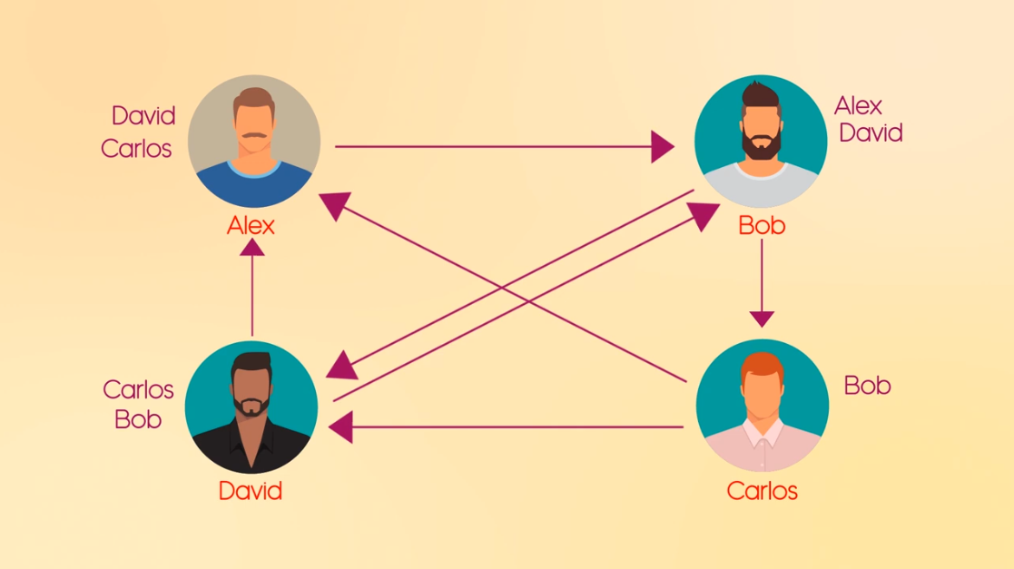
Graph formation:

Slide 28
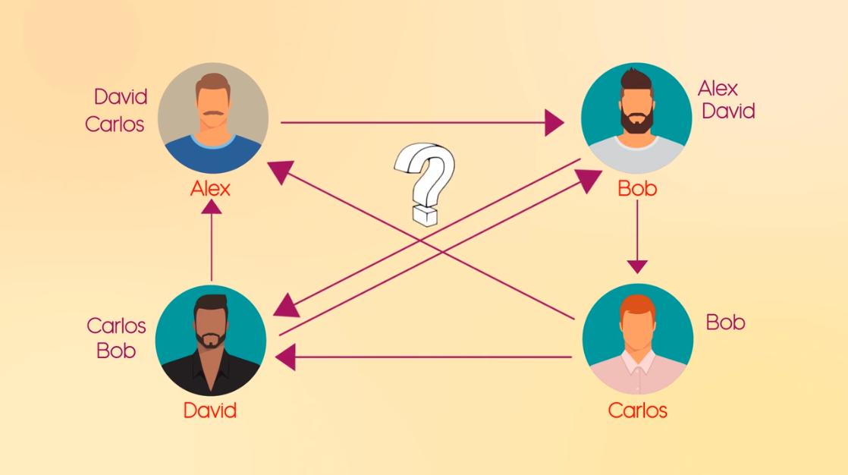
Who to select?

Slide 29
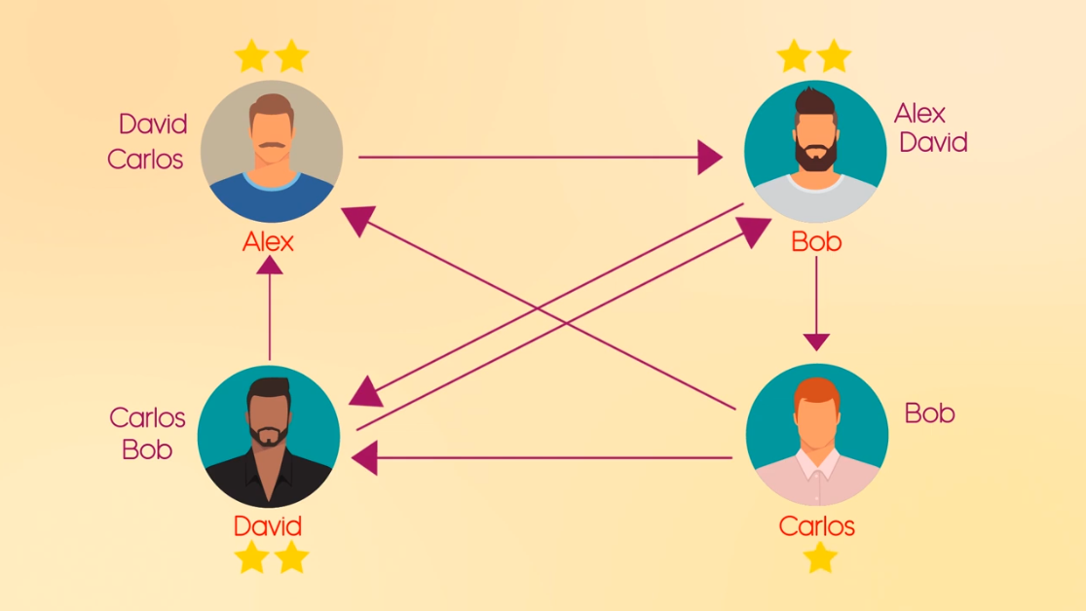
Ratings:

Slide 30
Bachelors = websites
Endorsement = outgoing link

Slide 31
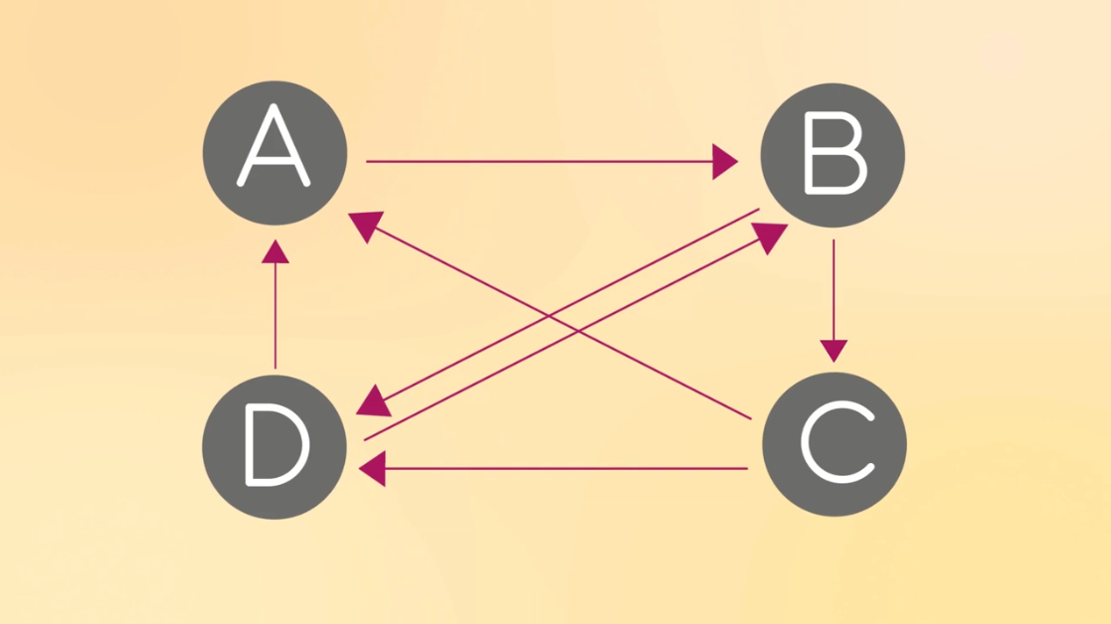
Page-rank in disguise:

Slide 32
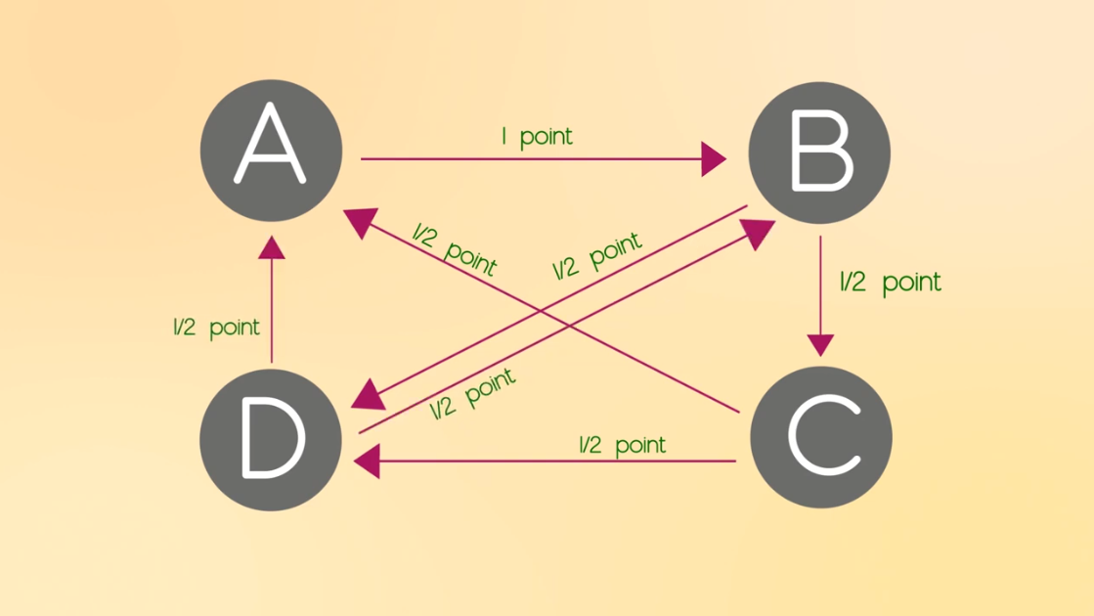
Weights of the graph:

Slide 33
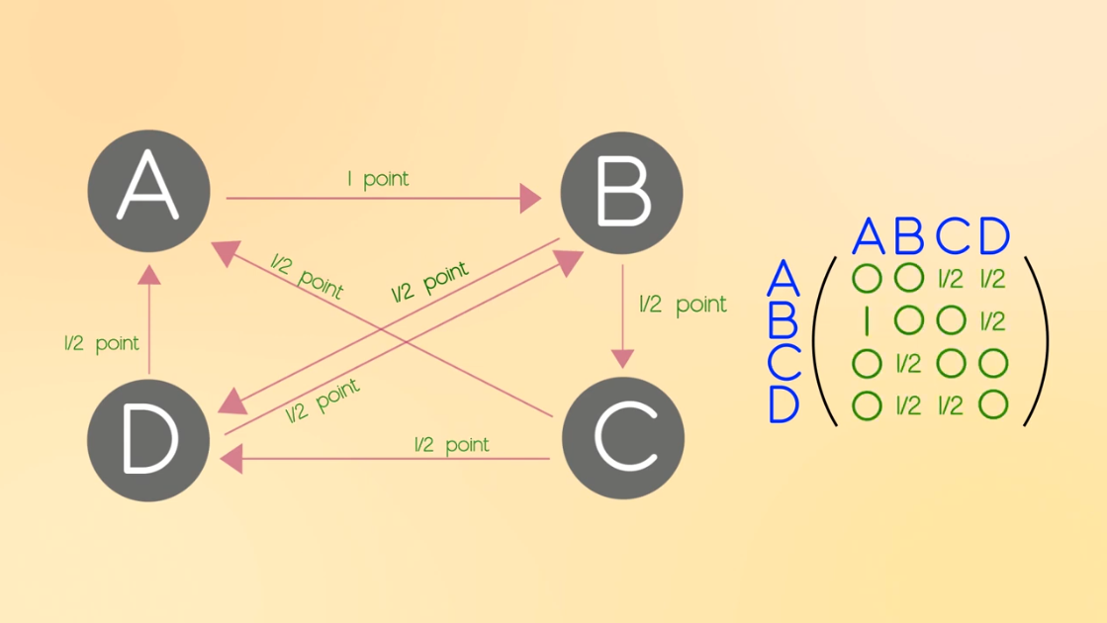
Matrix (R):

Slide 34
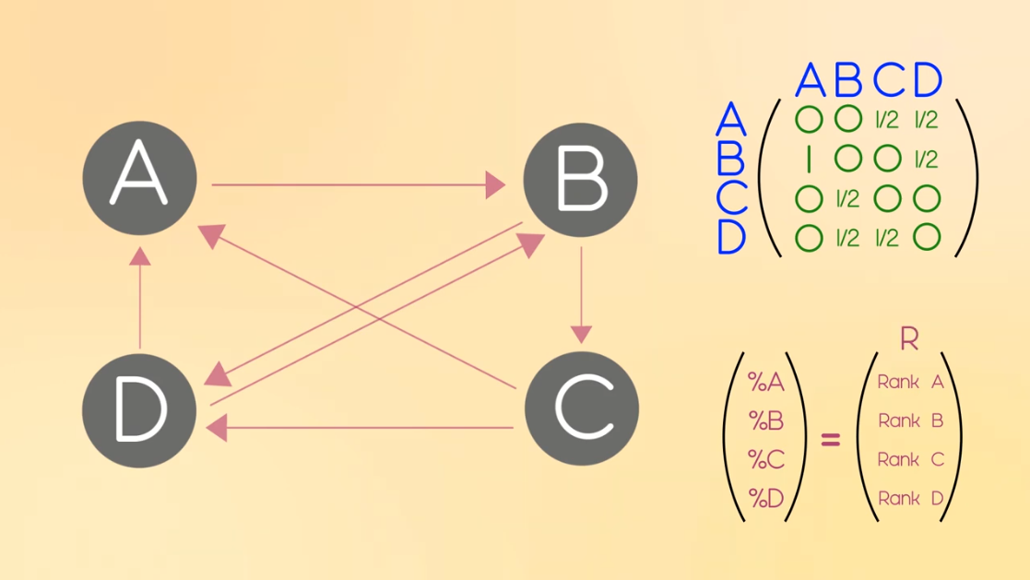
Matrix (R):

Slide 35
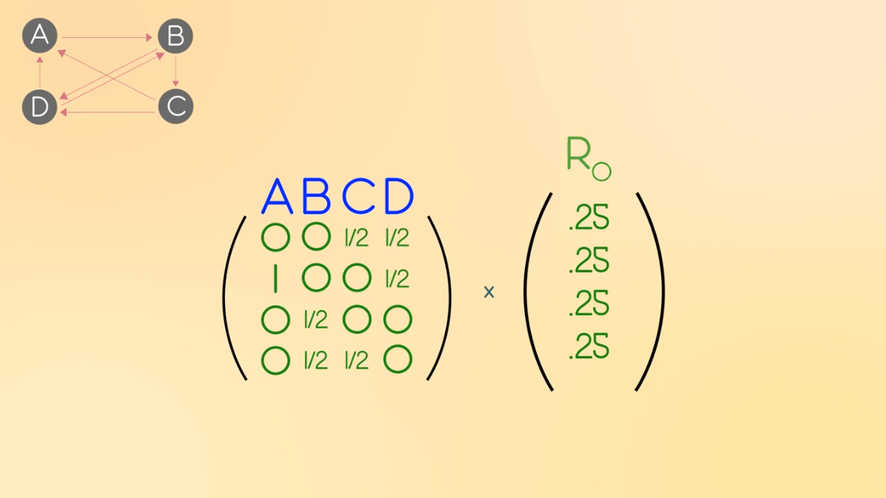
Matrix:

Slide 36
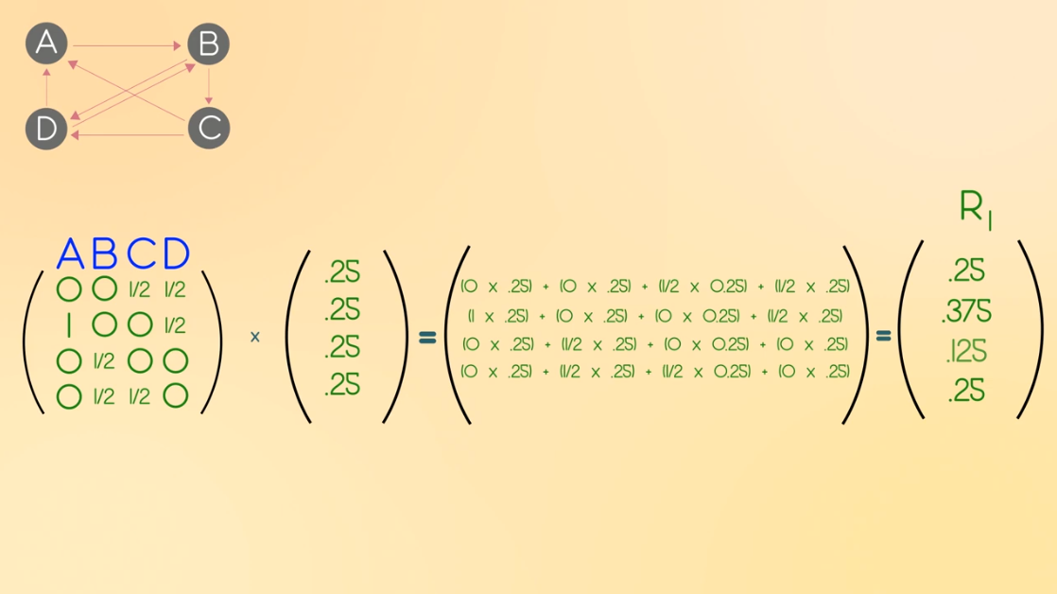
Matrix:

Slide 37
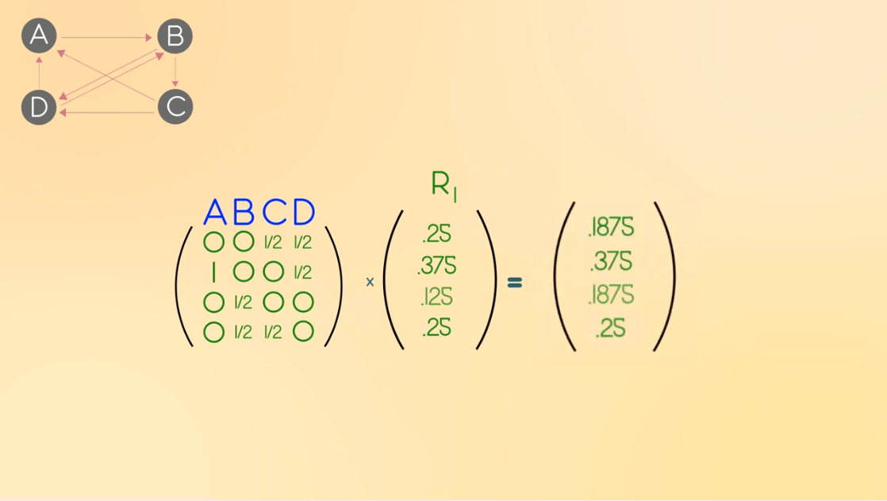
Matrix:

Slide 38
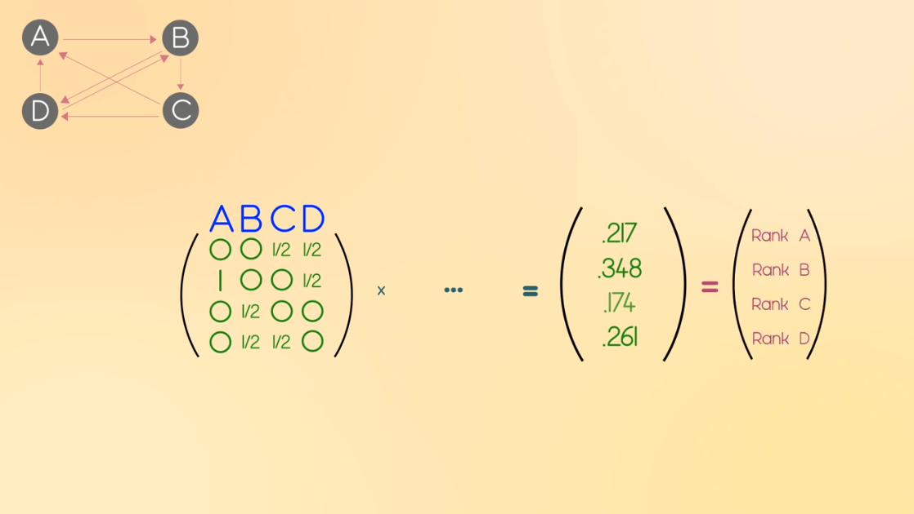
Iteration

Slide 39
Convergence:

Slide 40
Different configurations which affect the PR of Homepage?

Slide 41
Principle
It doesn’t matter where you start your guess, once the PageRank calculations have settled down, the “normalized probability distribution” (the average PageRank for all pages) will be 1.0

Slide 42
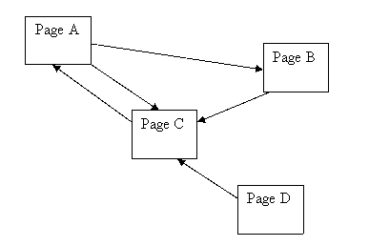
Example 1

Slide 43
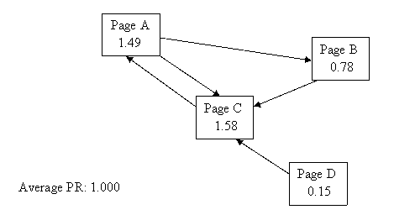
Example 1
Average PR=1
Page D has PR of 0.15 even though no-one is voting for it i.e. it has no incoming links.

Slide 44
The first part, or "term" to be technical, of the PR equation is doing this:
PR(A) = (1-d) + d (PR(T1)/C(T1) + ... + PR(Tn)/C(Tn))
So, for Page D with no inlinks:
PR(A) = (1-d) + d*(0)
PR(A) = 0.15

Slide 45
Observation
Every page has at least a PR of 0.15 to share out.

Slide 46
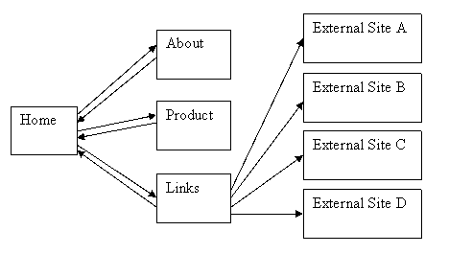
Example 2
A simple hierarchy with some outgoing links.

Slide 47
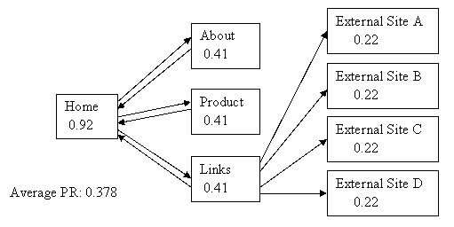
Example 2
Home page has most PR as expected.
But what’s happened to the average?

Slide 48
Example 2
Home page has most PR as expected.
But what’s happened to the average?
It’s only 0.378!!!

Slide 49
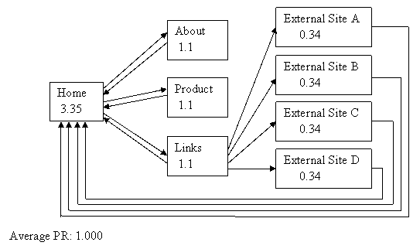
Example 2
Let’s link those external sites back into our home page just so we can see what happens to the average…

Slide 50
Example 2
Average PR = 1
That’s better - it does work after all! And look at the PR of our home page! All those incoming links sure make a difference.

Slide 51
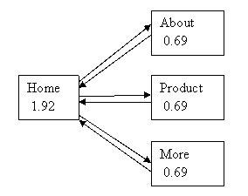
Example 3
A simple hierarchy

Slide 52
Example 3
Our home page has 2 and a half times as much PR as the child pages!

Slide 53
Observation:
A hierarchy concentrates votes and PR into one page.

Slide 54
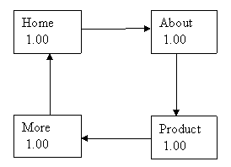
Example 4
Looping

Slide 55
Example 4
All the pages have same number of incoming links.
All pages are of equal importance to each other.
Average PR = 1

Slide 56
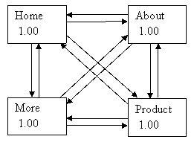
Example 5
Extensive Interlinking – or Fully Meshed.

Slide 57
Example 5
All the pages have same number of incoming links.
Average PR = 1

Slide 58
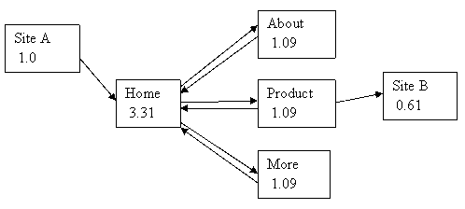
Example 6
Hierarchical – but with a link in and a link out.

Slide 59
Example 6
External site A has PR of 1.0
Webmaster of site A likes us and there’s just one link from that page and it’s pointing at our home page.

Slide 60
Example 6
PR of Home page = 3.31
Site A contribute 0.85 PR to our web from example 3.
Which raised PR of “Home”, “Amount”, “Product” and “More” by significant amounts.

Slide 61
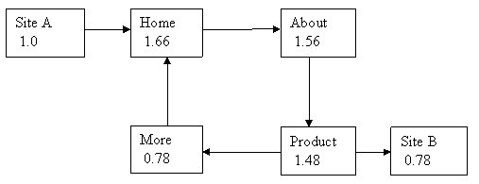
Example 7
Looping - but with a link in and a link out.

Slide 62
Example 7
PR of home page has gone up a little.
But what about “More” page?

Slide 63
Example 7
PR of home page has gone up a little.
But what about “More” page?
The vote of the “Product” page has been split evenly between it and the external site B.
Not good for us.

Slide 64
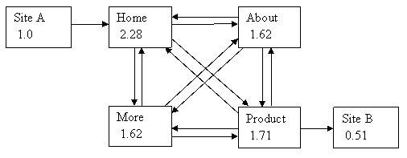
Example 8
Fully meshed – but with a link in and a link out.

Slide 65
Example 8
The “More” page is still getting less share of the vote than in example 5.
But now the “Product” page has kept three quarters of its vote within our site.

Slide 66
Observation
Increasing the internal links in your site can minimise the damage to your PR when you give away votes by linking to external sites.

Slide 67
Principle:
If a particular page is highly important – use a hierarchical structure with the important page at the “top”.

Slide 68
Principle:
If a particular page is highly important – use a hierarchical structure with the important page at the “top”.
Where a group of pages may contain outward links – increase the number of internal links to retain as much PR as possible.

Slide 69
Principle:
If a particular page is highly important – use a hierarchical structure with the important page at the “top”.
Where a group of pages may contain outward links – increase the number of internal links to retain as much PR as possible.
Where a group of pages do not contain outward links – the number of internal links in the site has no effect on the site’s average PR. You might as well use a link structure that gives the user the best navigational experience.

Slide 70
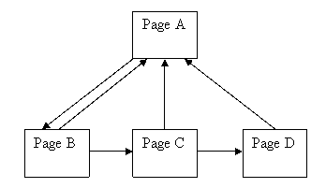
Example 9
Lets try to fix our site to concentrate the PR into the home page.
That looks good, most of the links seem to be pointing up to page A so we should get a nice PR.

Slide 71
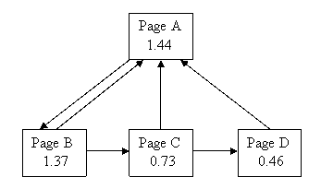
Example 9
That didn’t work at all well!
What’s going on is that pages C and D have such weak incoming links that they’re no help to page A at all.

Slide 72
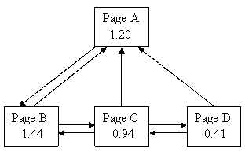
Example 9
A common web layout for long documentation is to split the document into many pages with a “Previous” and “Next” link on each plus a link back to the home page.
The home page then only needs to point to the first page of the document.

Slide 73
Example 9
We can observe that the first page of the document has a higher PR than the Home Page!
This is because page B is getting all the vote from page A, but page A is only getting fractions of pages B, C and D.

Slide 74
Principle:
In order to give users of your site a good experience, you may have to take a hit against your PR.
If your site is a pleasure to use then lots of other webmasters will link to it and you’ll get back much more PR than you lost.

Slide 75
How can we get high PR ?
The wrong and the right way

Slide 76
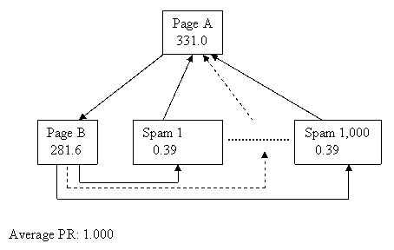
The wrong way...
Let’s see if we can get 1,000 pages pointing to our home page, but only have one link leaving it.
What will happen?

Slide 77
The wrong way...
PR of home page i.e. page A is 331.0 which is very high.
These type of pages are spam pages having high PR.
This is a technique used by some disreputable sites (mostly adult content sites).

Slide 78
Observation:
It doesn’t matter how many pages you have in your site, your average PR will always be 1.0 at best. But a hierarchical layout can strongly concentrate votes, and therefore the PR, into the home page!

Slide 79
The right way...
Be a Mega-site
Eg https://news.bbc.co.uk
Principle: Content Is King! There really is no substitute for lots of good content…

Slide 80
The right way...
Give away something useful
www.phpbb.com has a Toolbar PR of 8/10 and it has no big money or marketing behind it! How can this be?
This site contains open source bulletin board software which is free to use.

Slide 81
The right way...
Give away something useful
What the group has done is write a very useful bulletin board system that is becoming very popular on many websites. And at the bottom of every page, in every installation, is this HTML code:
Powered by <a href="https://www.phpbb.com/" target="_blank">phpBB</a>
The administrator of each installation can remove that link, but most don’t because they want to return the favour…
Can you imagine all those millions of pages giving a fraction of a vote to www.phpbb.com? Wow!

Slide 82
Principle:
Make it worth other people’s while to use your content or tools. If your giveaway is good enough other site admins will gladly give you a link back.
It’s probably better to get lots (perhaps thousands) of links from sites with small PR than to spend any time or money desperately trying to get just the one link from a high PR page.

Slide 83
Convergence of the PageRank Algorithm
Perron-Frobenius Theorem:
The Perron-Frobenius Theorem states that for any column-stochastic matrix with positive entries, we can always find 1 as an eigenvalue, and all other eigenvalues have magnitude strictly less than 1. Moreover, 1 is a simple eigenvalue (“simple” means that 1 is a root, but not a repeated root, of the characteristic polynomial.)

Slide 84
Convergence continued..
The matrix M is column-stochastic by the design of pagerank algorithm and have all the entries positive.
Let λ_{i} , for i = 1, 2, . . . , N be the eigenvalues of the matrix M, sorted in decreasing order of absolute values.
By Perron-Frobenius theorem, we have

Slide 85
Convergence continued..
We make a simplifying assumption that all eigenvalues are distinct, i.e., we can find N distinct eigenvalues for the N × N matrix M.
Using the fact from linear algebra that if the eigenvalues of a matrices are distinct, we can find an eigenvector for each of the N eigenvalues, and the N eigenvectors are linearly independent.
Let v_{i} , for i = 1, 2, . . . , N, be the eigenvectors, corresponding to the eigenvalues λ_{i}, respectively.

Slide 86
Convergence continued..
Let P be an N × N matrix with the j-th column equal to v_{j} , for j = 1, 2, . . . , N,
Since the column of P are linearly independent, the determinant of P is non-zero, and hence the inverse of P exists.
Let D be a diagonal matrix, whose diagonal entries are the eigenvalues λ_{i} ,

Slide 87
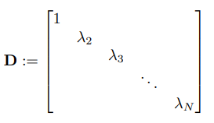
Convergence continued..
We can put the defining equation of eigenvectors, Mv_{i} = λ_{i}v_{i} , for i = 1, 2, . . . , N, together in a single matrix equation
Or equivalently

Slide 88
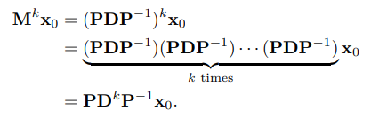
Convergence continued..
Let x₀ be the initial pagerank vector. The pagerank vector after k iterations is given by
When k → ∞

Slide 89
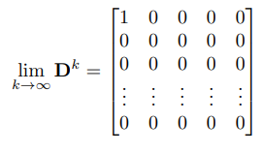
Convergence continued..
After running the Pagerank algorithm for a long time, the pagerank vector will converge to

Slide 90
Convergence continued..
which is a scalar multiple of the eigenvector v₁.
Hence, we can conclude that the Pagerank with damping factor, under the assumption that all eigenvalues of M are distinct, converges to an eigenvector corresponding to the largest eigenvalue λ₁ = 1.

Slide 91
Modifications

Slide 92
Example 1

Slide 93
Example 1
 | A | B | C | D
A | 0 | 0 | 1 | 0
B | 1/2 | 0 | 0 | 0
C | 1/2 | 1 | 0 | 1
D | 0 | 0 | 0 | 0

Slide 94
Example 1
 | A | B | C | D
A | 0 | 0 | 1 | 0
B | 1/2 | 0 | 0 | 0
C | 1/2 | 1 | 0 | 1
D | 0 | 0 | 0 | 0

Slide 95
PR(A) = (1-d) + d (PR(T1)/C(T1) + ... + PR(Tn)/C(Tn))
So, for Page D with no inlinks:
PR(D) = (1-d) + d*(0)
PR(D) = 0.15

Slide 96
Example 2
Here the Average PR is 0.378 How is this possible!!!
Dangling Pages: No Outgoing Links

Slide 97
Dangling Page
4 is the dangling Page and 6 is the dummy node. (Just An example not same as example given before.)

Slide 98
Dangling Page
Here 1/N is used to handle dangling pages. (values used here are different, Only to demonstrate handling of dangling Pages.)

Slide 99
Weighted Page Rank
 | A | B | C | D
A | 0 | 0 | 1/2 | 1/2
B | 1 | 0 | 0 | 1/2
C | 0 | 1/2 | 0 | 0
D | 0 | 1/2 | 1/2 | 0

Slide 100
Weighted Page Rank
 | A | B | C | D
A | 0 | 0 | 1/2 *w13 | 1/2 *w14
B | 1 *w21 | 0 | 0 | 1/2 *w24
C | 0 | 1/2 *w32 | 0 | 0
D | 0 | 1/2 *w42 | 1/2 *w43 | 0

Slide 101
Modified PageRank Formula
PR(A) = (1-d) + d (PR(T1)×L(T1,A) + ... + PR(Tn)×L(Tn,A))
Here, L(Ti,A) represents the evaluation of a link which points from page Ti to page A

Slide 102
Modifications - Summing Up
d - Damping Factor
Dangling Pages
Weighted Formula for PageRank
This was thought of along with the original algorithm.
The best method to cater to these pages is to assume they connect to every page.
Most Accurate we know of Although Calculating how to weigh pages can prove to be a vast field in itself.

Slide 103
Applications

Slide 104
Biology and Medicine
NeuroScience
Protein
Pharmaceutical Industry
Cancer

Slide 105
Impact of Science Papers
P. Chen, H. Xic, S. Maslov and S. Rodner: Finding scientific gems with Google’s PageRank algorithm,doi:10.1016/j.joi.2006.06.001

Slide 106
Remember Movie Recommendation Project
http://www.algorithm.co.il/blogs/computer-science/pagerank-recommends-movies/

Slide 107
Google and Google’s Page Rank

Slide 108
Where is Google today with this
Factors other than the links
How does this relate to google itself!

Slide 109
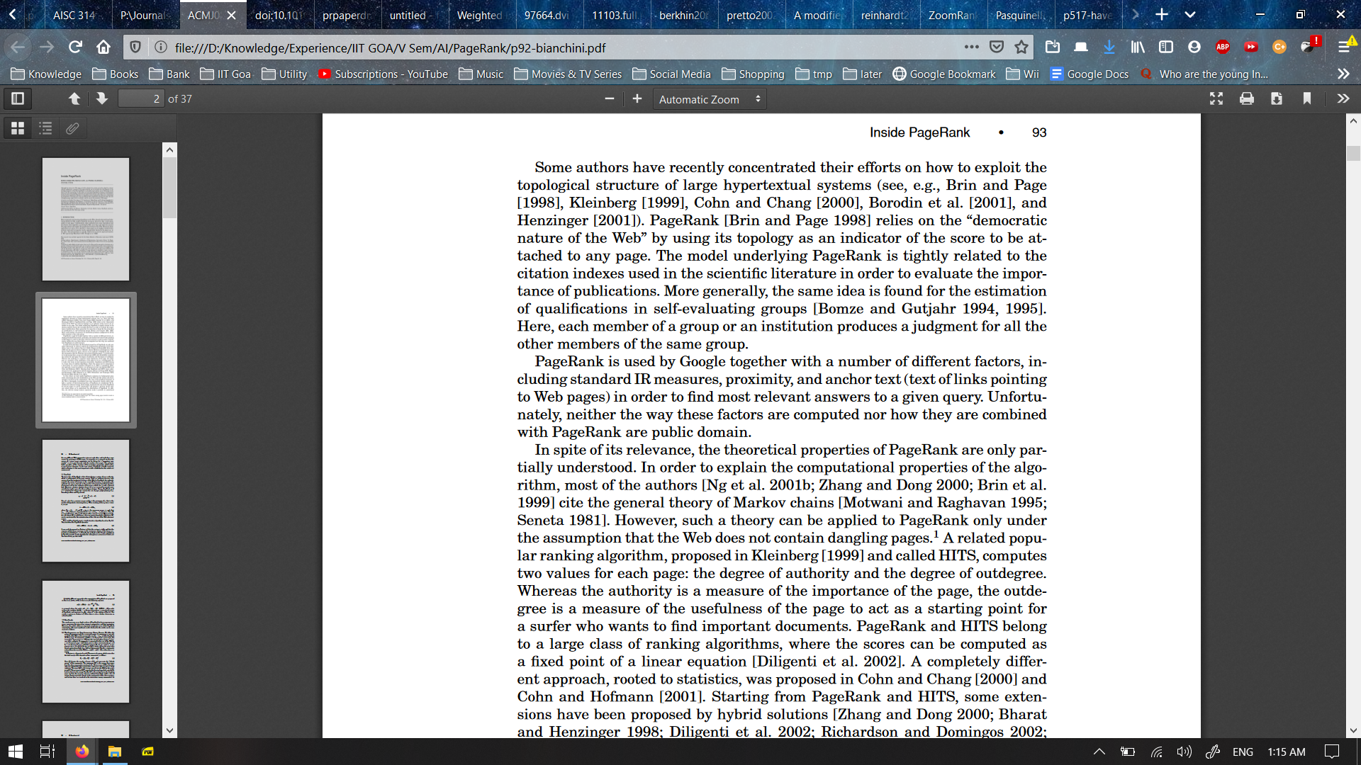

Slide 110
Modified PageRank Formula
PR(A) = (1-d) + d (PR(T1)×L(T1,A) + ... + PR(Tn)×L(Tn,A))
Here, L(Ti,A) represents the evaluation of a link which points from page Ti to page A

Slide 111
References
David Austin: How Google Finds Your Needle in the Web's Haystack, feature column monthly essays on mathematical Topics.
S. J. Kim and S. H. Lee: An Improved Computation of the PageRank Algorithm
Zhang Q.: A modified PageRank algorithm for biological pathway ranking.Stat. 2018;7:e204.https://doi.org/10.1002/sta4.204
T. H. Haveliwala: Topic-Sensitive PageRank.
D. F. Gleich: PageRank Beyond the Web 2015, SIAM REVIEW Vol. 57, No. 3, pp. 321–3632015, Society for Industrial and Applied Mathematics
https://www.cs.princeton.edu/~chazelle/courses/BIB/pagerank.htm
http://pr.efactory.de/e-further-factors.shtml
https://www.youtube.com/watch?v=qxEkY8OScYY
https://home.ie.cuhk.edu.hk/~wkshum/papers/pagerank.pdf

Slide 112
Questions
What is The Time Complexity of PageRank Algorithm?
Find the transformation matrix and the convergence values for the given network.

Slide 113
Answers
Time complexity = O(n^2) where n is the size of the transformation matrix

Slide 114
THANK YOU!!

