Slide 1
Decision Trees for Regression
TEAM 7
ABHINAV KUMAR
PARAS YADAV
RAHUL SALUNKE

Slide 2
Outline
Tree-based Methods
Decision Trees
Regression Trees
Advantages and Disadvantages of using tree-based methods

Slide 3
Tree-based Methods

Slide 4
Basic Idea
Segment the predictor space into sub-regions and we learn from the training set the value to predict as the mean or mode or median of the respond variable of the training examples that are in that segment.

Slide 5
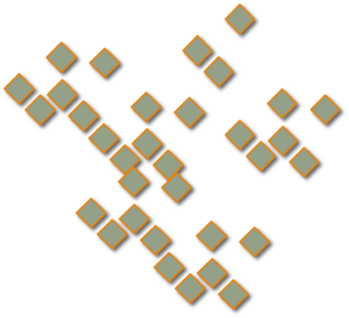
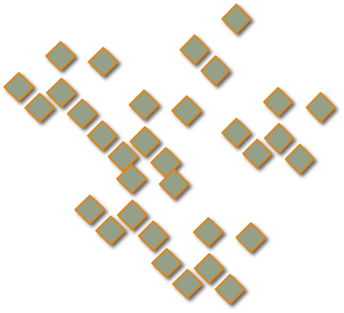
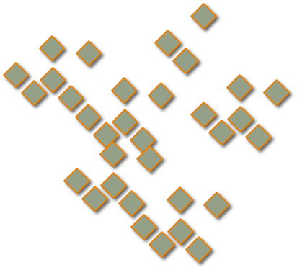
x₂
Region2
Region1
x₂ª
Region3
x₁ª

Slide 6
Outline
Tree-based Methods
Decision Trees
Regression Trees
Advantages and Disadvantages of using tree-based methods

Slide 7
Why Trees?
What would you do tonight? Decide amongst the following:
Finish homework
Go to a party
Read a book
Hang out with friends

Slide 8
Homework Deadline tonight?
Yes
No
Do homework
Party invitation?
Yes
No
Do I have friends
Go to the party
Yes
No
Read a book
Hang out with friends

Slide 9
Why Trees?
We split the predictor space as branches of a tree and therefore these methods are called decision tree methods

Slide 10
Outline
Tree-based Methods
Decision Trees
Regression Trees
Advantages and Disadvantages of using tree-based methods

Slide 12
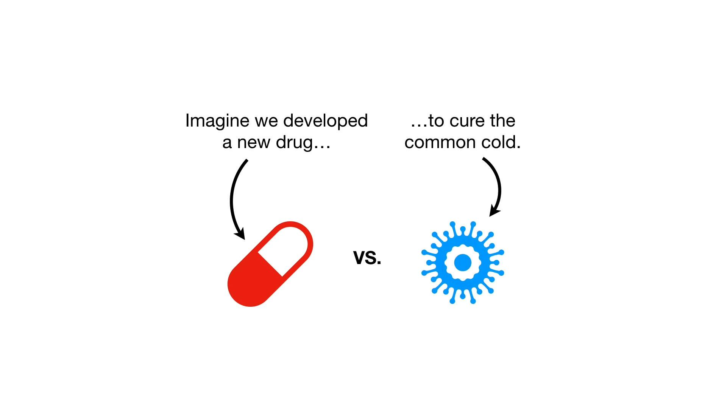

Slide 14
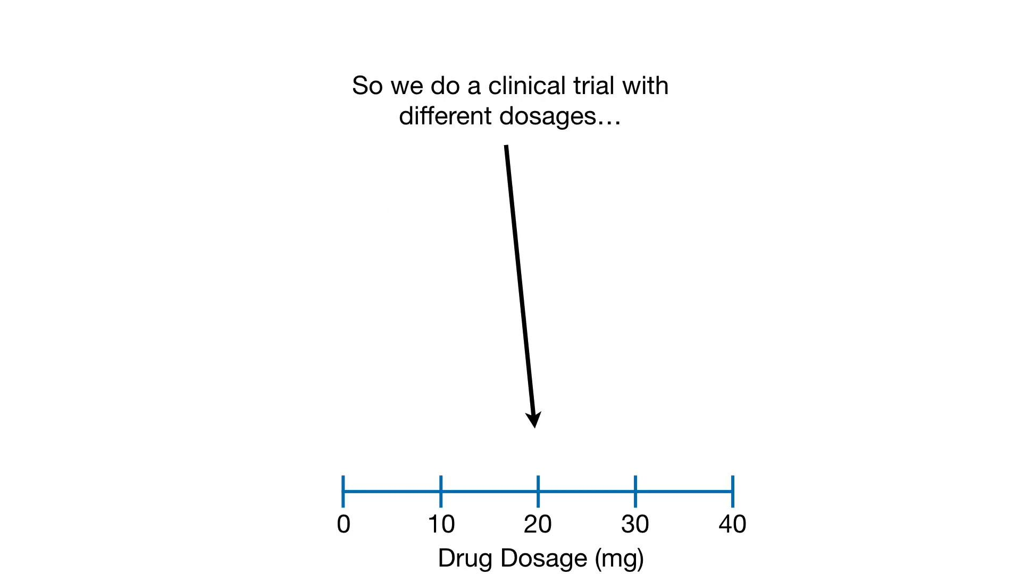

Slide 15
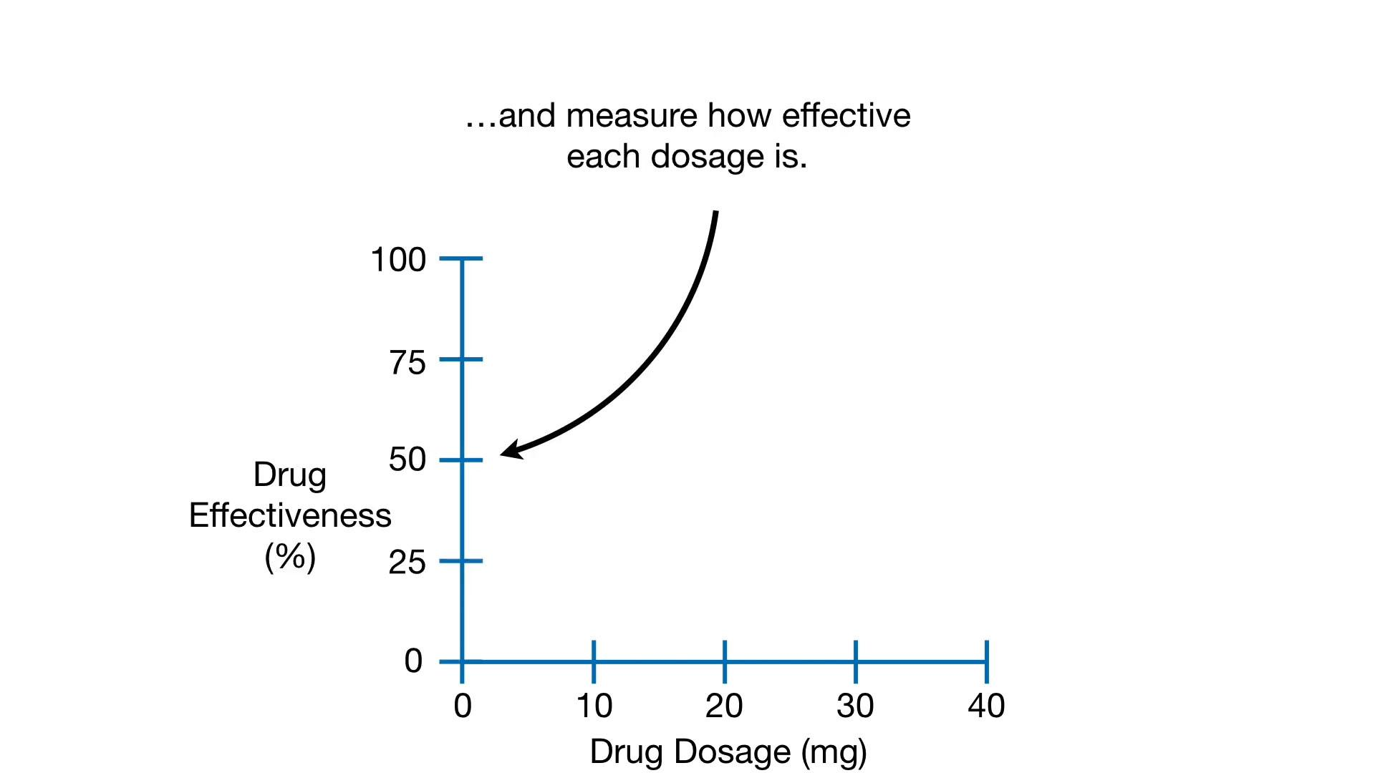

Slide 17
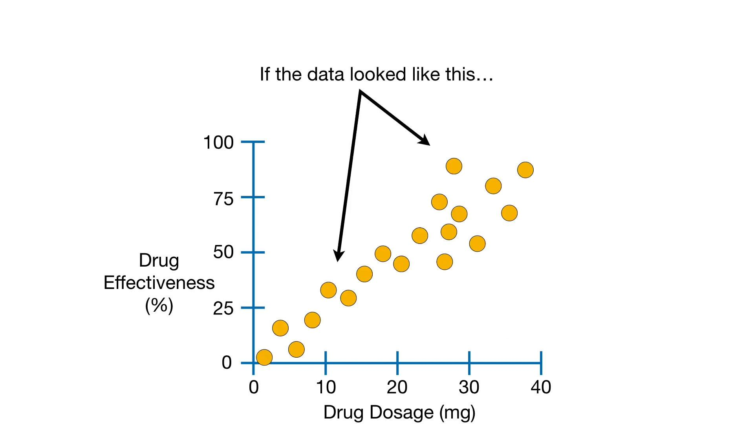

Slide 18
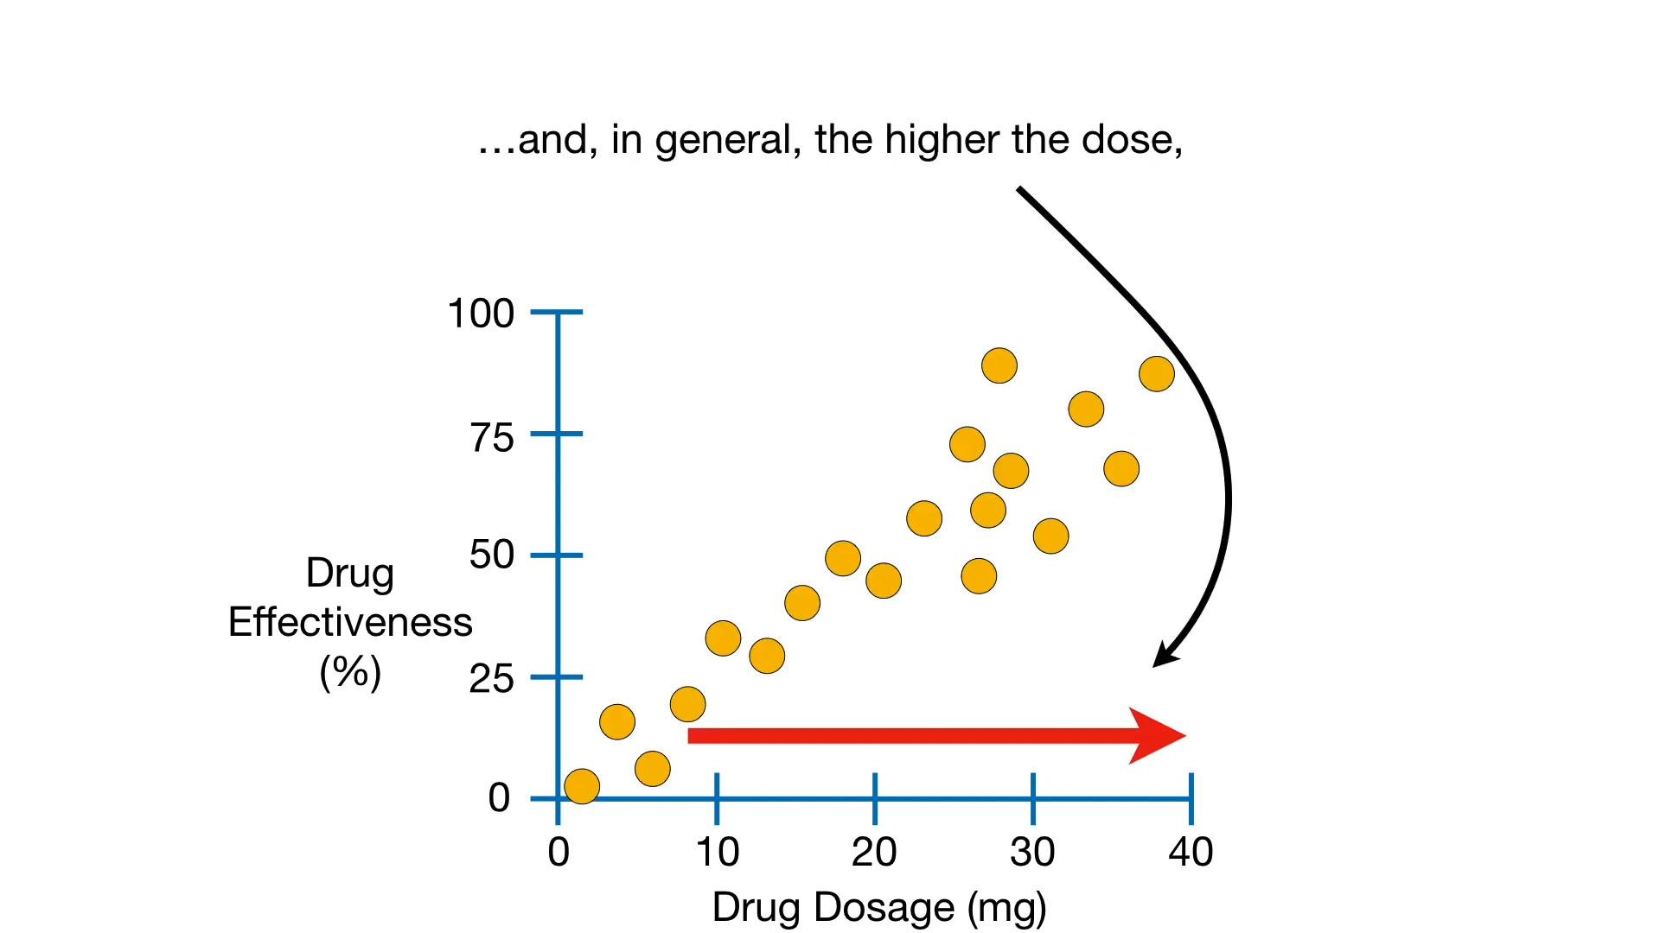

Slide 19
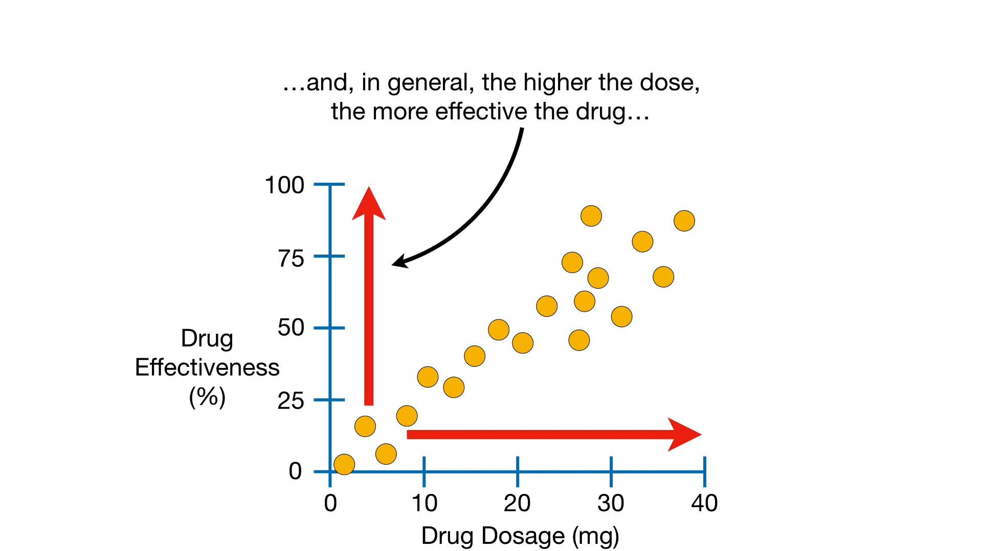

Slide 20
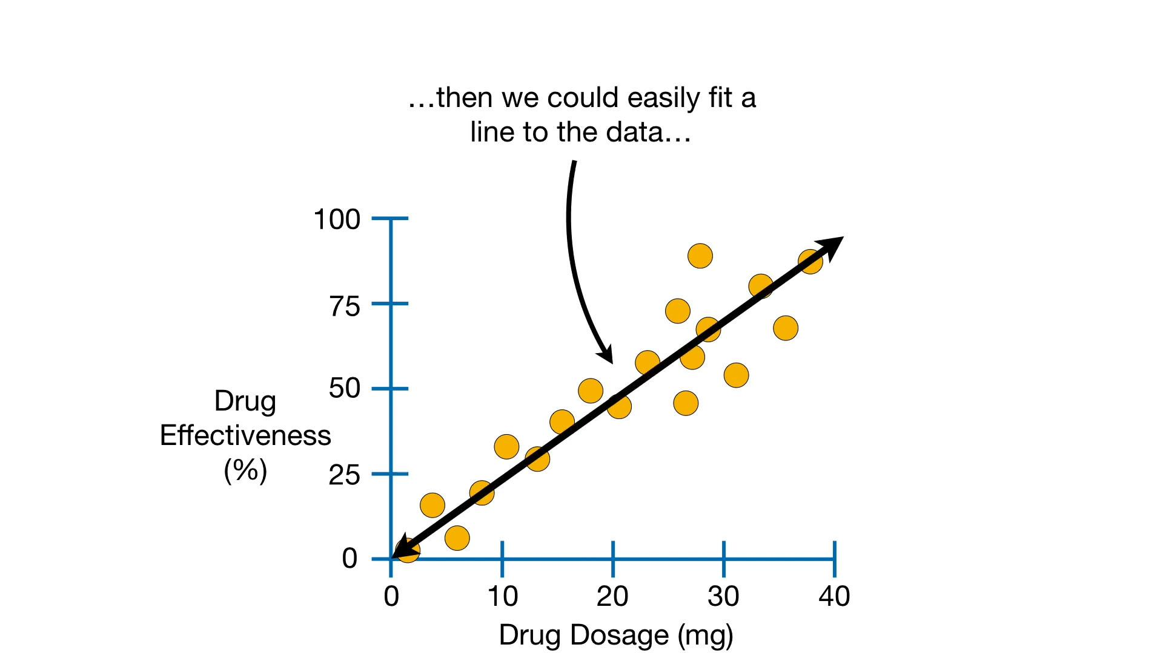

Slide 21
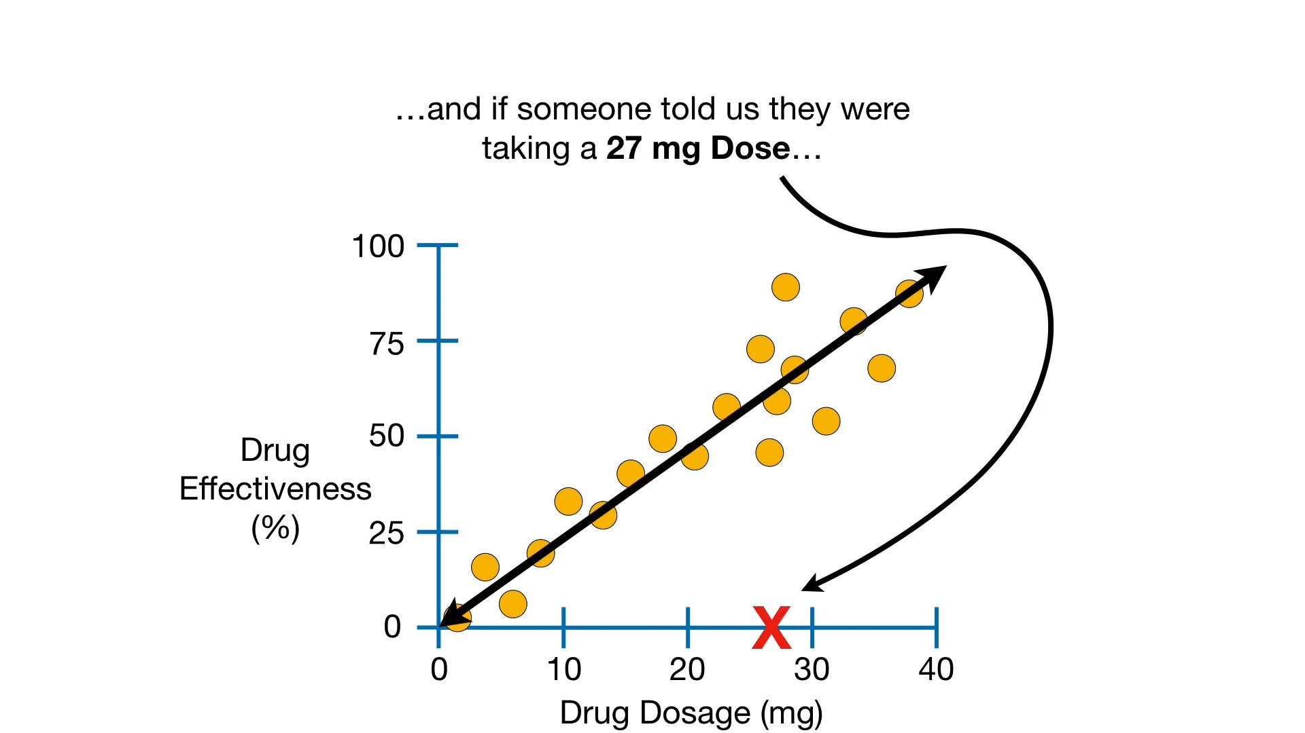

Slide 22
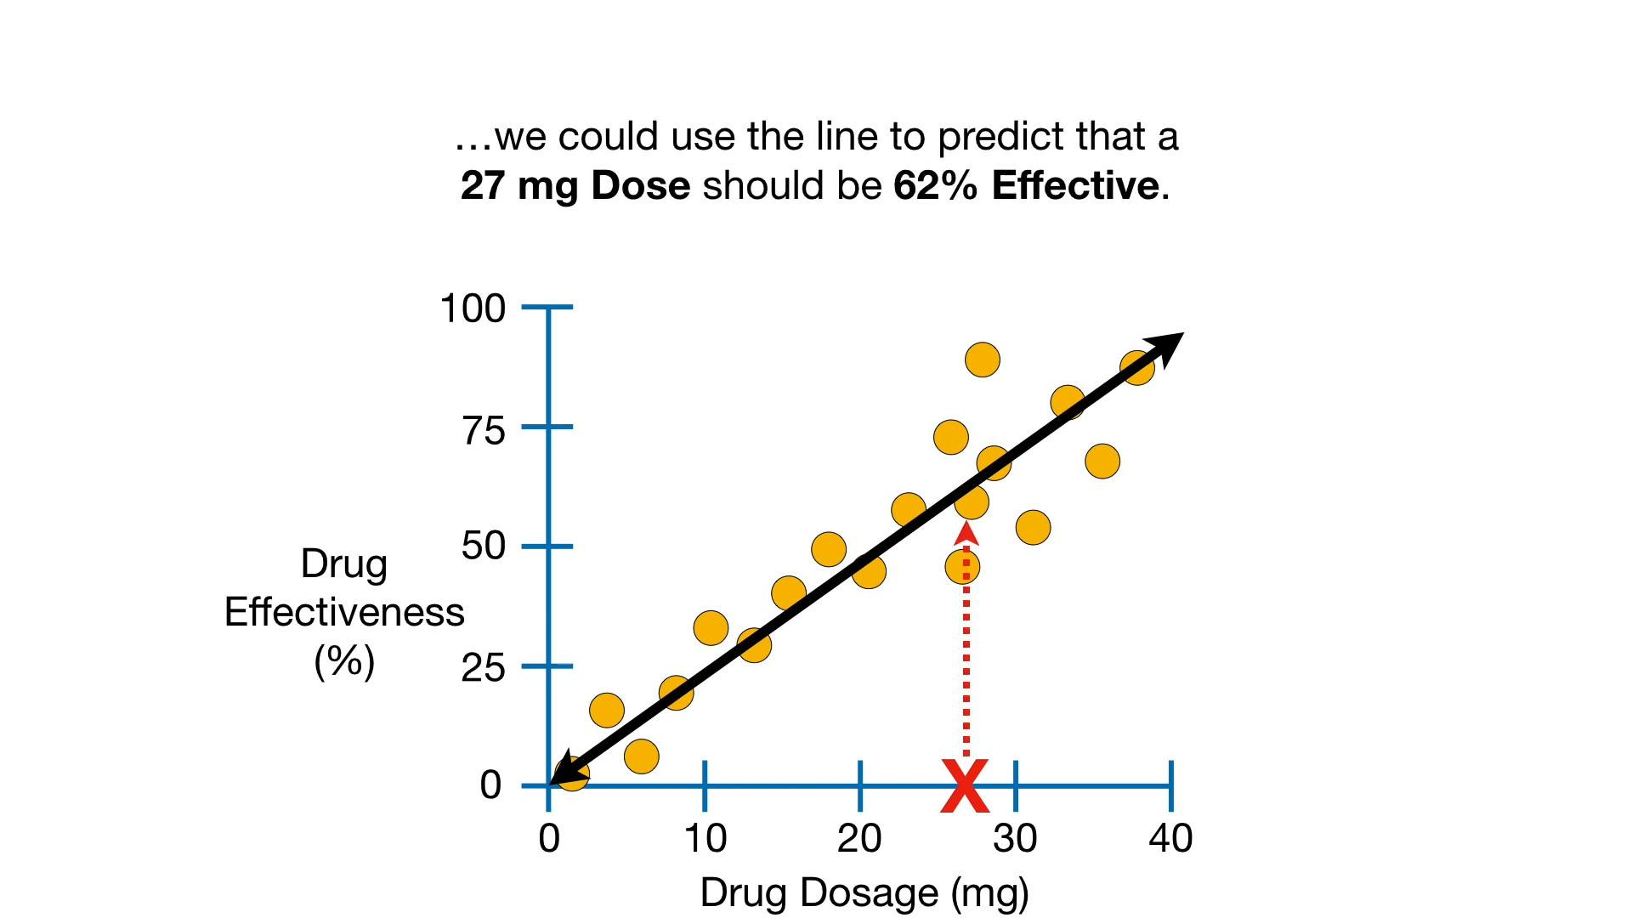

Slide 23
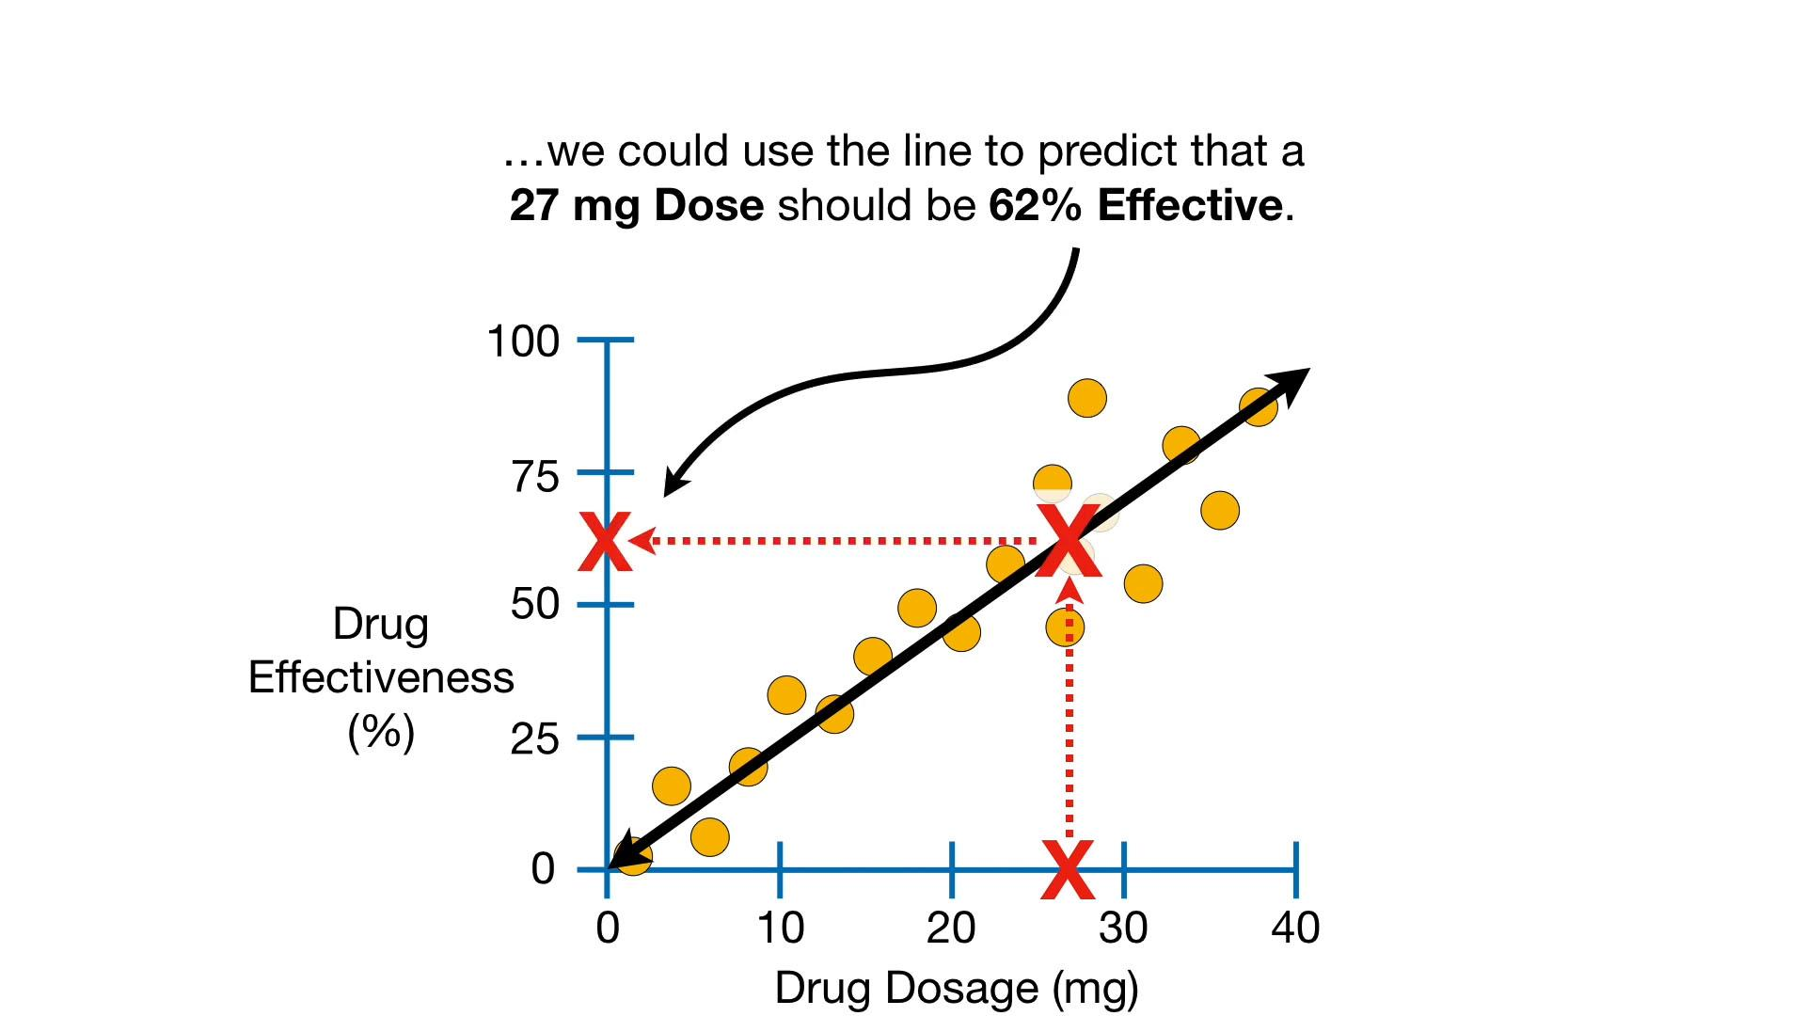

Slide 24
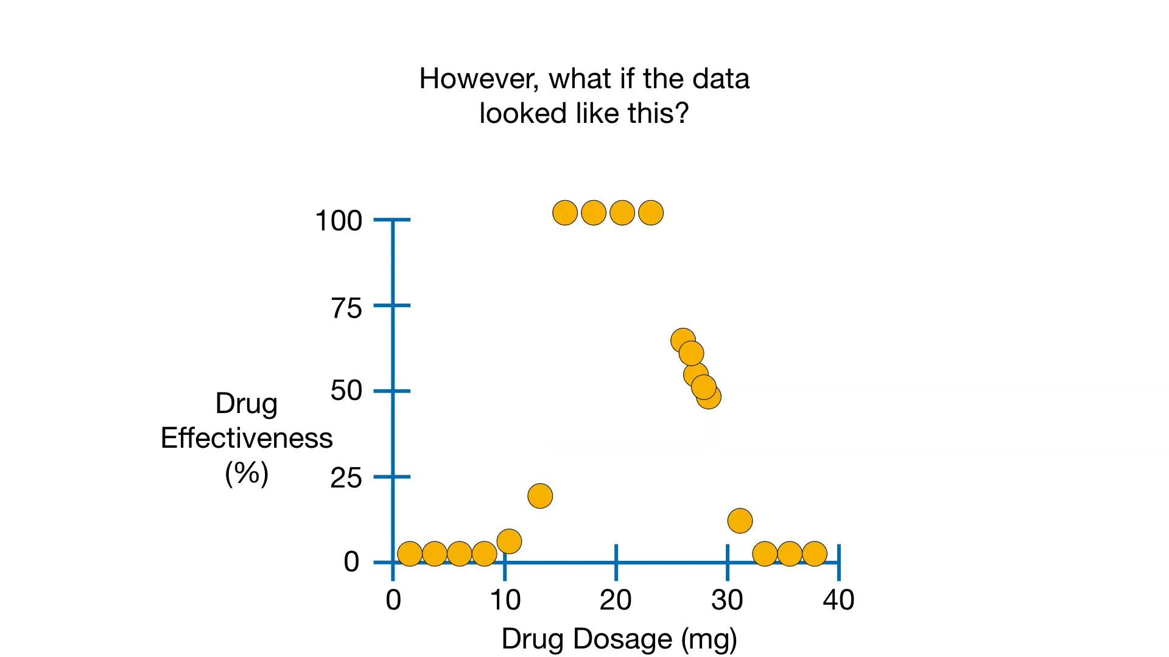

Slide 25
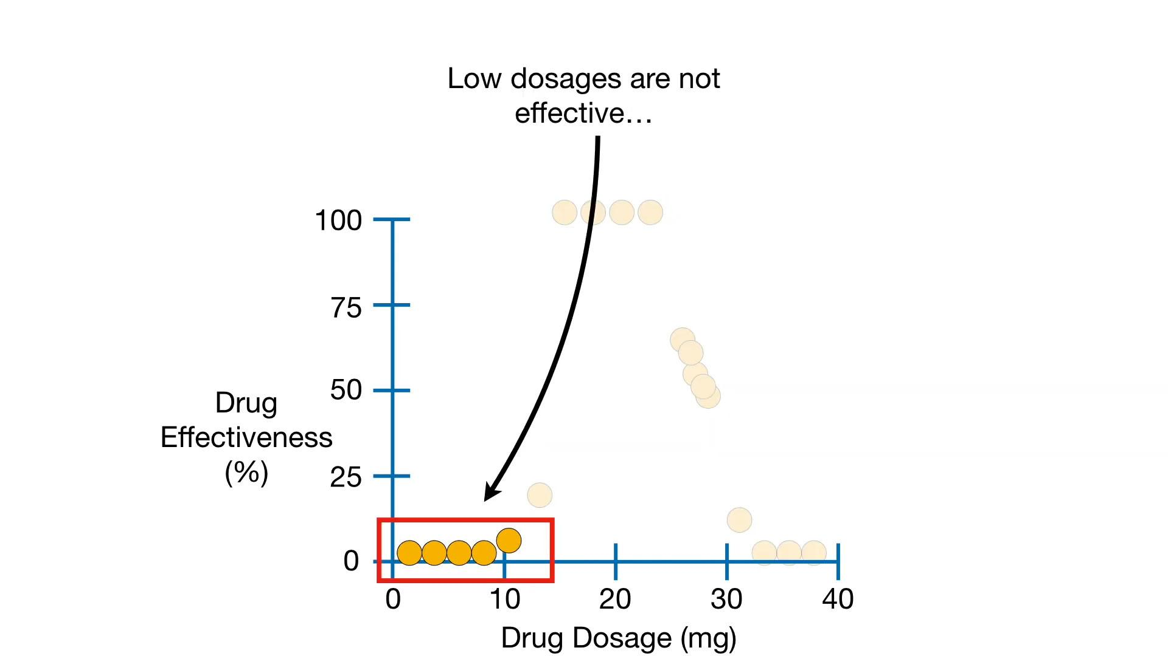

Slide 26
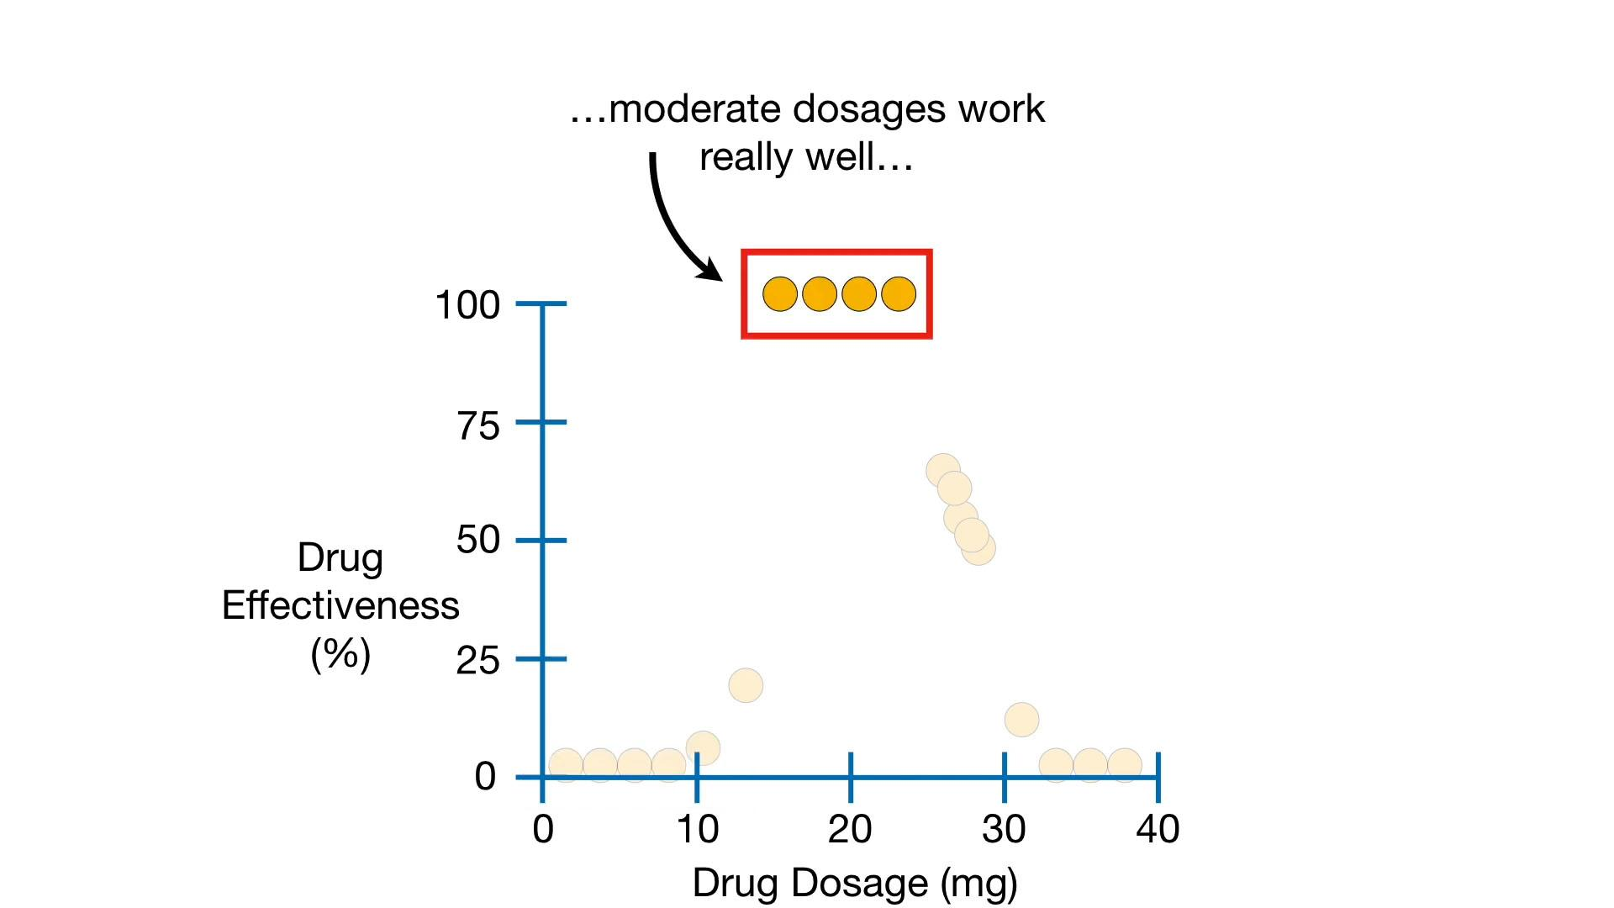

Slide 27
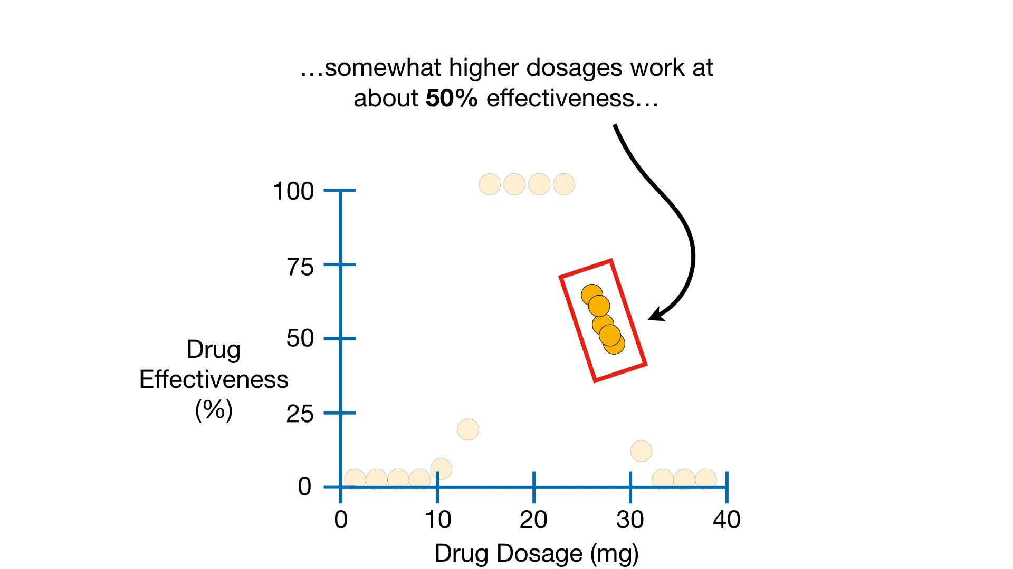

Slide 28
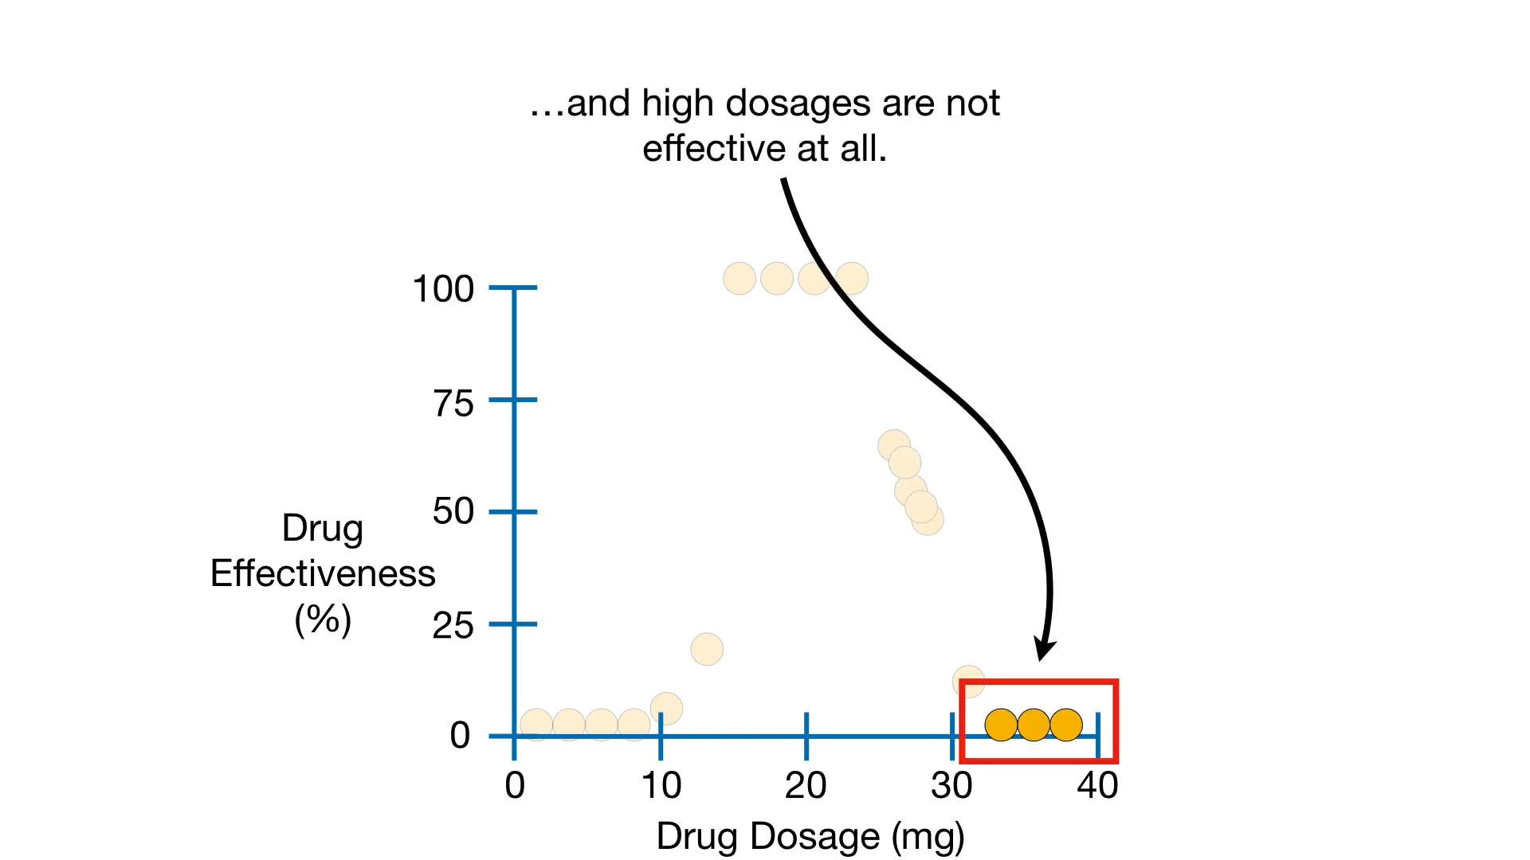

Slide 29
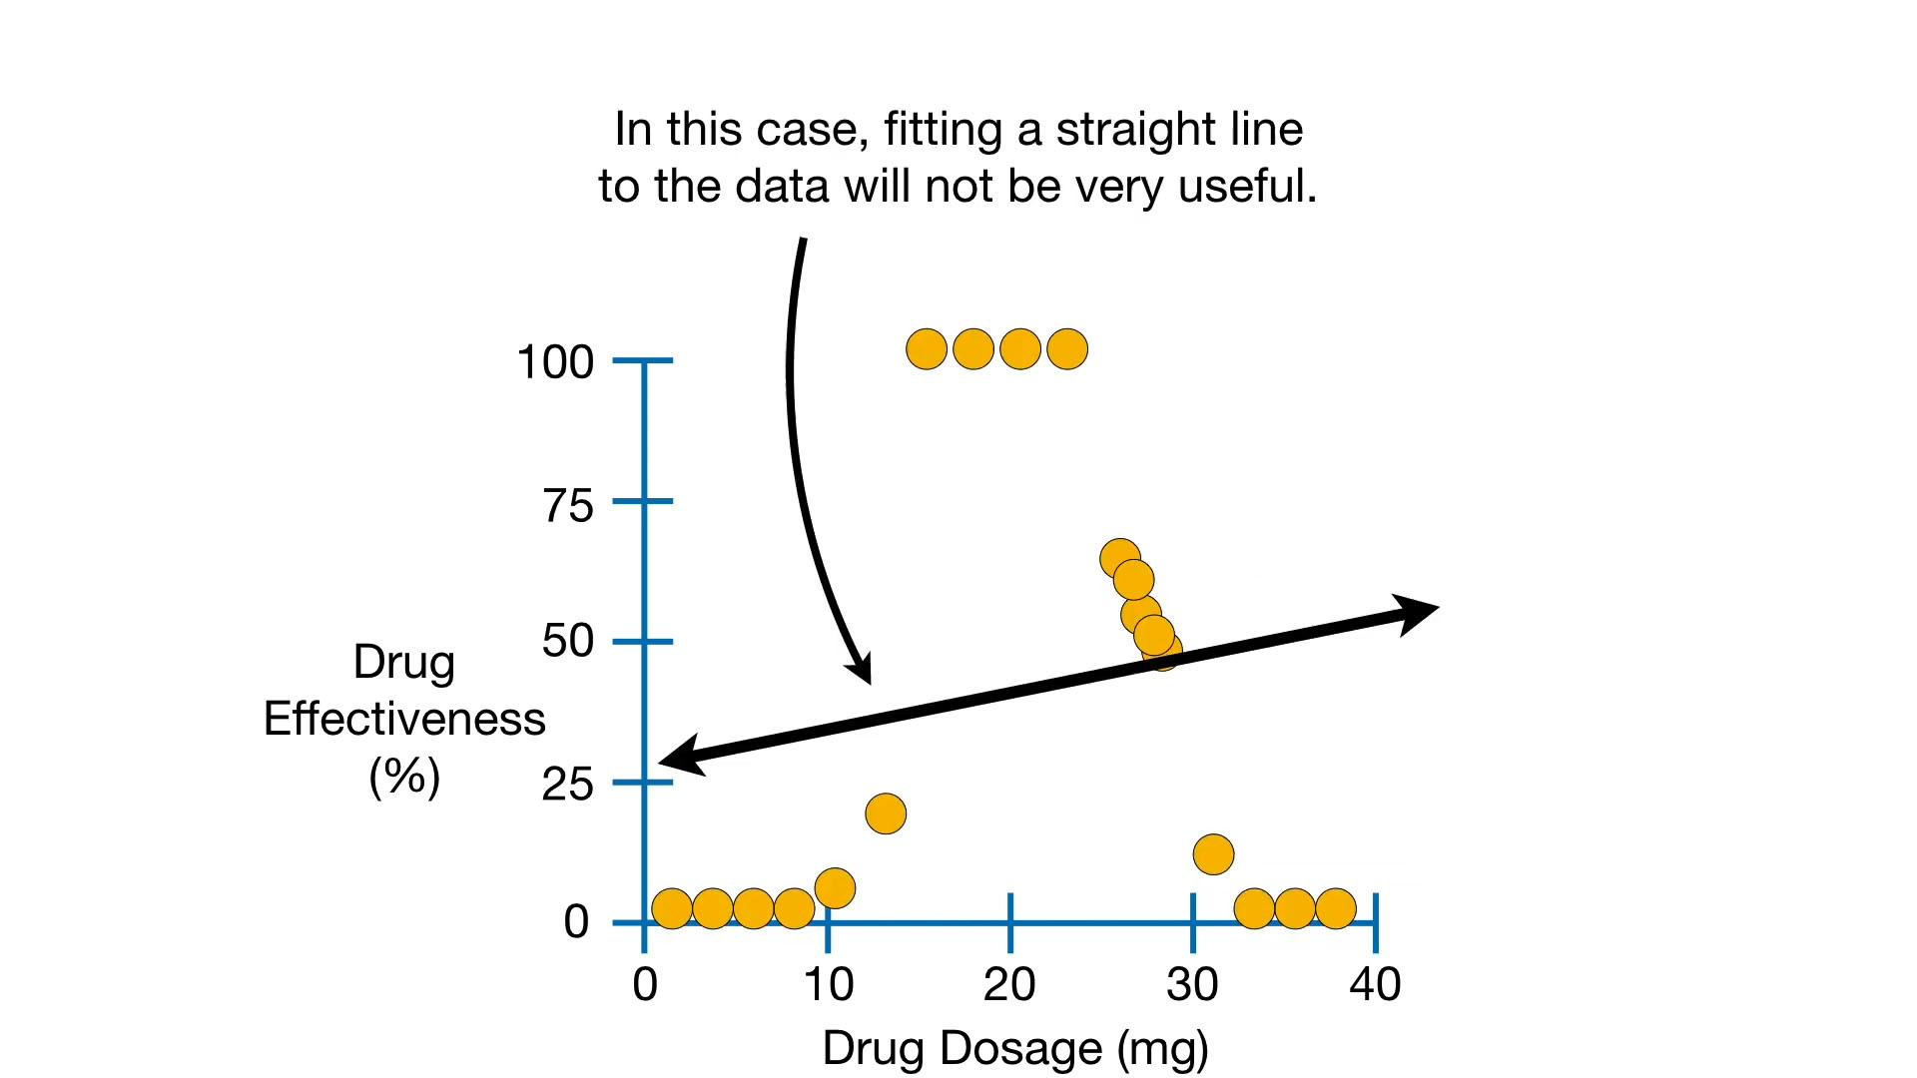

Slide 30
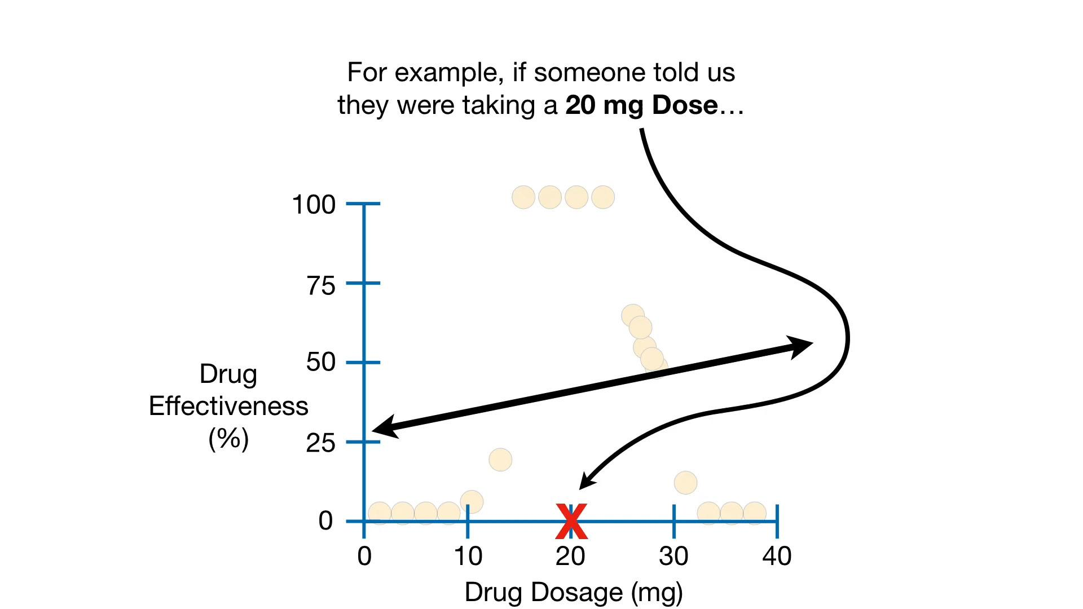

Slide 31
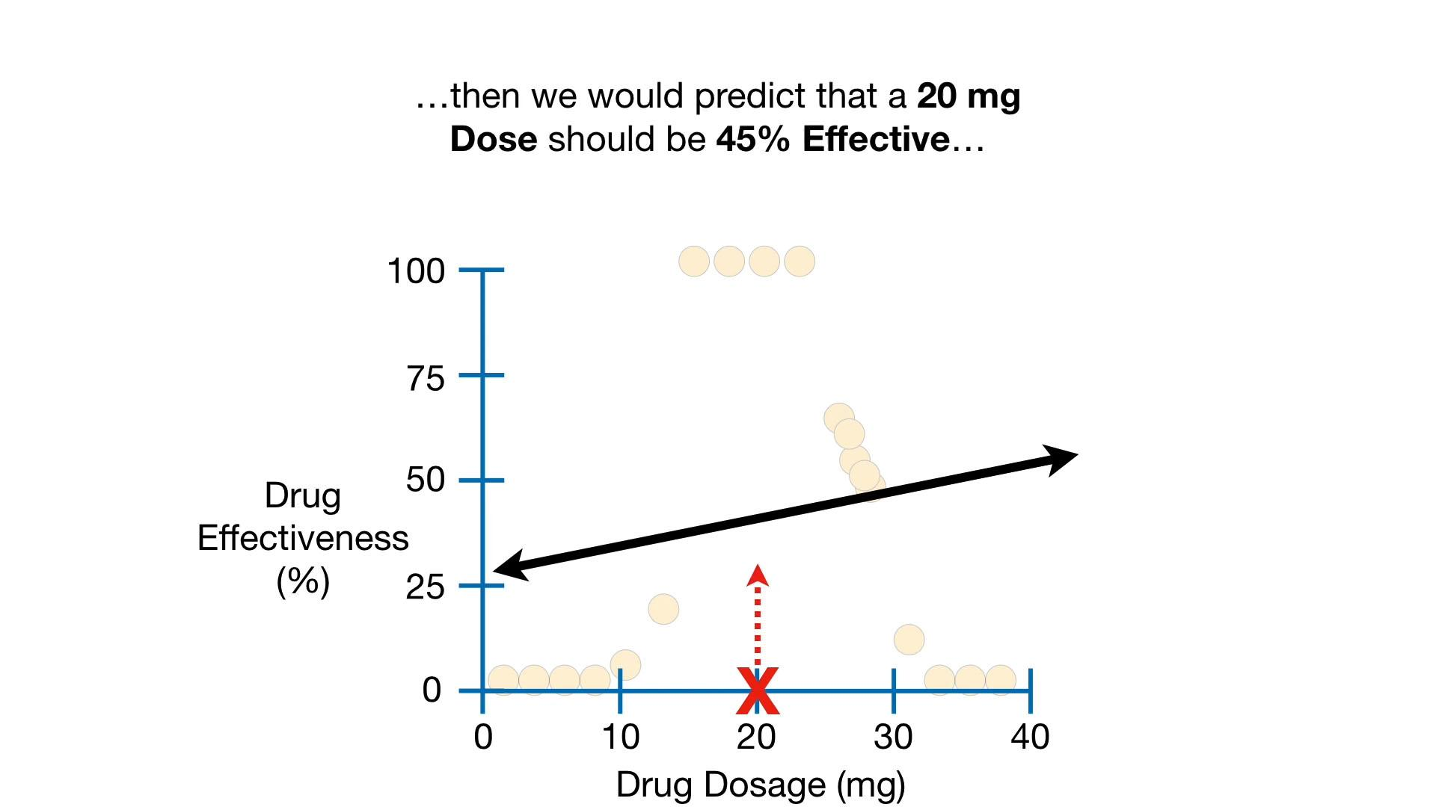

Slide 32
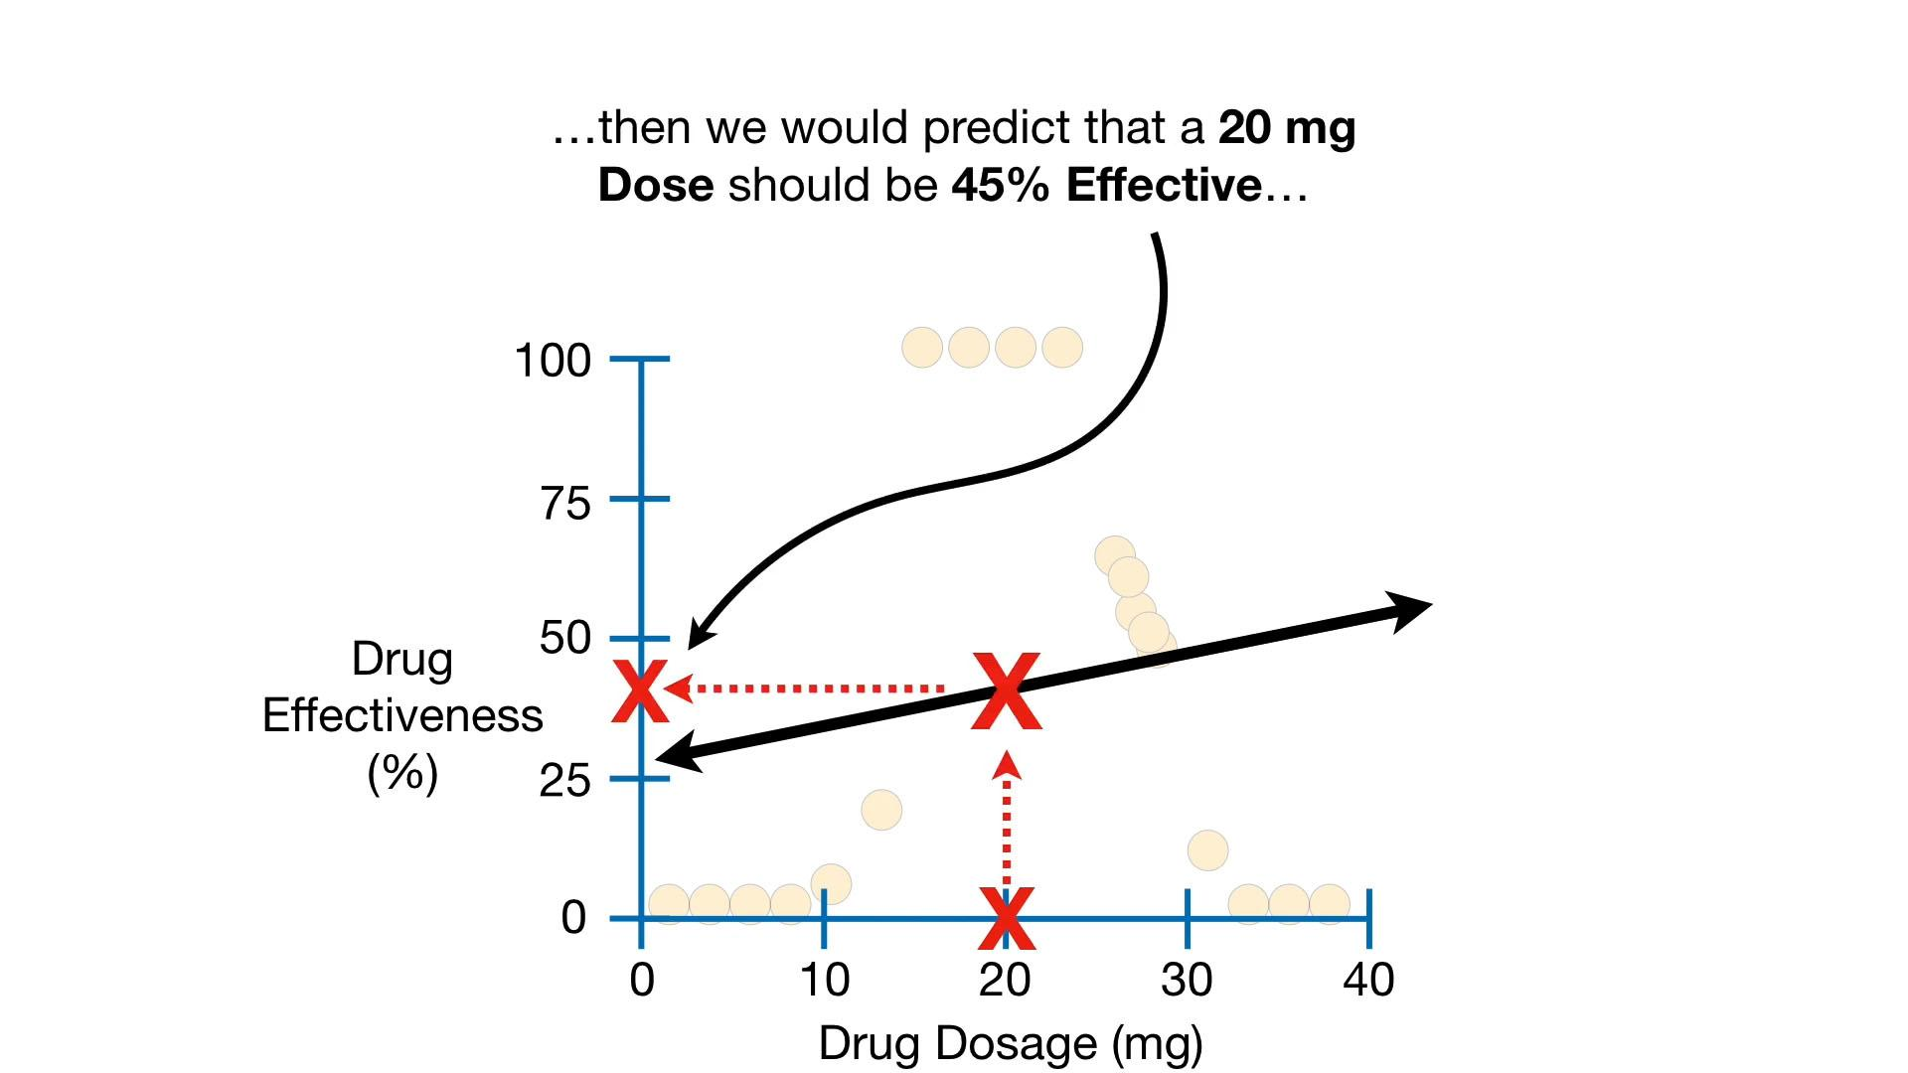

Slide 33
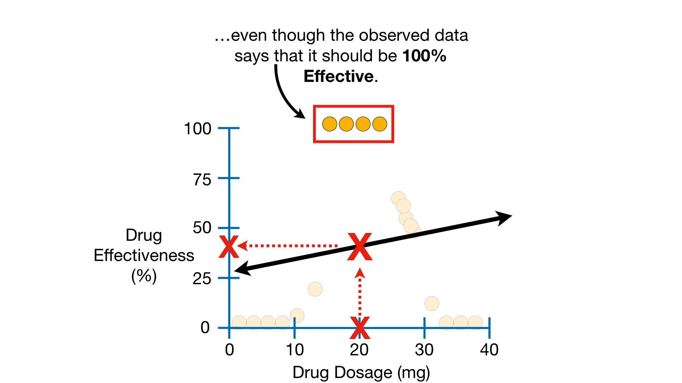

Slide 36
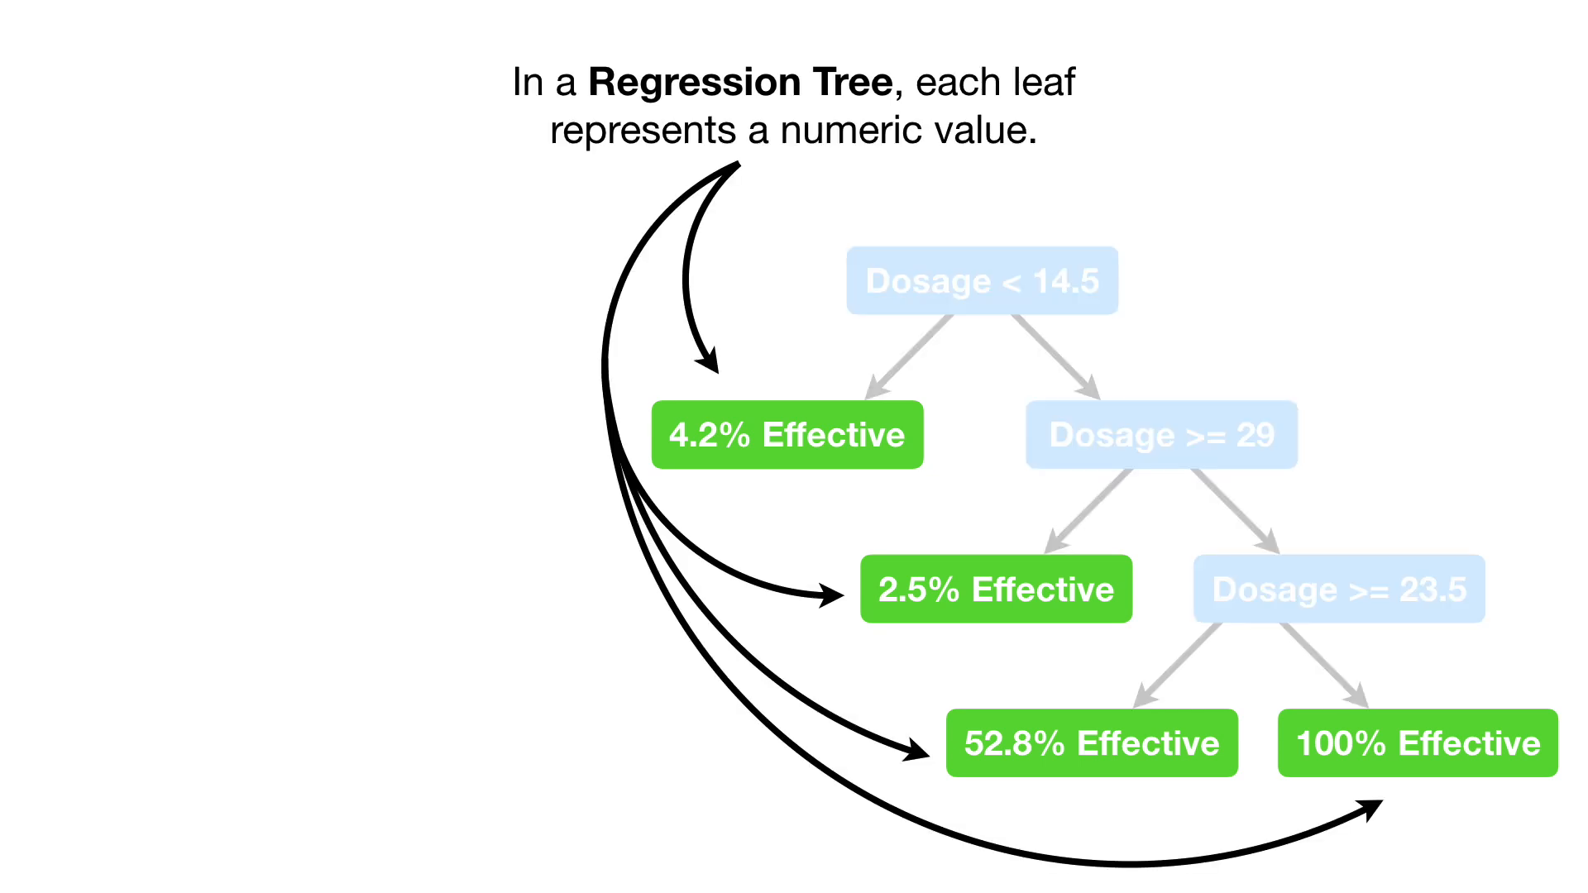

Slide 37
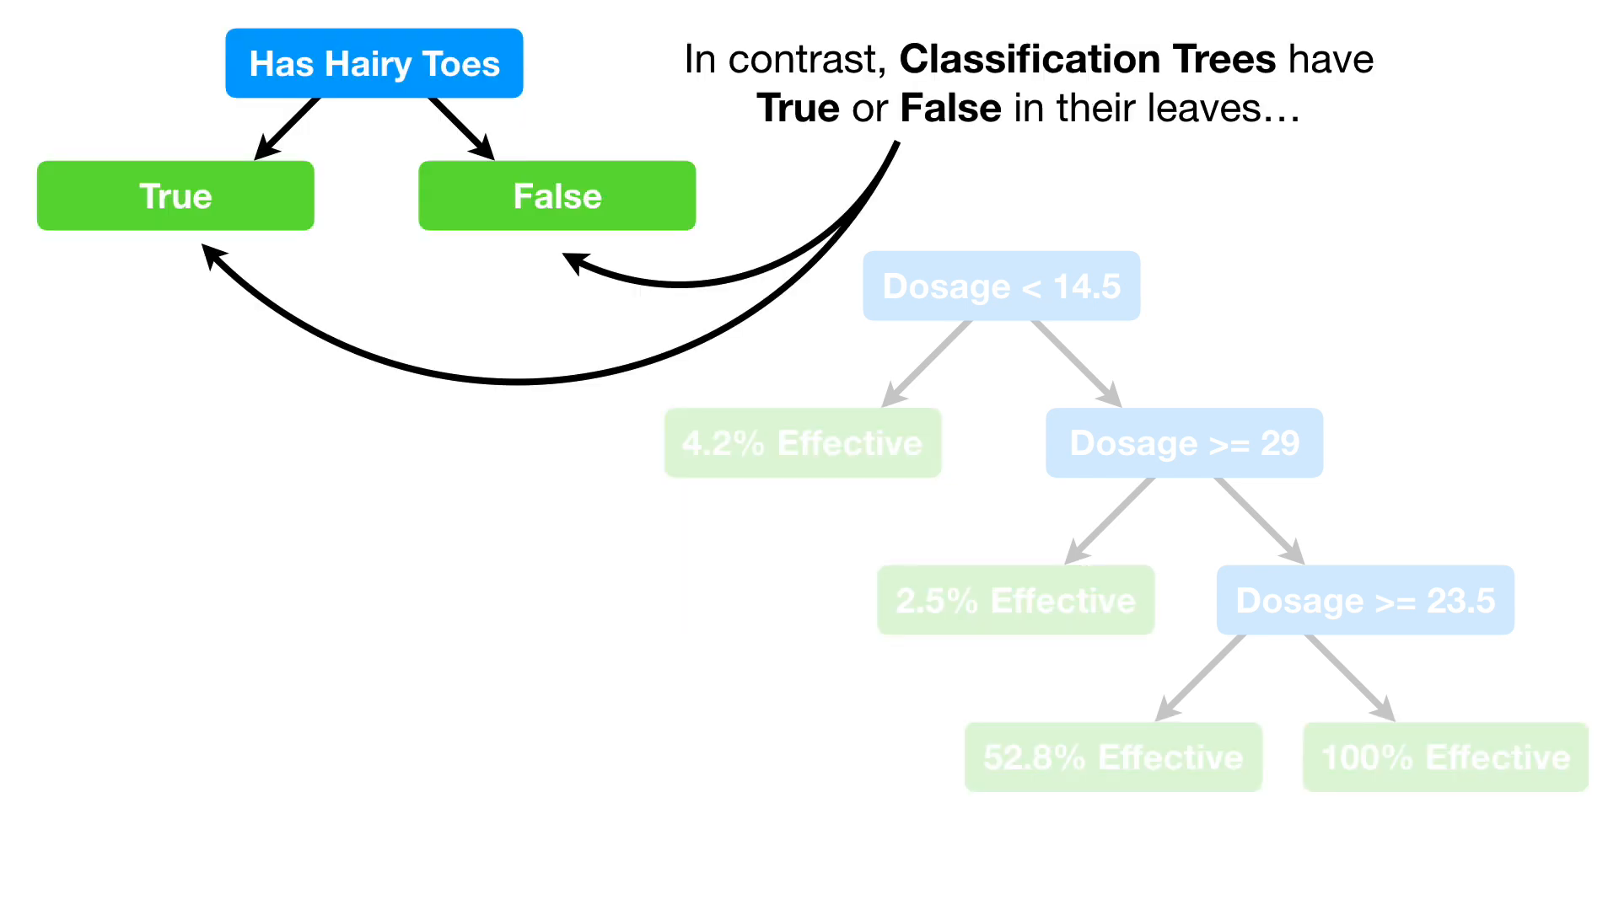

Slide 38
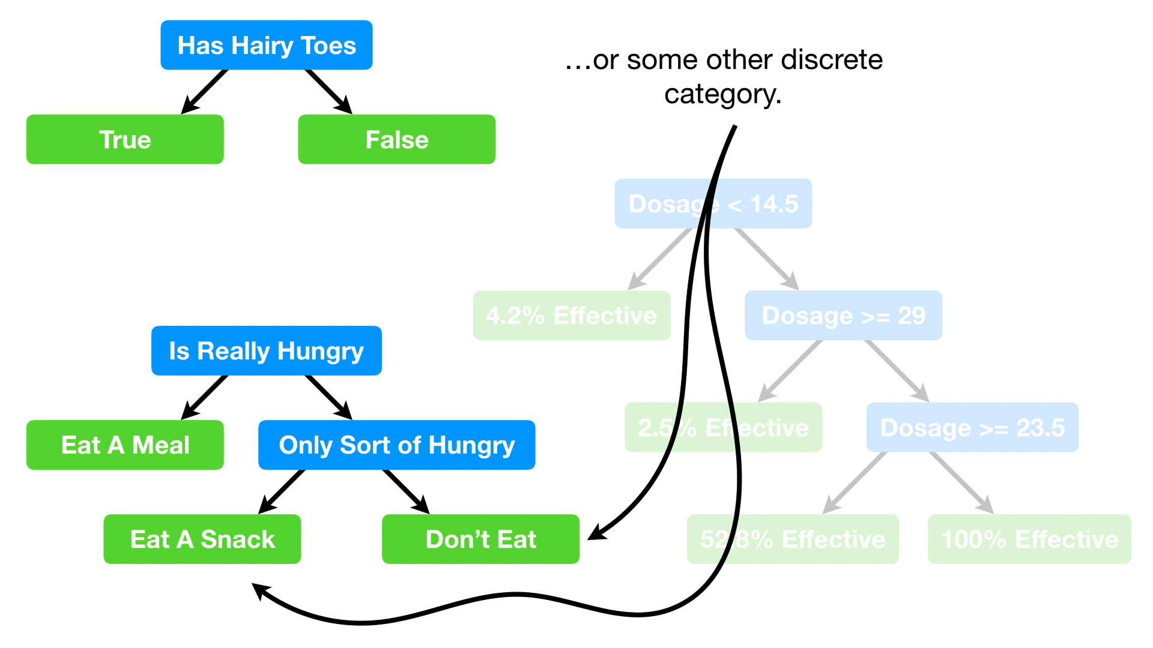

Slide 43
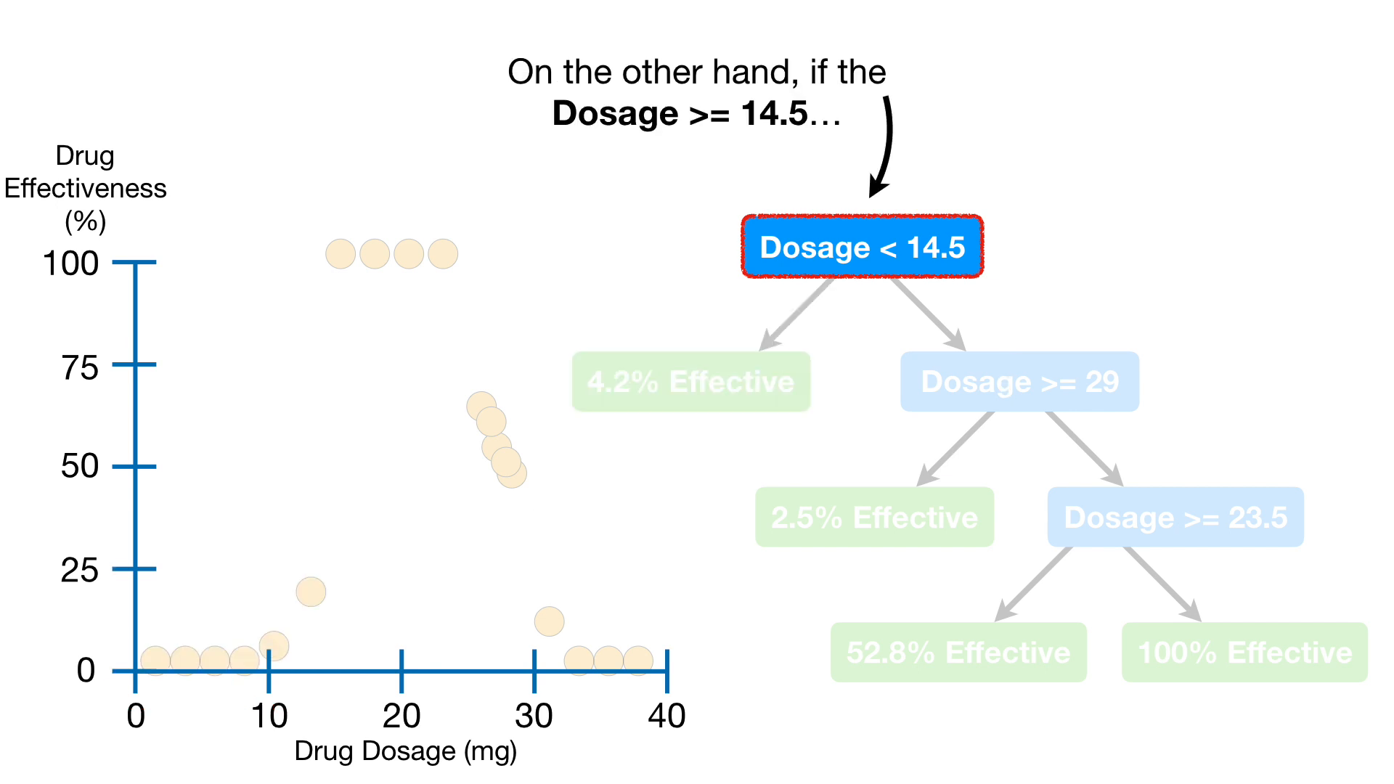

Slide 44
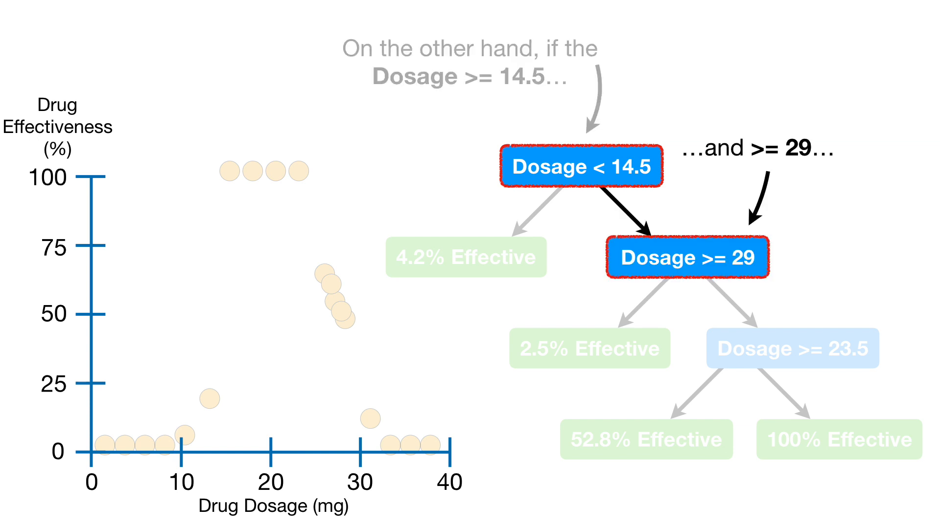

Slide 47
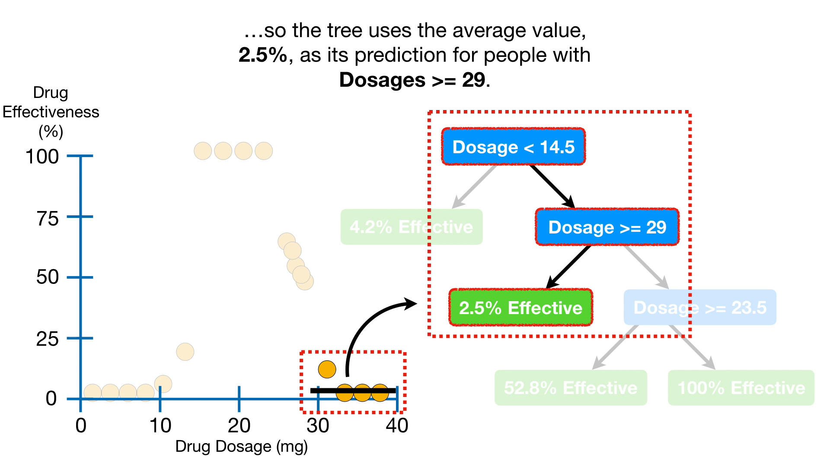

Slide 48
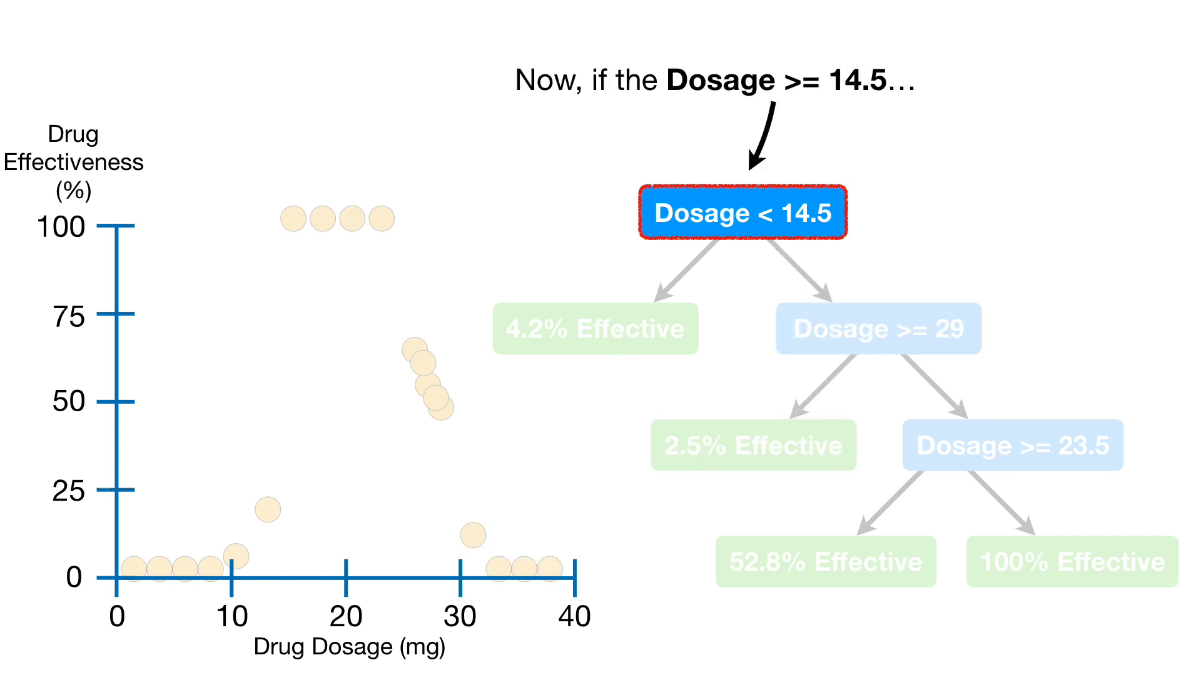

Slide 49
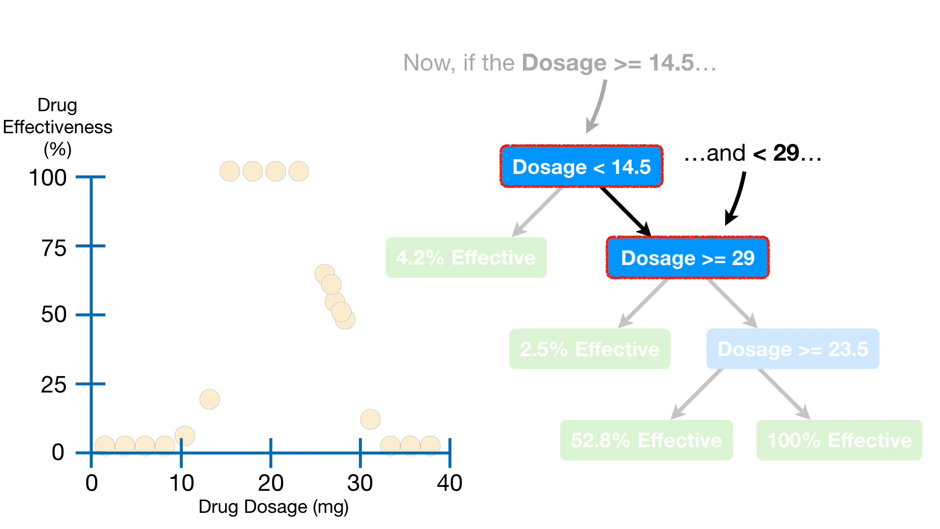

Slide 50
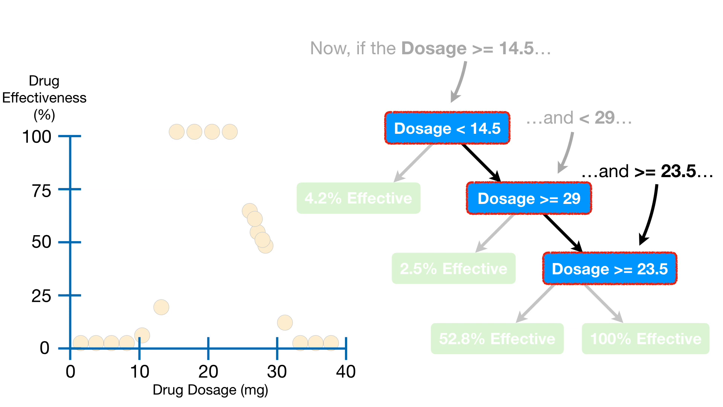

Slide 53
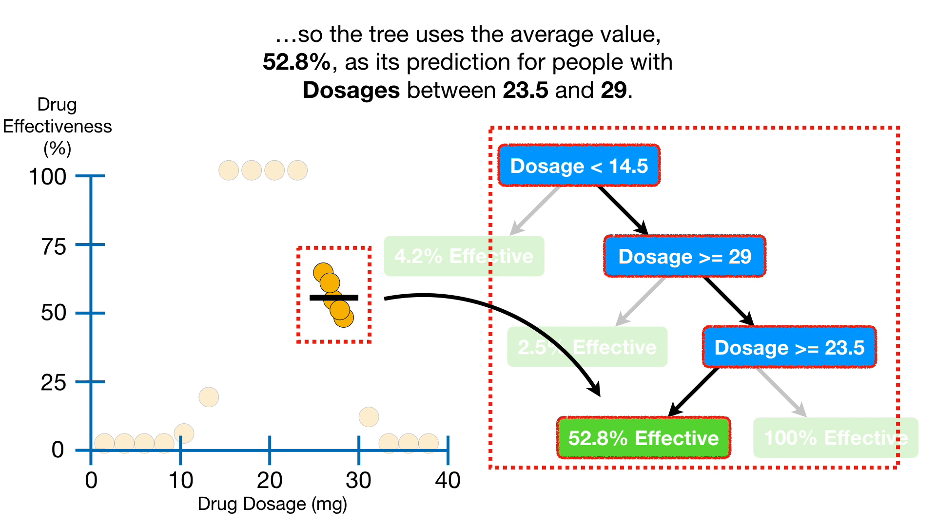

Slide 54
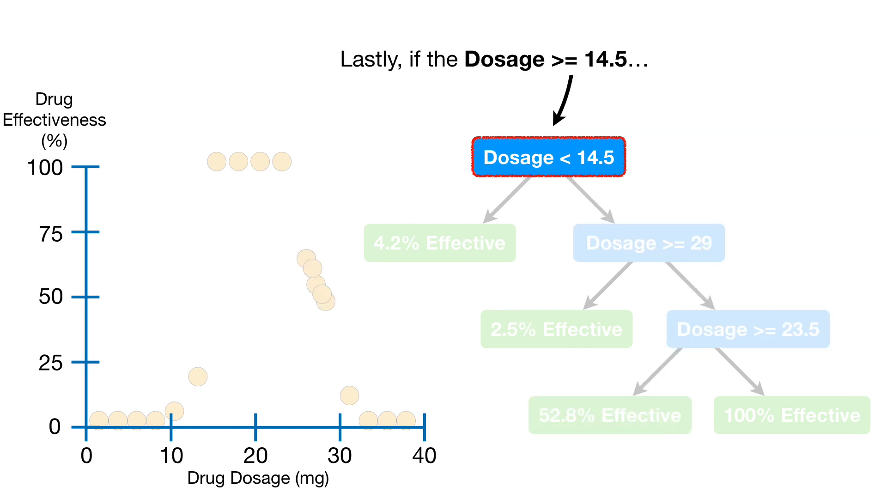

Slide 59
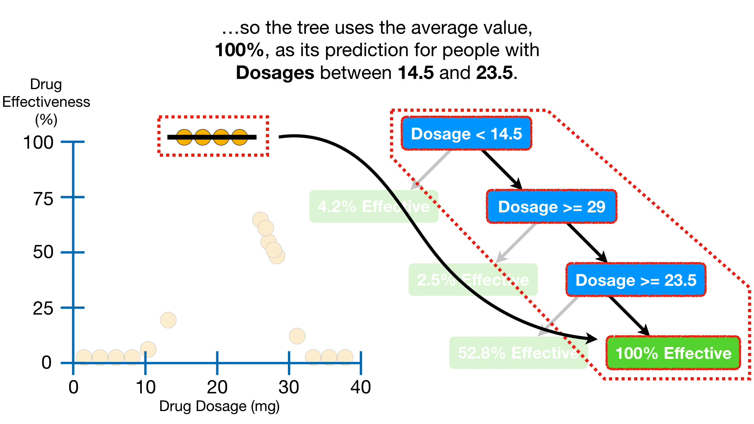

Slide 60
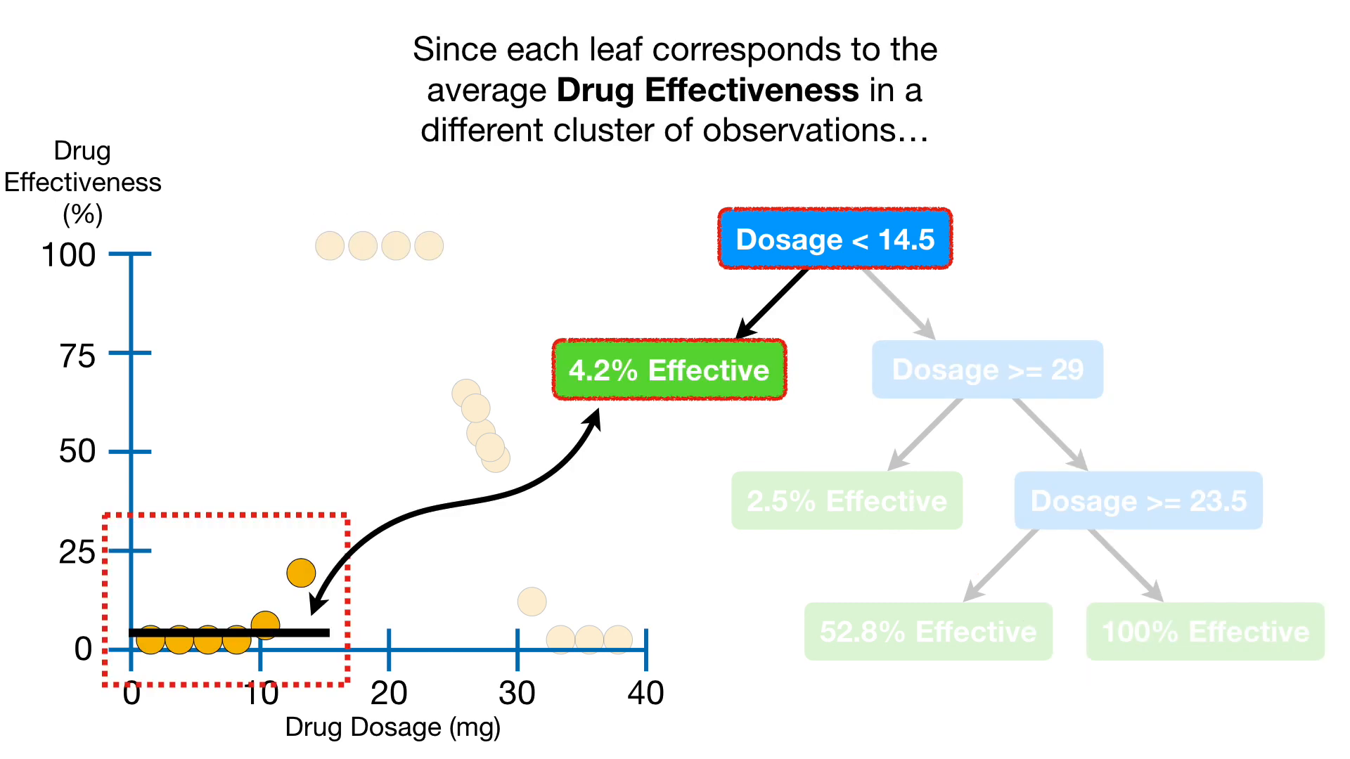

Slide 62
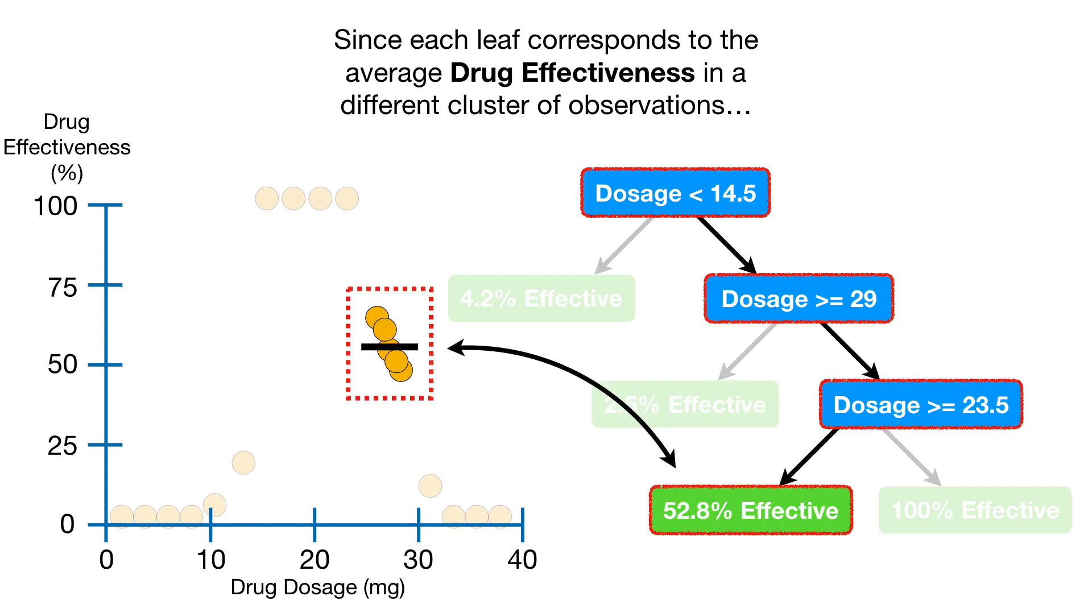

Slide 63
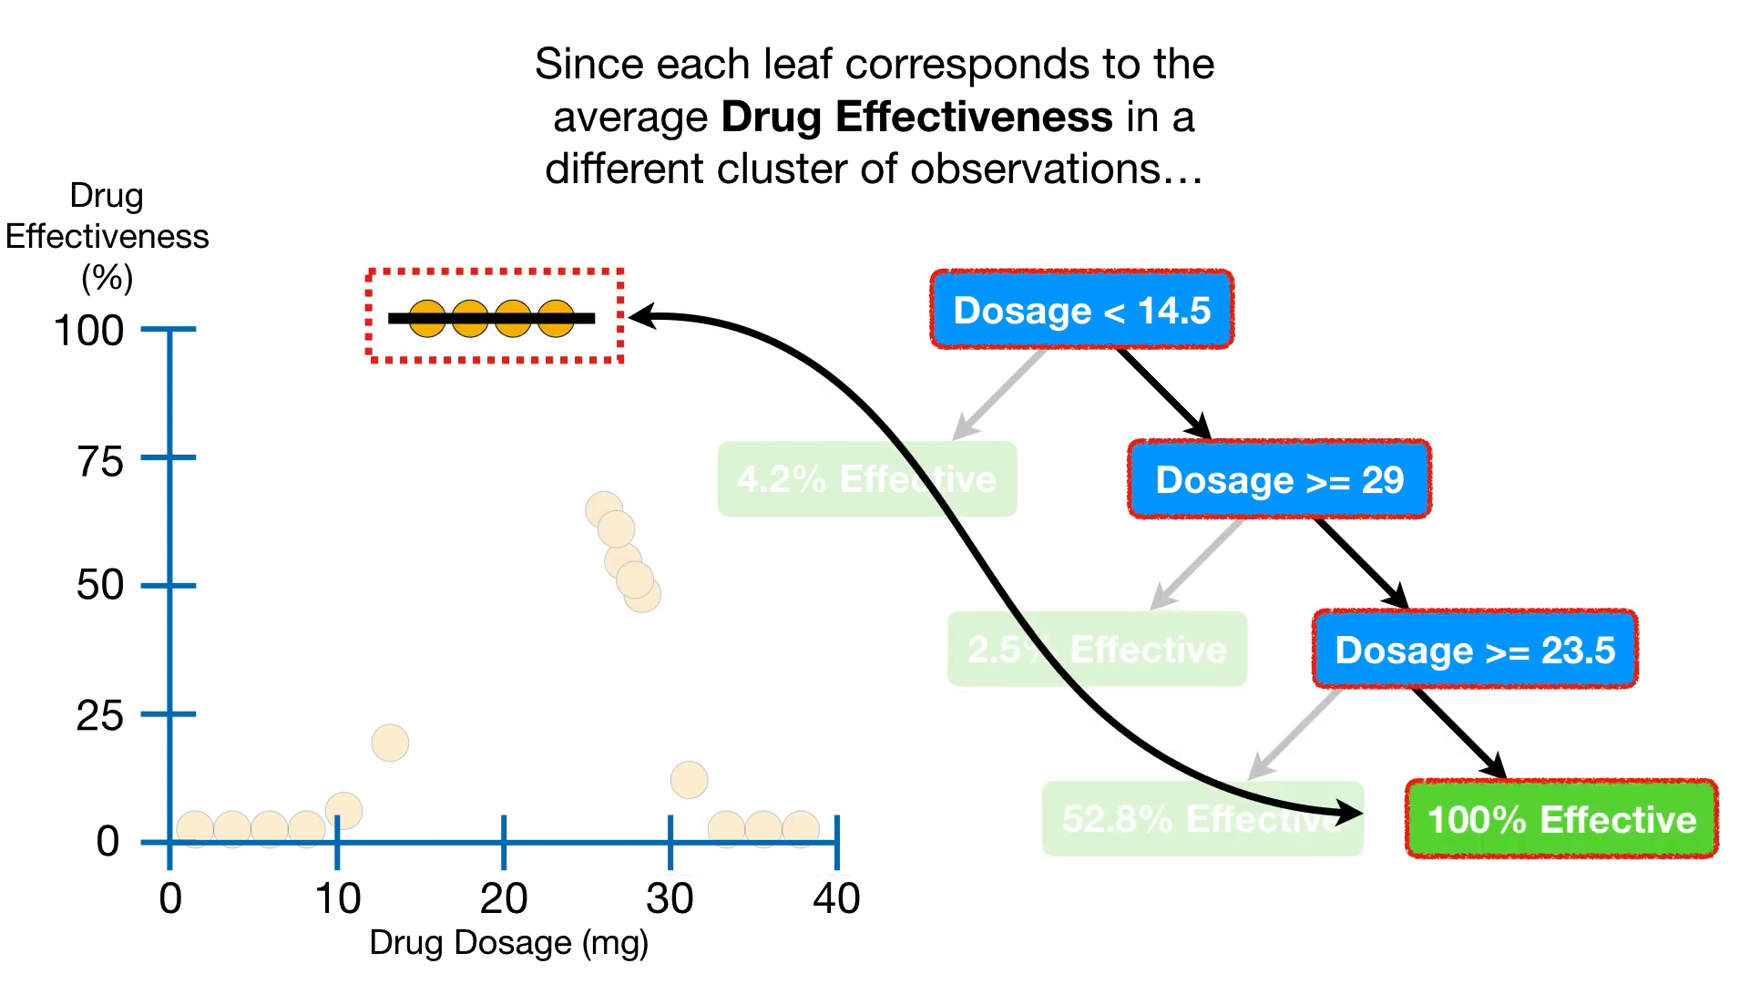

Slide 64
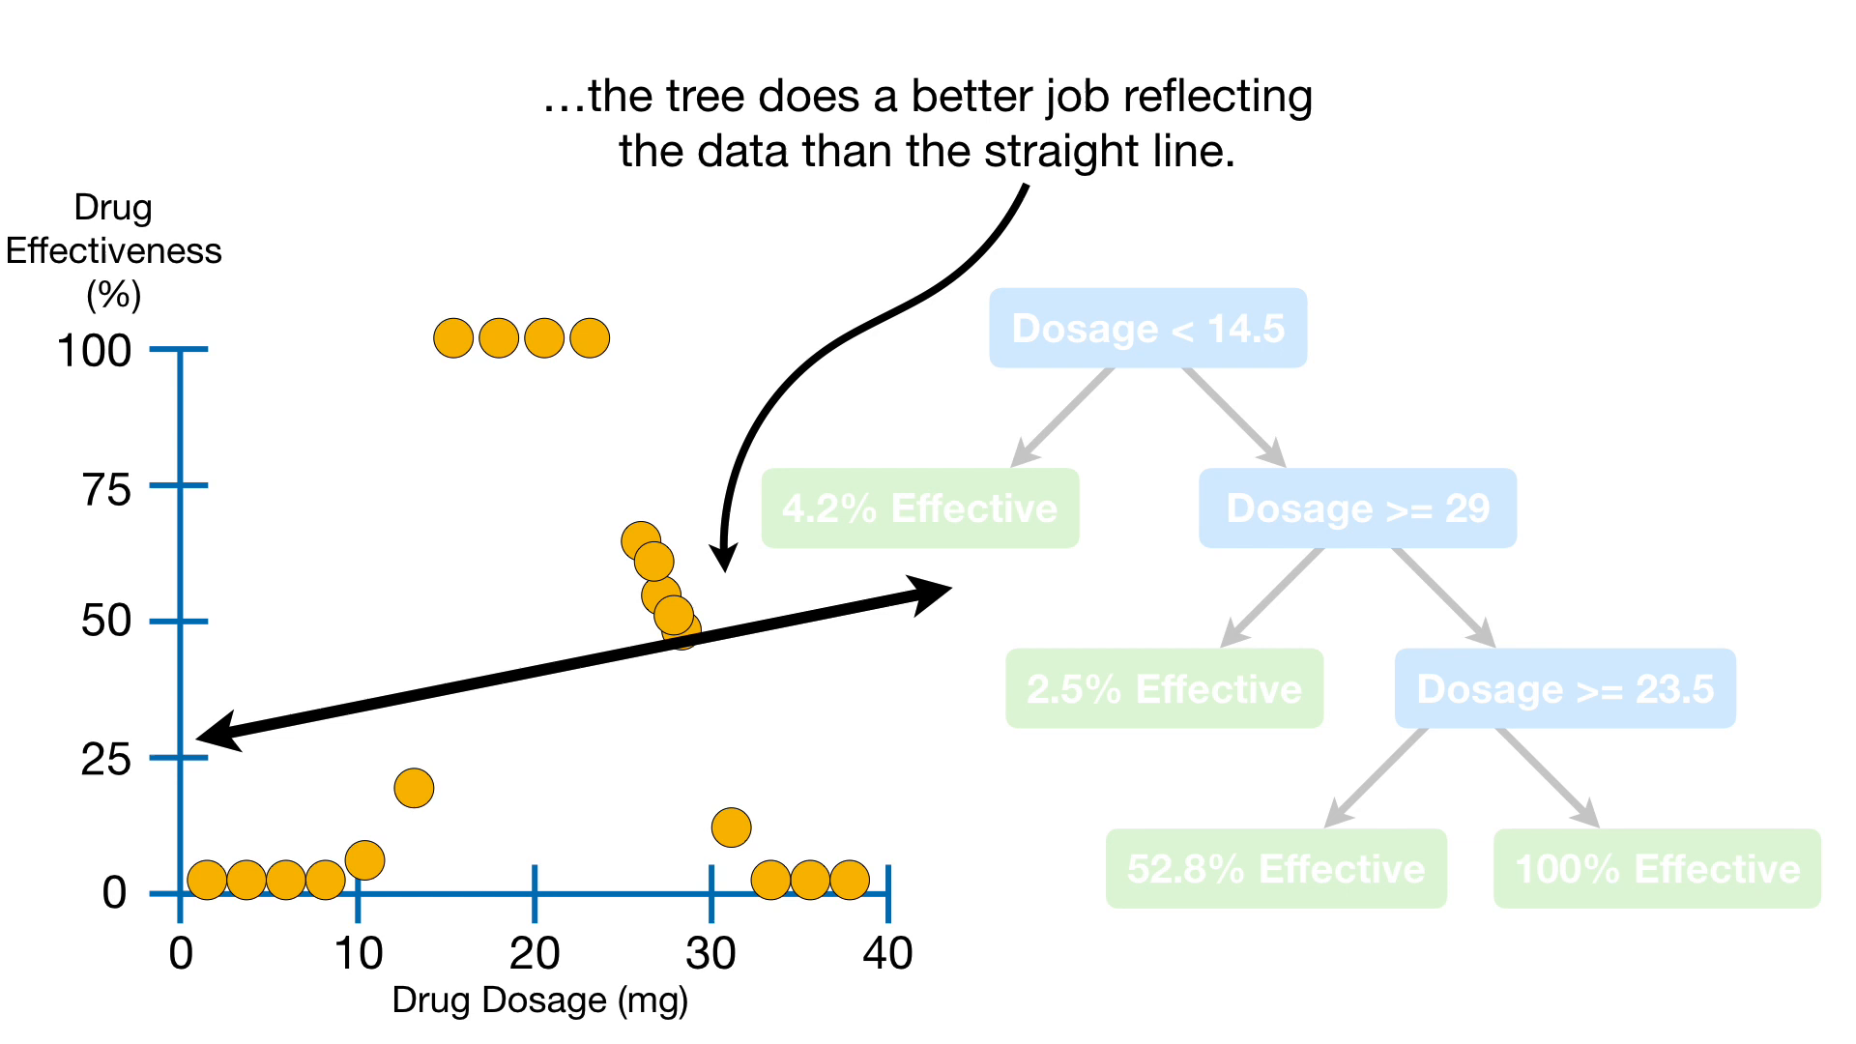

Slide 66
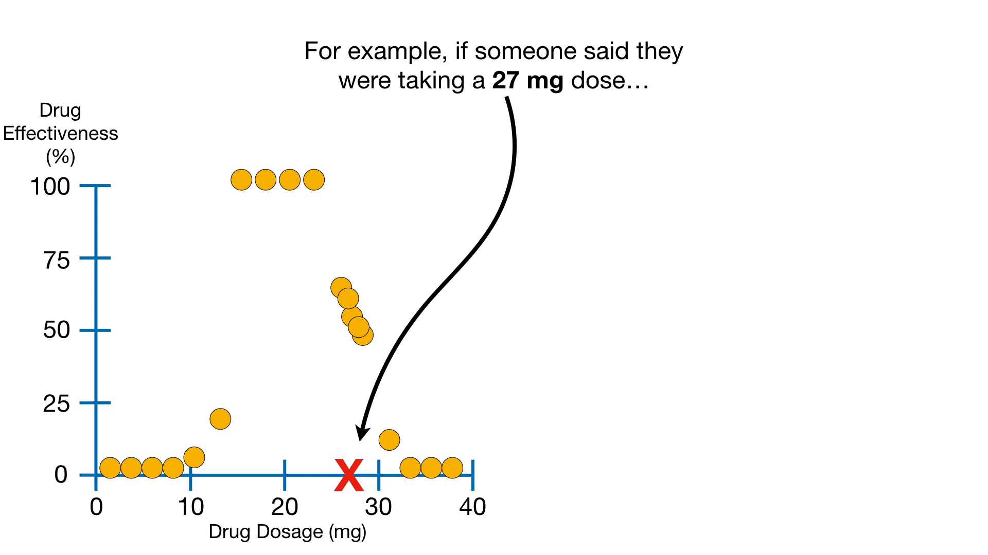

Slide 67
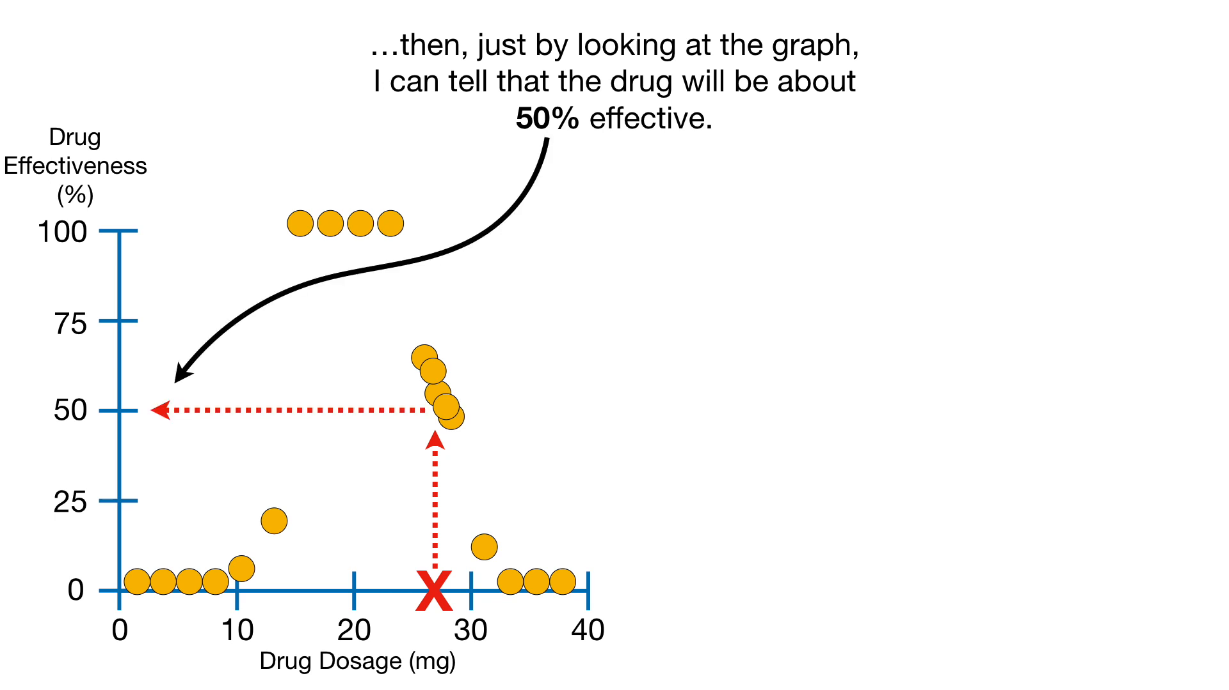

Slide 68
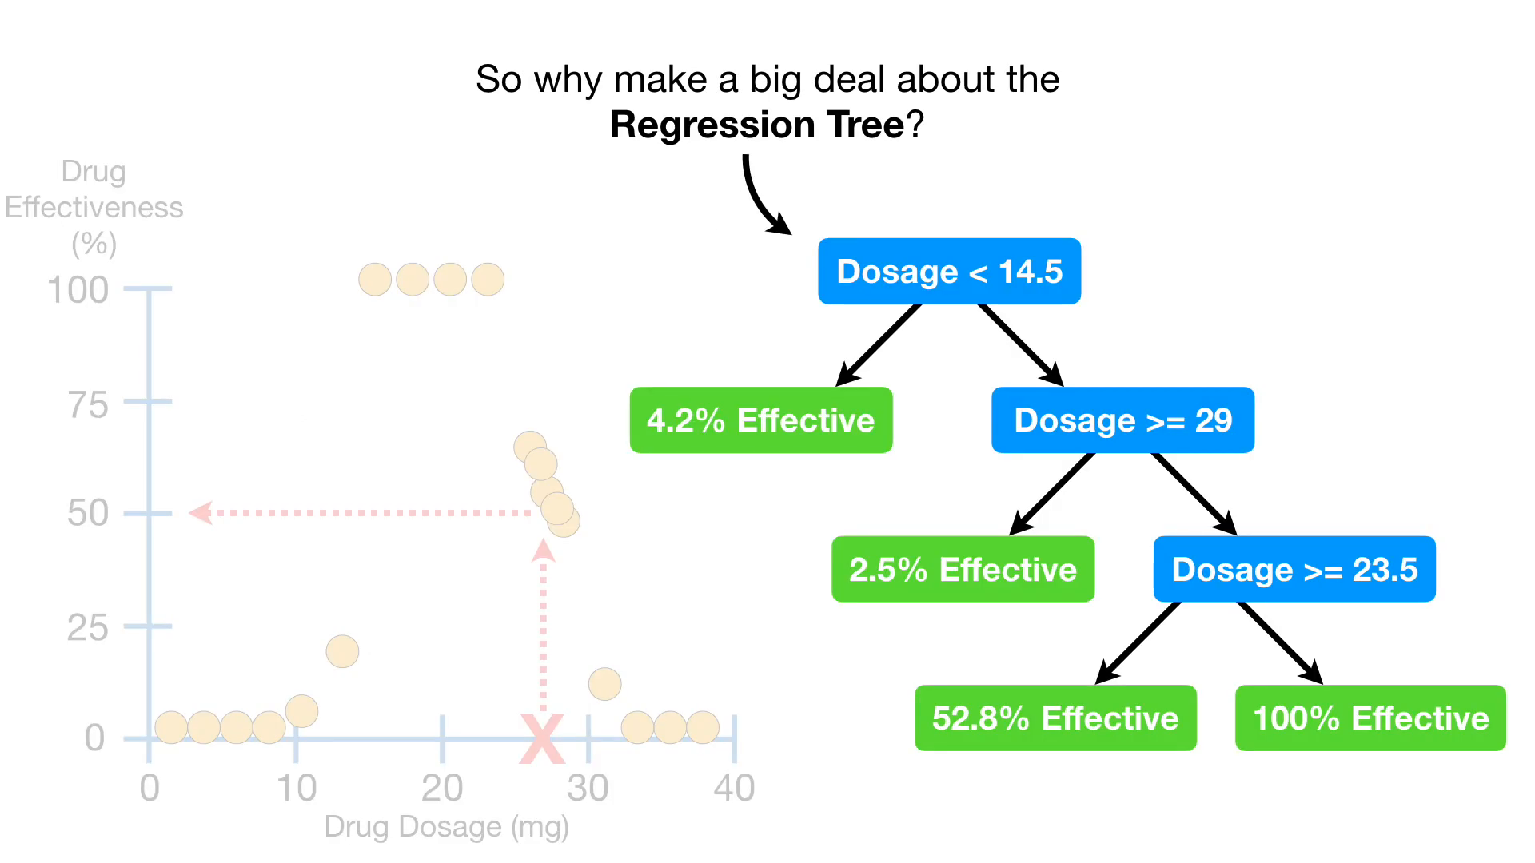

Slide 69
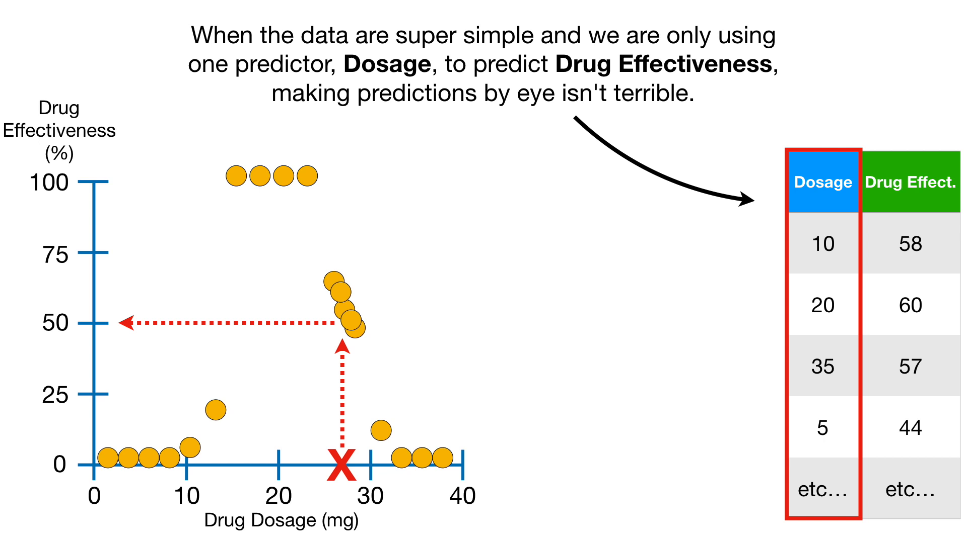

Slide 71
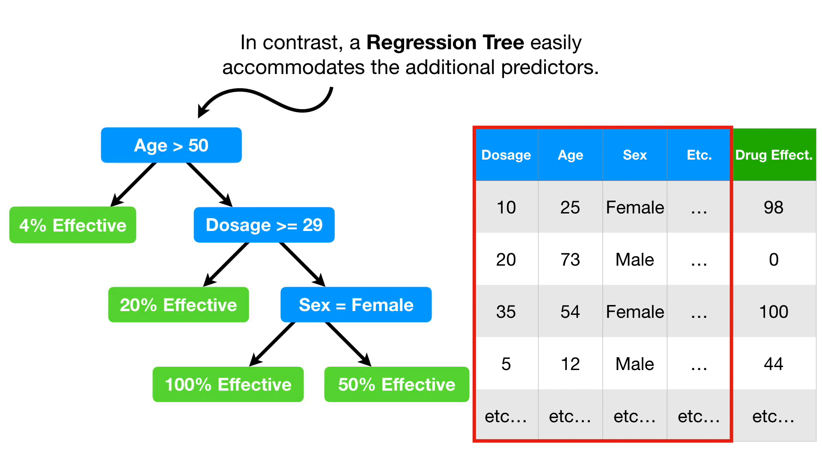

Slide 72
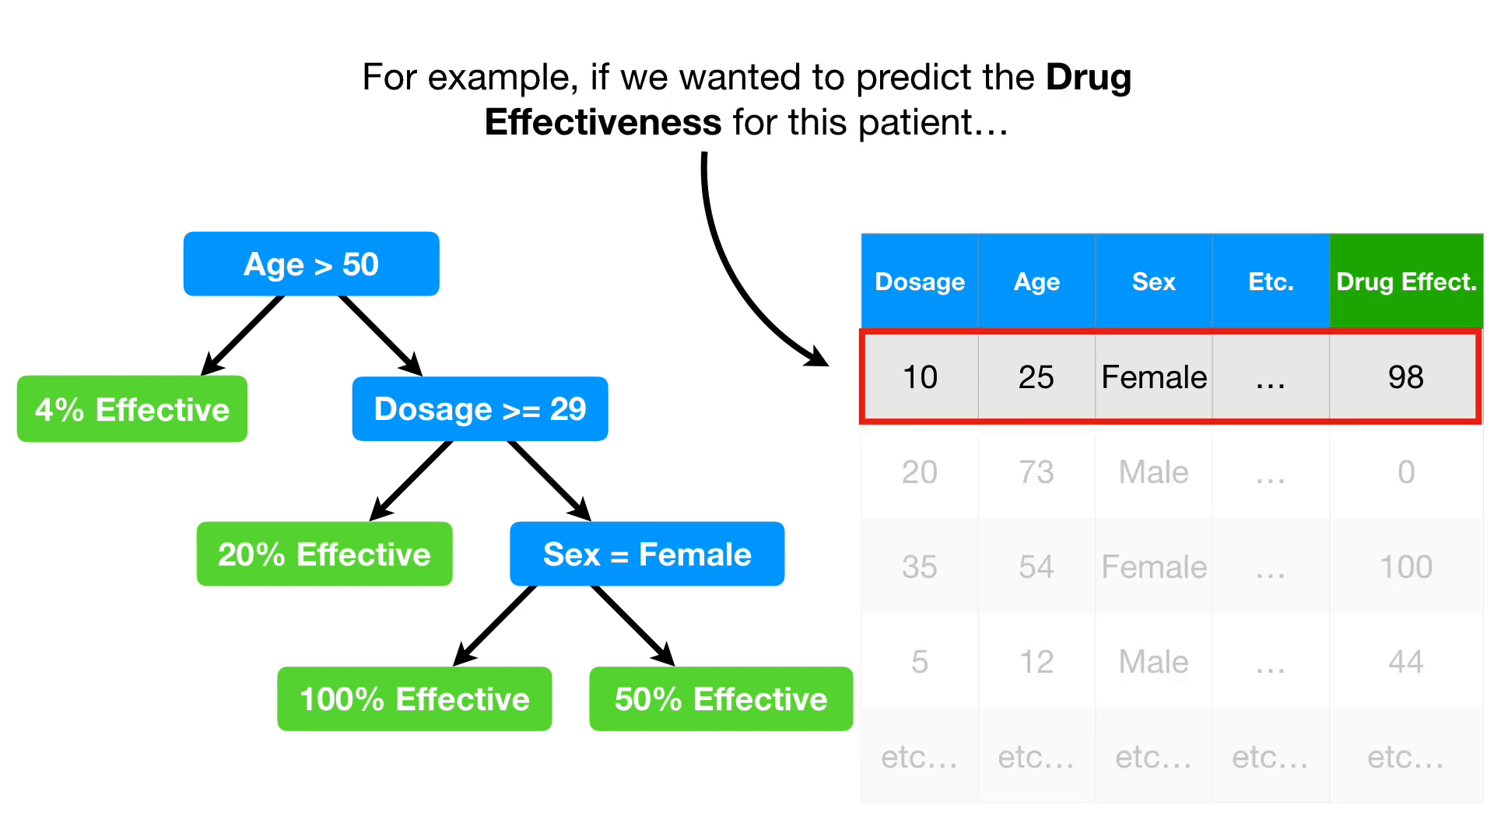

Slide 73
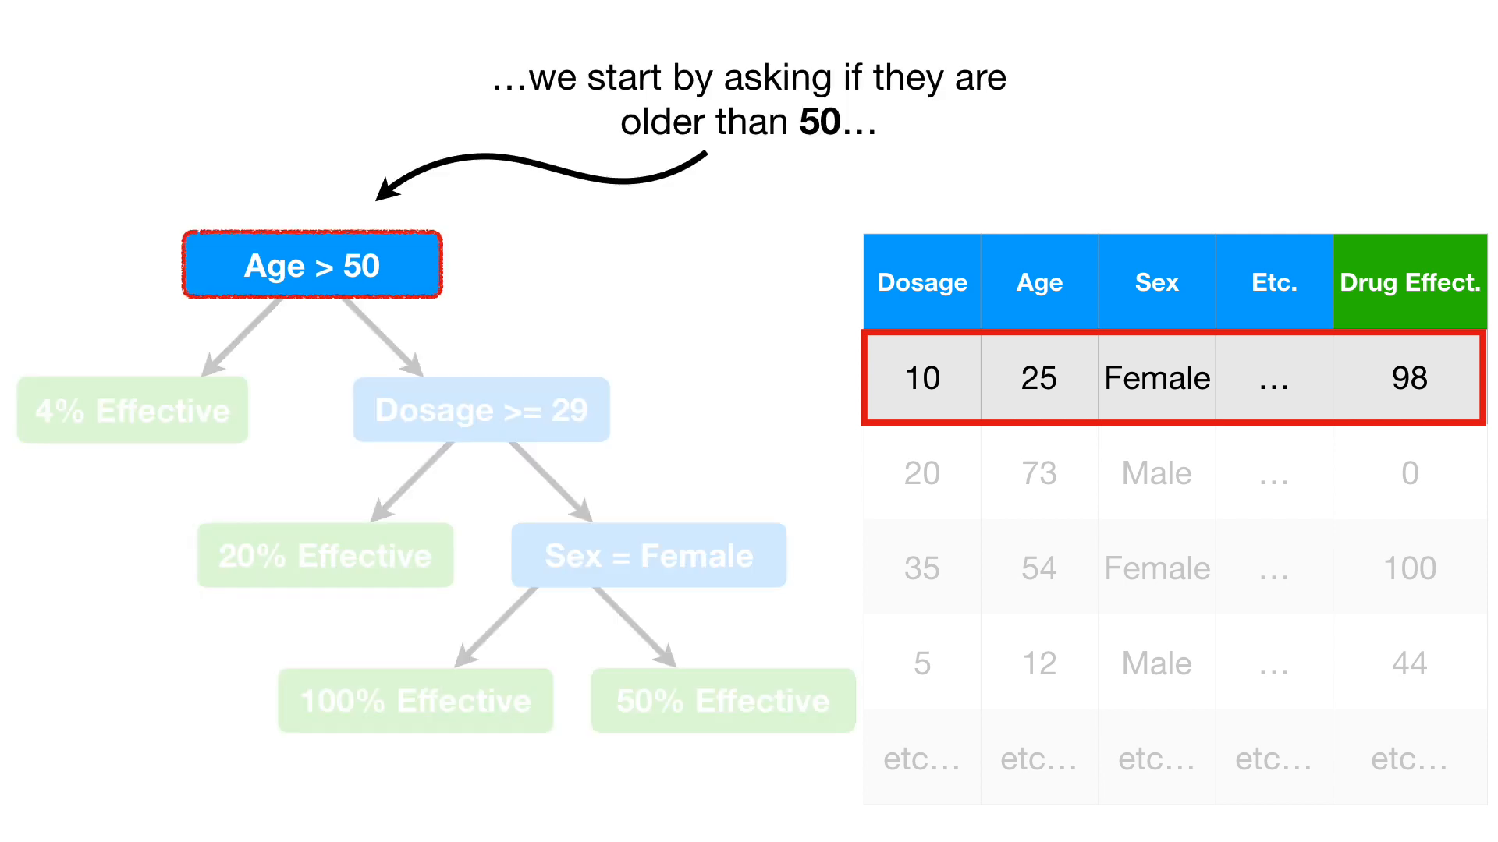

Slide 74
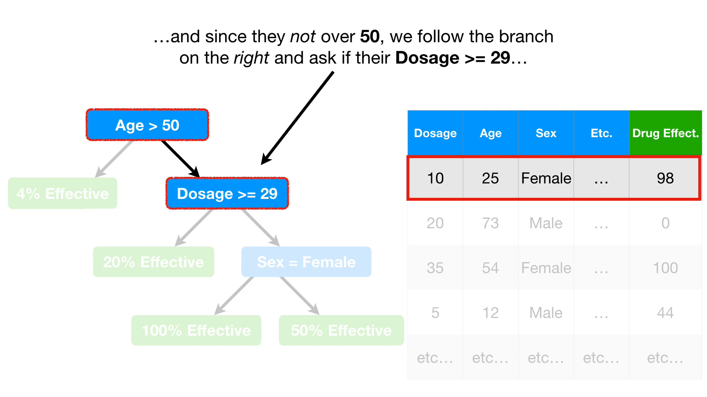

Slide 77
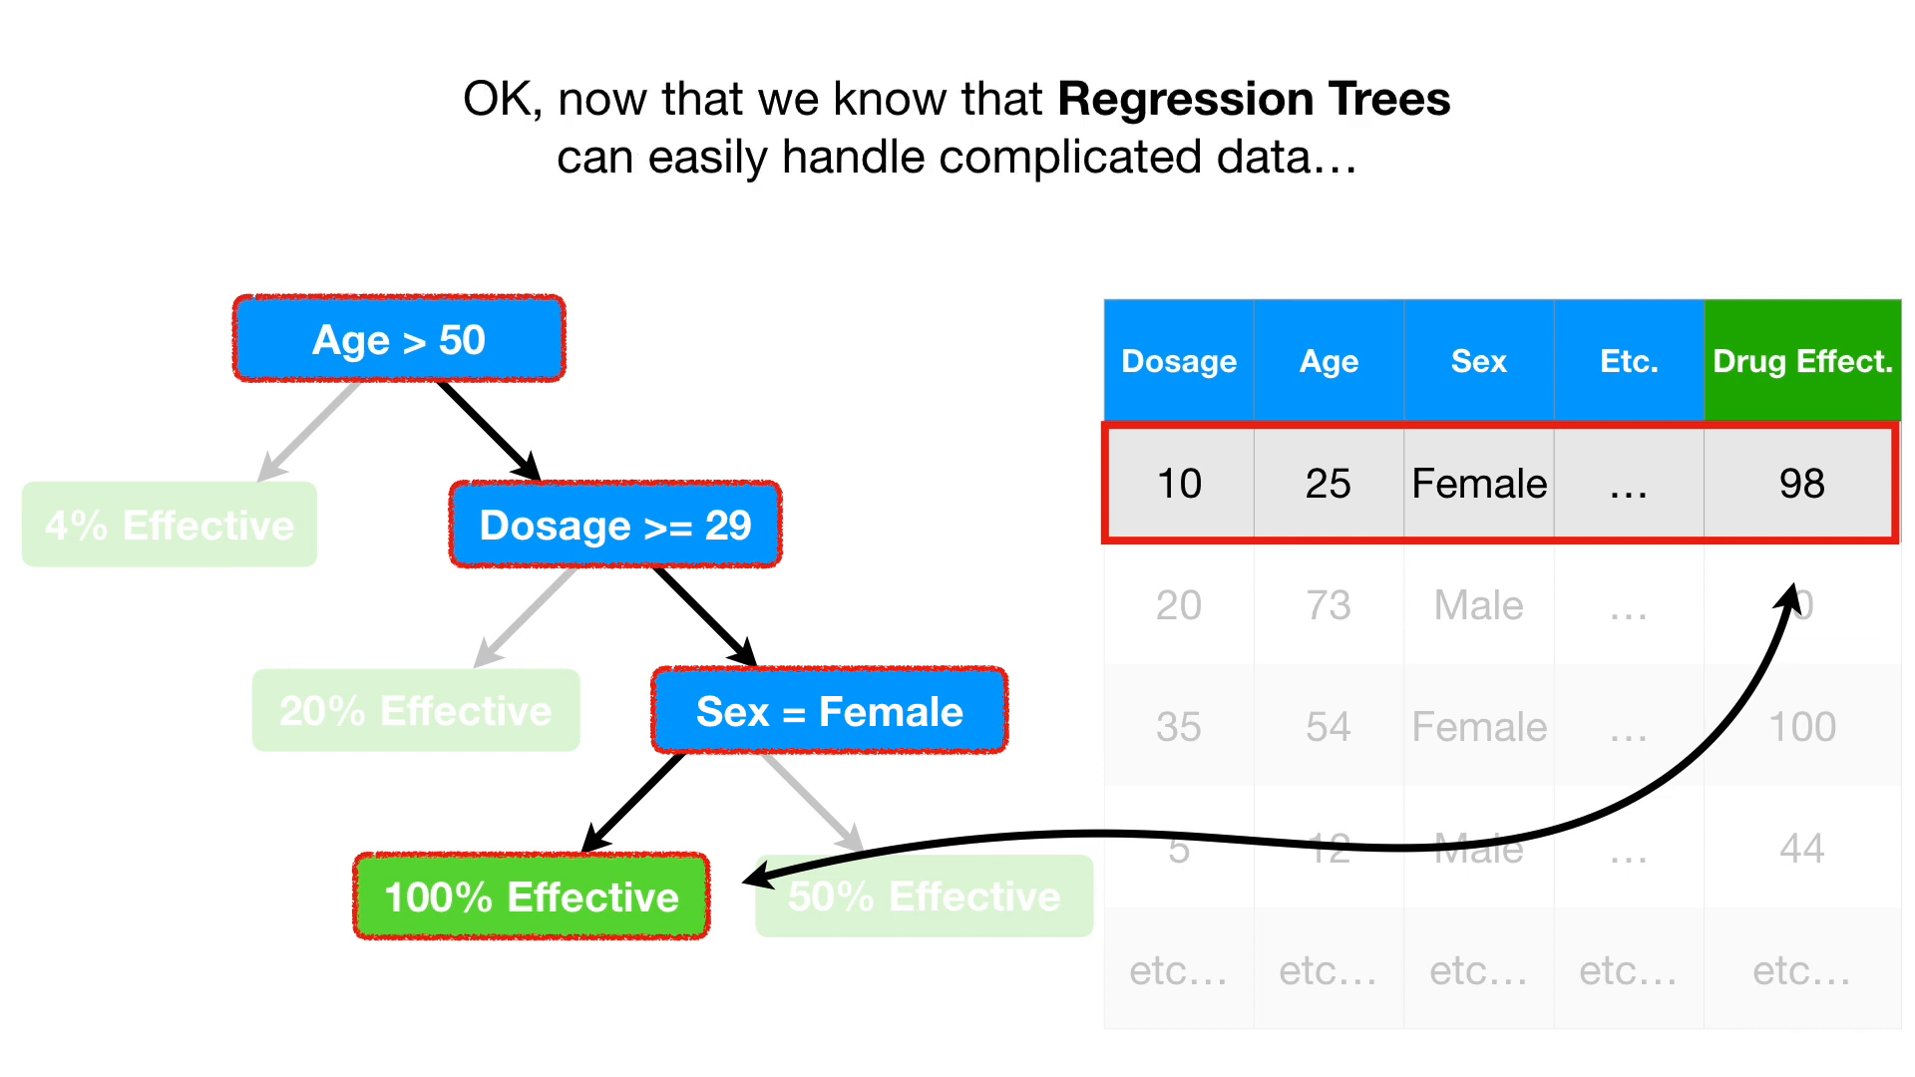

Slide 82
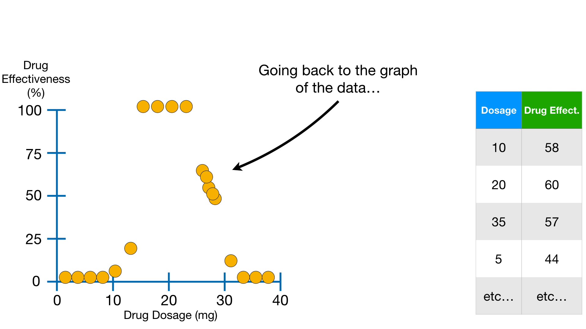

Slide 83
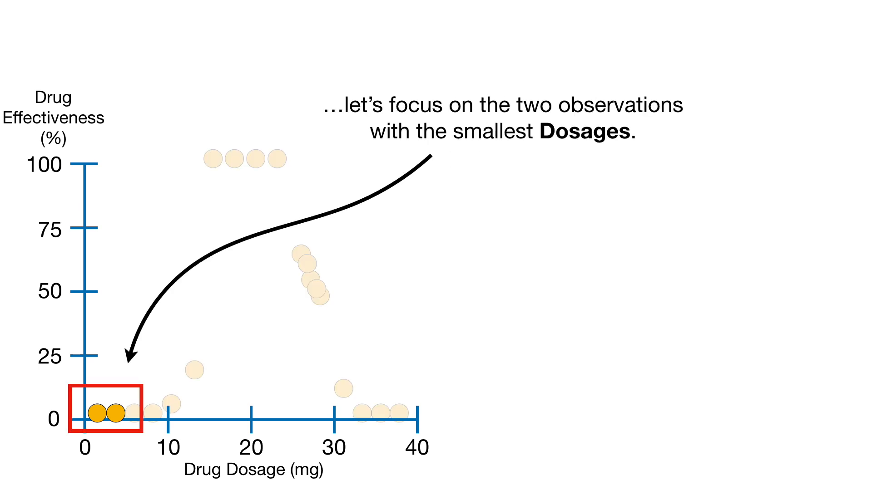

Slide 167
Advantages
1. A user can visualize each step, which can help with making rational decisions.
2. You can give the priority to a decision criterion.
3. Making a decision based on regression is much easier than most other methods. Since most of the undesired data will be filtered outlier each step, you have to work on less data as you go further in the tree.
4. It is easy to prepare a regression tree. A user can present it to the higher authorities in a much easier way as it can be represented on a simple chart or diagram.

Slide 168
Disadvantages
A small change in the data can cause a large change in the structure of the decision tree causing instability.
For a Decision tree sometimes calculation can go far more complex compared to other algorithms.
Decision tree often involves higher time to train the model.
Decision tree training is relatively expensive as complexity and time taken is more.

Slide 169
Questions
Is the approach we used in our example greedy? Explain for the same.
Can we use the pruning method as explained by Group 1 to improve the time complexity of the algorithm?
In the process of finding the optimal threshold split why don’t we use regular definite split instead of drawing lines between the pair of data points?
Why overfitting the data is not good?

Slide 170
Bibliography
We will like to thank Clint Sir for giving us this opportunity
We will like to thank Rich Caruana for her slides.
We will also like to thank Josh Starmer for his awesome knowledge about the topic and sharing it with through his youtube channel. We took snapshots from his video to make our presentation more expressive.

Slide 171
References
https://www.saedsayad.com/decision_tree_reg.htm#targetText=Decision%20Tree%20%2D%20Regression,decision%20tree%20is%20incrementally%20developed.&targetText=Decision%20trees%20can%20handle%20both%20categorical%20and%20numerical%20data.
https://towardsdatascience.com/https-medium-com-lorrli-classification-and-regression-analysis-with-decision-trees-c43cdbc58054

